Slide 1
How to pray for the East Africa hunger crisis

Slide 2
What is happening in East Africa?
More than 36 million people have been affected by the worst droughts East Africa has seen in forty years. Of those, 22 million do not have enough food to survive.
In some areas, there has been no rainfall for years. It is no longer possible for people to grow crops or keep their livestock alive. Local conflict, combined with skyrocketing food prices, has made the situation even worse.
All we know is hunger,’ Akina* aged 12 from Uganda, tells us. ‘When we sleep our stomachs are growling because we have not eaten for days.’
*Name changed to protect identity.

Slide 3
How is Tearfund responding?
Tearfund and our local partners are on the ground now in Ethiopia, Kenya and Uganda, responding to the crisis. Our work includes:
Providing emergency food relief and cash grants to communities suffering from hunger.
Building wells and solar-powered water pumps in drought-affected areas.
Training farmers with new techniques so that they can adapt to the changing weather patterns.

Slide 4
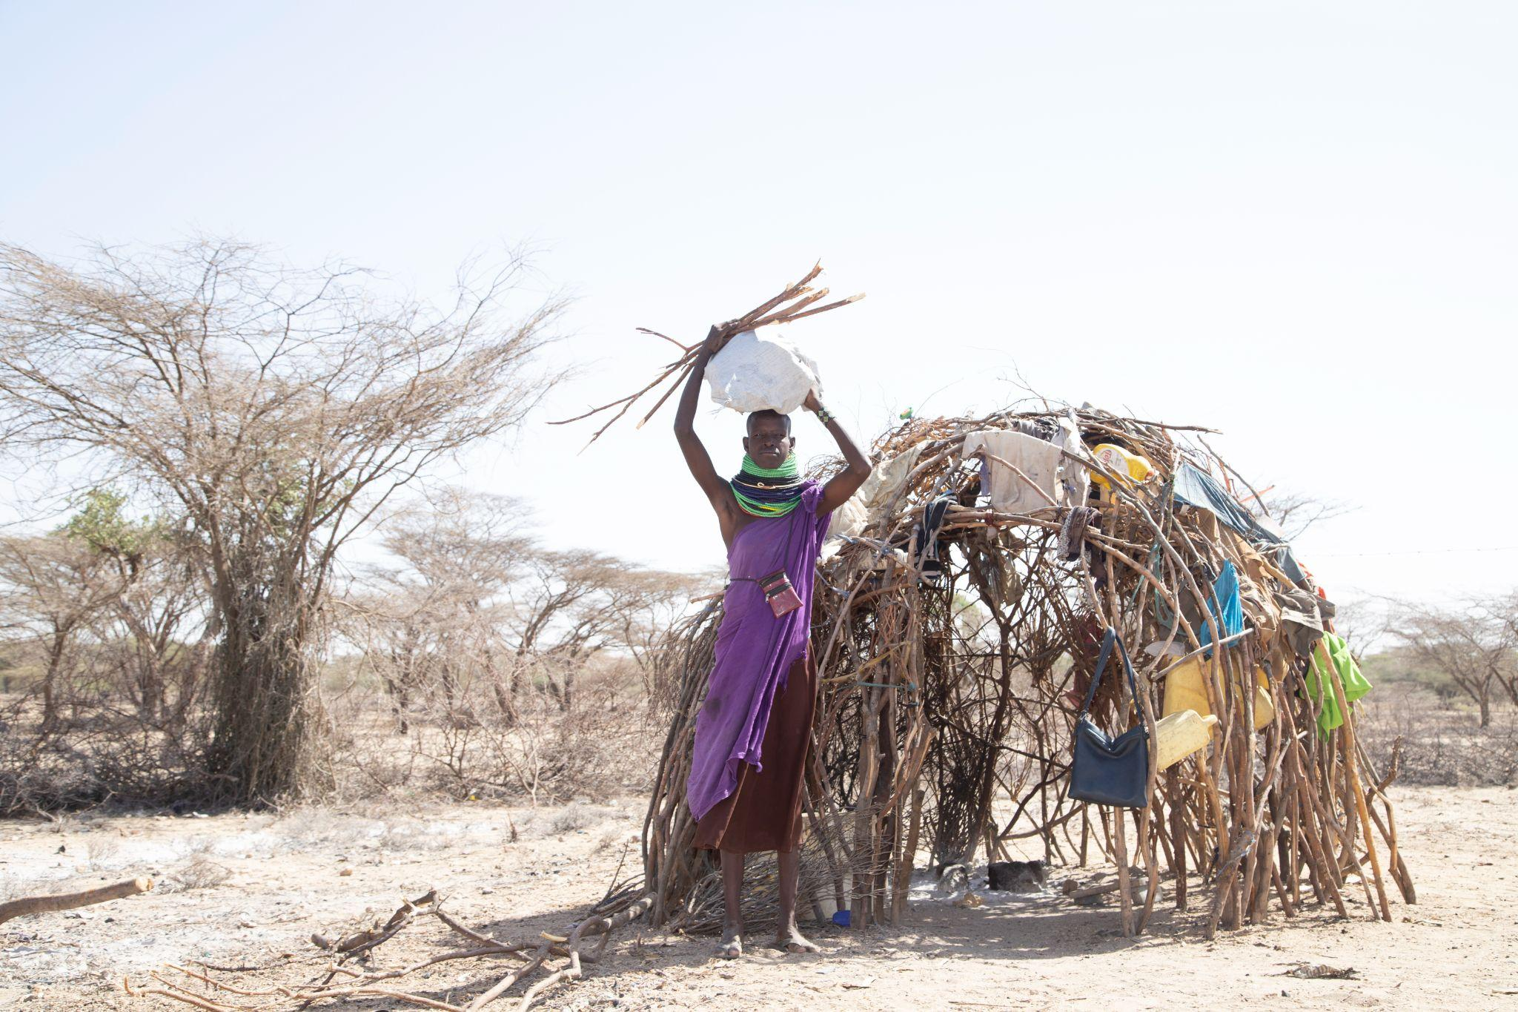
Pray for those suffering from severe hunger and water shortages
Pray for provision of nourishing food and clean water for those in need.
Pray for healing for those who are suffering from malnutrition and hunger. Pray that they will feel God’s love and comfort surrounding them. Pray that there will be no long-term side effects or medical conditions due to hunger.
Ask God to bring the rainfall that is needed to parts of Uganda, Ethiopia, Kenya and Somalia. Pray that this will lead to abundant harvests and for water sources to spring up again closer to communities.
Image credit: Alseba Wagah

Slide 5
Pray for the church
Pray for the church in the UK to speak out against the injustice of the hunger crisis and for it to use its influence to persuade the UK Government to take action.
Pray that God’s power will be revealed through the church across East Africa – that it will bring a message of hope amid the suffering.
Pray for our local church partners as they respond, and pray that the entire church in East Africa will be resourced to serve people who are suffering. Pray for church leaders – who are often struggling with the effects of hunger themselves. Ask God to strengthen and protect them as they live out God’s call to care for people in need.
Image credit: Alseba Wagah

Slide 6
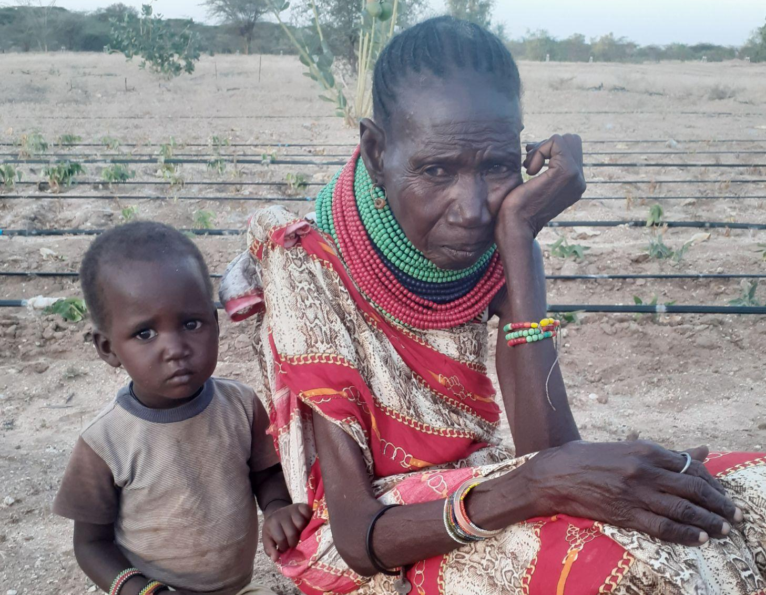
Pray for children and adults most at risk
The crisis has led to an increase in child marriages. In their desperation, parents are marrying off their daughters to wealthier families in the hope that they’ll have a better chance of survival. Pray for protection for these girls. Ask that they will be valued as God’s precious daughters by their communities.
Pray for a generation of children who are missing out on their education because parents cannot afford their school fees. Others are missing school because they are having to travel to collect water instead, or are simply too hungry to attend.
Pregnant and nursing mothers, people with disabilities and the elderly are especially vulnerable to food shortages. Pray for God’s protection and provision over them.
Image credit: Sarah Mitchell/Tearfund

Slide 7
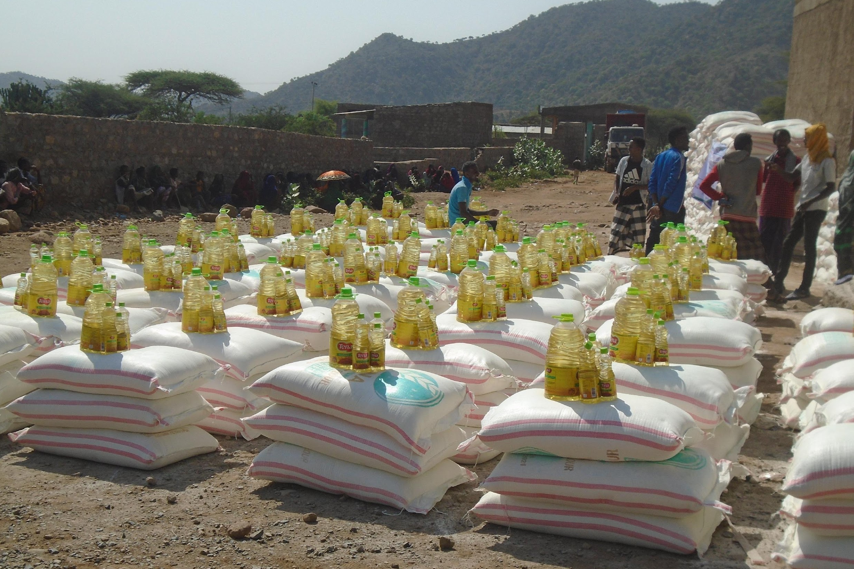
Pray for peace
The shortages of resources, including food, is making conflict worse in Ethiopia and leading to renewed conflict in other places. Pray for people’s safety and for peace to reign.
Pray for an end to the conflict in Ukraine, which is having a huge effect on the price of essential food supplies such as flour and cooking oil.
Image credit: Friendship Support Association

