Slide 1
Praying for the climate crisis

Slide 2
What is a prayer room?
A prayer room is a space in your church (or other building) that’s dedicated to helping and inspiring people to pray. It will normally feature a number of prayer ‘stations’, each with a different prayer prompt or activity.
Some churches choose to have their prayer rooms open 24/7, others on specific days/times. Prayer rooms can be open for anyone to use whenever they like, or you can implement a booking system, where people can book a hour slot to have the room to themselves.
You can tailor your prayer room to whatever you feel will best suit your church or group.
Everyone has their own preferred style of prayer. Prayer rooms enable people to pray however they like: whether through writing, drawing/painting, praying out loud, or simply sitting in silence.

Slide 3
Praying for the climate crisis
‘The earth is the Lord’s, and everything in it, the world, and all who live in it; for he founded it on the seas and established it on the waters.’ (Psalm 24:1-3)
We are in a time of climate crisis. As a result, more people are going hungry, extreme weather events are more frequent and severe, and communities are being displaced. People are being pushed back into poverty and the damage to creation is accelerating.
As we are confronted with the scale of the crisis, this prayer room will help you keep your eyes fixed on the God of justice, who loves creation and longs to bring restoration and peace.
There are six ideas for prayer stations, which you can either print off to put in your prayer room or use as inspiration for your own ideas. You can use all of these, mix and match, or come up with your own.

Slide 4
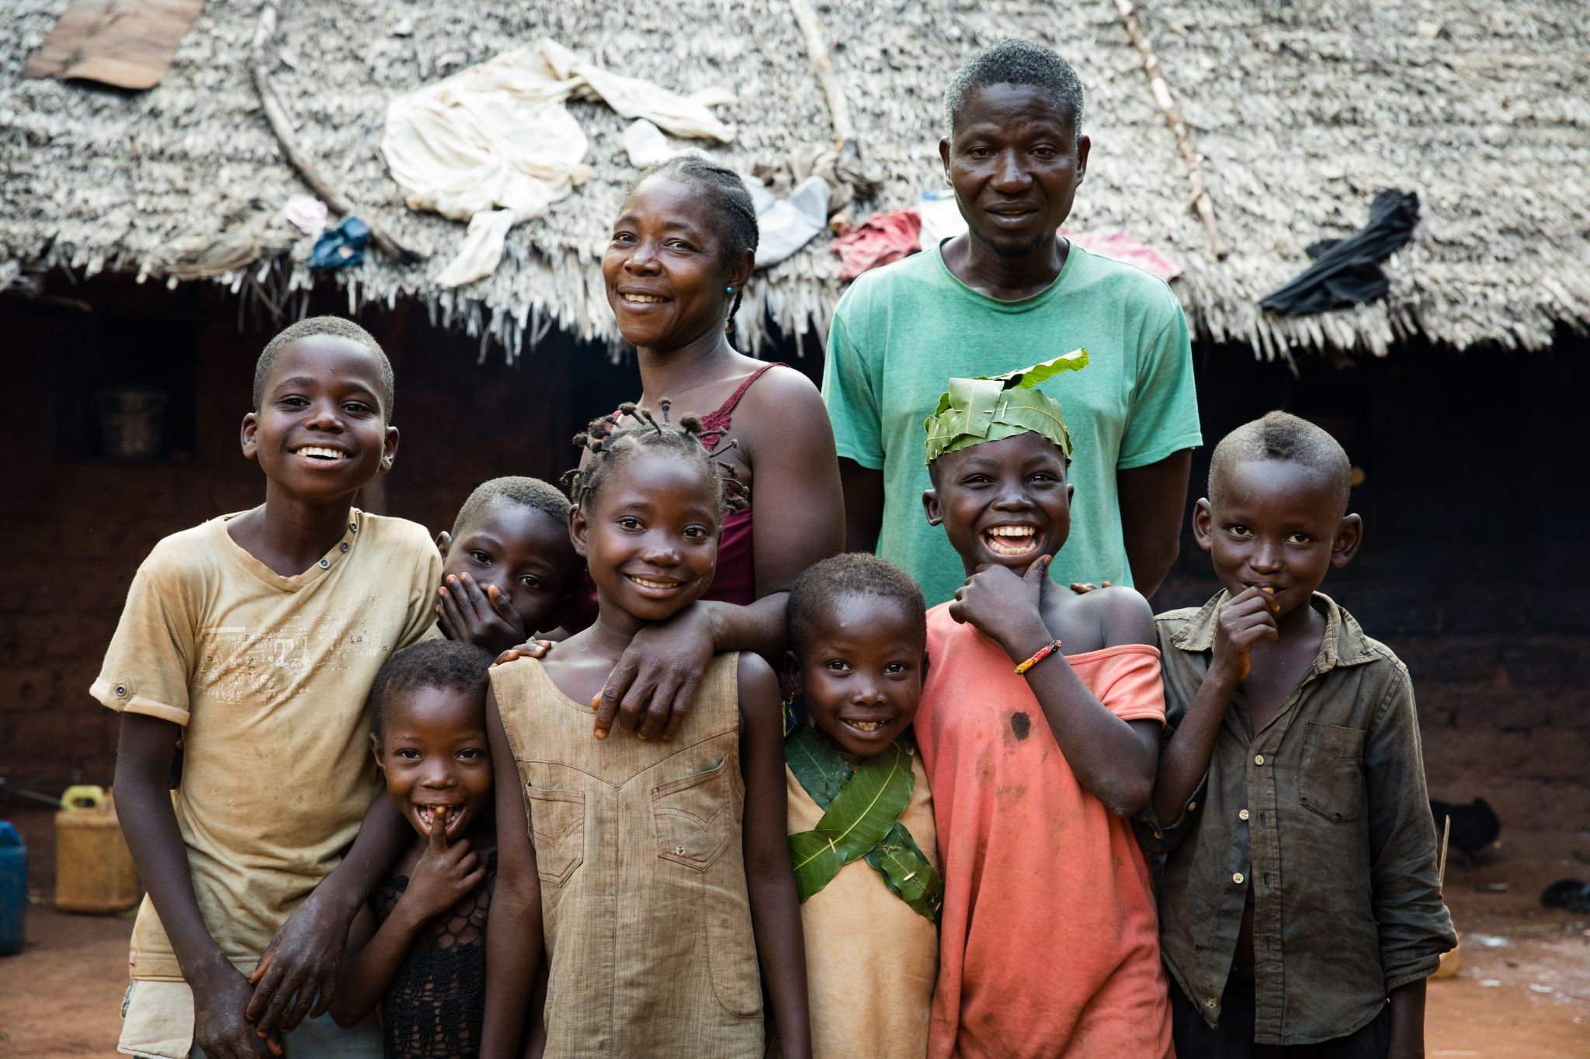
Station one: beauty of creation
This station will help you to consider the beauty of creation and inspire you to take care of it. You will need a Bible, a laptop/phone/tablet and headphones.
Listen to the sounds of an African village waking up (search ‘African tribes - the sounds of a village waking up’ on YouTube)
Read and reflect on the words of Psalm 24, how the Earth is the Lord's, and what it means to let the King of Glory come in.
Lift up people in Africa and across the world who are being affected by the climate crisis right now. Ask God to inspire world leaders to come together to bring lasting change.
Family in the Central African Republic.
Photo credit: Hazel Thompson/Tearfund.

Slide 5
Station two: overwhelmed by plastic
This station will help you visualise the conditions in which many people live, overrun by plastic pollution and without a rubbish collection service. Put down a plastic sheet and pile it up high with (washed) plastic waste: water bottles, yoghurt pots and other plastic food packaging.
If you are comfortable to do so, sit amongst the plastic waste and ask God to speak to you about how you can choose to use less plastic.
Up to one million people die each year as a result of mismanaged waste. Pick up an item of plastic and pray for people around the world who live surrounded by rubbish. You could also put a recycling bin in the station and ask people to put a plastic item into it once they have prayed until the area is clear.

Slide 6
Station three: harmony of creation
This station will help you to appreciate the intricacies of creation and the harmony and interconnectedness of the natural world. Fill an area with pot plants, fresh fruit and photographs/books of natural things such as flowers, pine cones and leaves. Also put out some crayons, pencils and scrap paper.
Spend some time drawing and copying/tracing the natural shapes in the objects and photographs around you. Then display them.
As you do this, reflect on Genesis 1:31: ‘God saw all that he had made, and it was very good’.
Pray and ask God about ways you can build into your everyday life more appreciation of the natural world by growing vegetables or going on nature walks. Write them down to remind you. And taste some fruit!
Photo credit: Alex Baker/Tearfund

Slide 7
Station four: ancient inspiration
Read and reflect on these verses, an expression of the wonder and beauty of creation from the writings of Francis of Assisi (1181–1226):
Most High, all-powerful, good Lord.
Yours are the praises, the glory, the honor, and all blessing.
To you alone, Most High, do they belong,
and no one is worthy to mention your name.
Praised be you, my Lord, with all your creatures,
especially Brother Sun,
Who is the day and through whom you give us light.
And he is beautiful and radiant with great splendor; and bears a likeness of you, Most High One.
Praised be you, my Lord, through Sister Moon and the stars,
in heaven you formed them clear
and precious and beautiful…
Praised be you, my Lord, through Sister Water,
which is very useful and humble and precious and chaste.
Praised be you, my Lord, through Brother Fire,
through whom you light the night
and he is beautiful and playful and robust and strong…
Praise and bless my Lord and give him thanks
and serve him with great humility.
(In response you could write your own poem or prayer.)

Slide 8
Station five: a new song of creation
‘Sing to the Lord a new song; sing to the Lord, all the earth.’ Psalm 96:1
This station will help you worship and draw close to God as you consider the damage to creation and the people who are suffering right now as a result. You will need a laptop/tablet/phone and some headphones.
Create an area that is comfortable to sit in and be private. Set up Renew Our World Worship Song (this can be found on YouTube) on your device or download it as a music file. Listen to the song and repeat if you want to go deeper into the words. Once you feel ready, reflect on the words of this prayer of renewing and refocusing on God’s love for all he has made:
Creator God,
Renew our spirits and cleanse our hearts.
Renew our minds and transform our lives.
Renew our cities and rebuild our ruins.
Renew our world, in your name we pray,
Amen
(A prayer from the global prayer and justice movement Renew Our World)

Slide 9
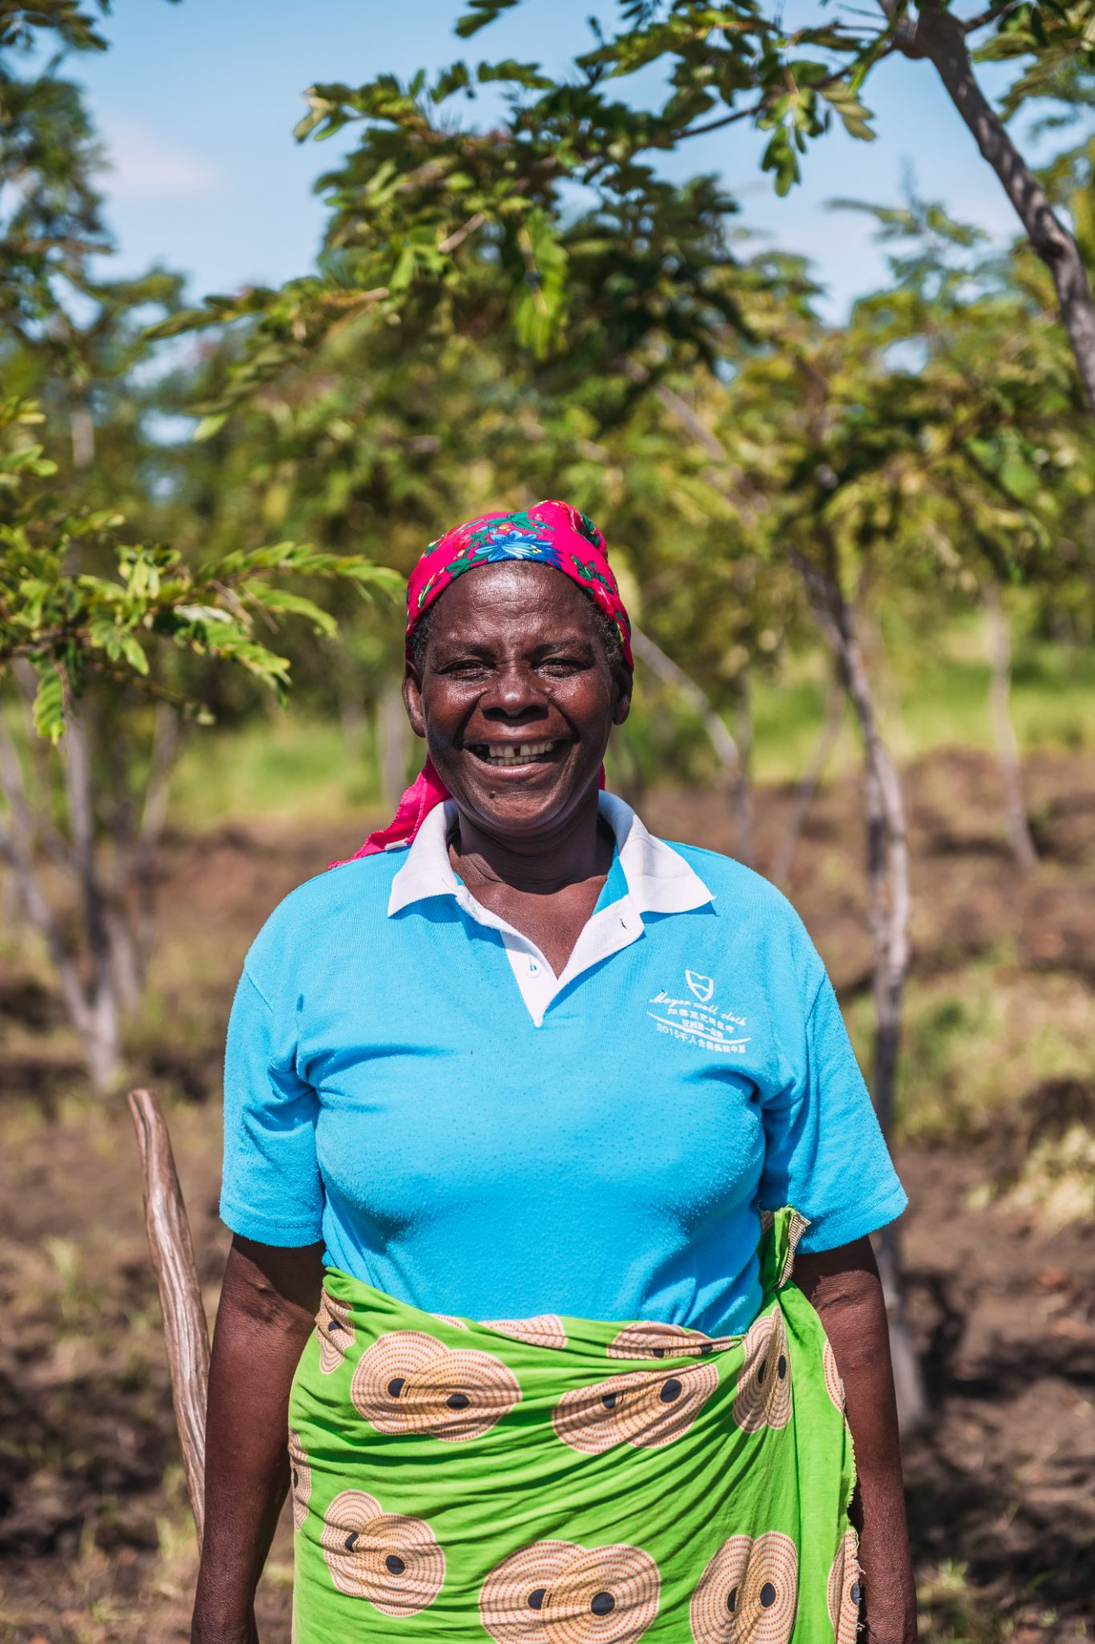
Station six: Beatrice’s story of transformation
Extreme and unpredictable weather events, such as drought and floods, are becoming more common because of the changing climate. Beatrice is a farmer from Malawi who had been struggling to grow enough to feed her extended family of seven children and grandchildren.
‘Yes, I have known hunger,’ she says. But Tearfund’s partner has taught her how to farm more effectively using better techniques, natural fertiliser and efficient use of water.
Now she can grow enough to feed the children and have a surplus to sell to others and pay for her children’s education.
Give thanks for the transformation that has come to Beatrice and her family, and pray for many others across the world still facing hunger and hardship because of climate change.
Photo credit: Alex Baker/Tearfund

