Slide 1
Praying for ‘forgotten’ crises

Slide 2
What is a prayer room?
A prayer room is a space in your church (or other building) that’s dedicated to helping and inspiring people to pray. It will normally feature a number of prayer ‘stations’, each with a different prayer prompt or activity.
Some churches choose to have their prayer rooms open 24/7, others on specific days/times. Prayer rooms can be open for anyone to use when they like, or you can implement a booking system, where people can book an hour slot to have the room to themselves.
You can tailor your prayer room to whatever you feel will best suit your church or group.
Everyone has their own preferred style of prayer. Prayer rooms enable people to pray however they like: whether through writing, drawing/painting, praying out loud, or simply sitting in silence.

Slide 3
Persisting in prayer for ‘forgotten’ crises
‘For I am the Lord your God who takes hold of your right hand and says to you, do not fear; I will help you.’ (Isaiah 41:13)
We have a God who wants us to bring everything to him in prayer (Philippians 4:6-7). However, it can sometimes be difficult to know where to begin – or how to keep going – when the situation feels unchanging or too big. And how can we talk to God about refugees or hunger when sometimes we don’t even know the scale of the crisis ourselves?
We do not have to carry the crises of the world alone; God knows, understands and cares deeply. We can be assured that God is working to restore all things and when we align ourselves with his plan, incredible things can happen.
This prayer room will equip you with creative ideas and stories to help you to keep your eyes fixed on God and bring to him petitions of prayer for our global neighbours about these issues. There are six ideas for prayer stations, which you can either print off to put in your prayer room or use as inspiration for your own ideas. You can use all of these, mix and match, or come up with your own.

Slide 4
Station one: calling on God
The scale of devastation we see on news updates can feel overwhelming. And there are still many crises that we never hear about. Contemplative prayers can help us to keep our eyes fixed on God and not be overburdened by the situation. They also allow God to guide our time of prayer, as we listen to what he wants to share with us.
Take a few moments to be still. God’s presence is always with you. Open yourself to his Spirit now.
As you breathe in, say ‘God you are here.’ As you breathe out, say ‘And I am with you.’
Do this until you feel undistracted by your surroundings and feel the presence of God enveloping you.
Then, ask God to reveal to you what crisis is on his heart for you to pray to him about. Spend time crying out to God on behalf of this issue.
Listen to him as he responds. You may want to write down any words, scriptures, or pictures he has for you.
End by thanking God for being with you and working in you.

Slide 5
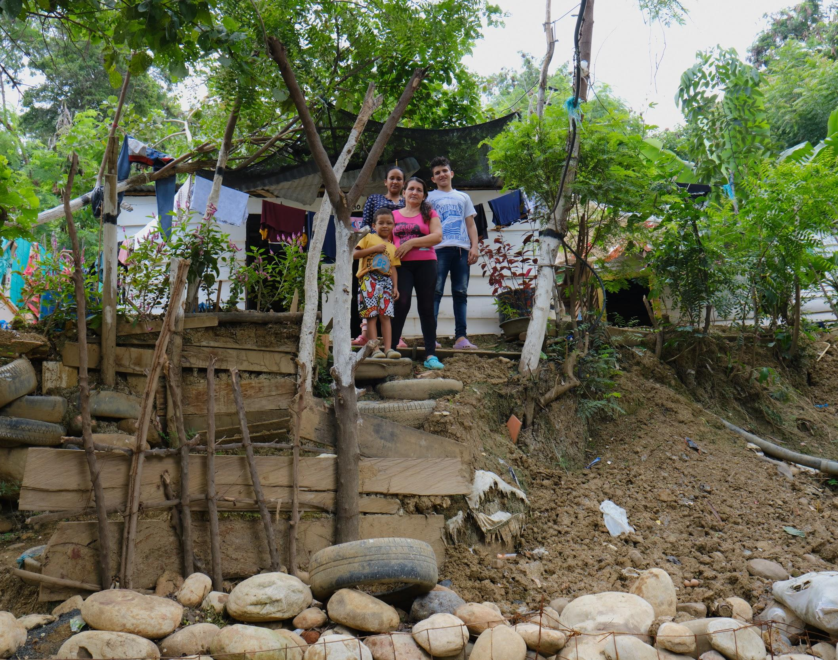
Station two: safe passage
5 million Venezuelans have made journeys, many by canoe and on foot through dangerous terrain, to flee the economic and political crisis that has devastated their country. Nearly 2 million people fled to neighbouring Colombia.
‘It is very, very hard to leave your country and go to another place… it is too hard… it is as if a little piece was torn away from you,’ shares Yalitza, who fled Venezuela.
Tearfund is working with local churches in Colombia to welcome Venezuelan refugees and to help them to rebuild their lives.
For this prayer station you will need a map of the world.
Place your hand over Latin America and pray for safe passage for Venezuelan refugees across the region. Ask God to comfort and provide for them as they seek refuge.
Repeat this with other refugee routes, such as Syria and Yemen.
Yalitza and her family in Colombia.
Photo credit: Ferley Ospina/Tearfund.

Slide 6
Station three: faith and fear
In the last few years in the Sahel region of West Africa – which includes Burkina Faso, Chad, Mali and Niger – thousands of people have been killed and more than a million people have fled their homes due to the growing insecurity. One of the main factors behind the increasing violence is hunger – driven in part by the worsening droughts and floods caused by the climate crisis.
From landmine explosions to ambushes, kidnappings and carjackings, the risk of violence towards the people we serve (as well as our local staff and partners) is high.
‘Without faith and a firm conviction that Christ died and rose again, it is impossible to survive in such an environment,’ shares Seid Zebe, who leads Tearfund’s work in Mali. ‘Our only recourse is the Lord Jesus Christ. As Psalm 20:7 declares: “Some trust in chariots and some in horses but we trust in the name of the Lord our God.”’
For this prayer station you will need a candle.
Christ is the light of the world. Light a candle and pray for Christ’s protection for the people we serve in the Sahel region, as well as for our staff and local partners. Pray that Christ will go before our teams as they visit people in need. Pray in Jesus’ name for faith to replace fear.
Pray for provision for people who are hungry. Ask God to provide long-term solutions for the hunger crisis, which is driving violence.

Slide 7
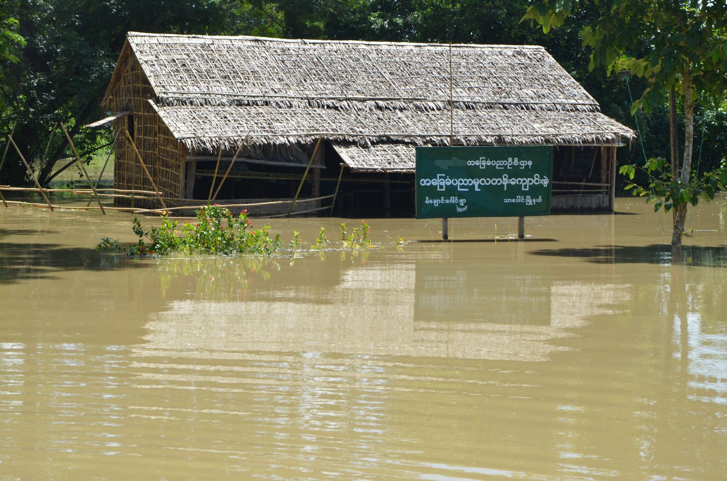
Station four: when disasters strike
When disasters strike it is people living in poverty who are hit the hardest. They are often living in areas prone to flooding, landslides and cyclones, and in houses that cannot withstand these shocks. And all through no fault of their own – they cannot afford to live anywhere safer. These families often did not have the income to meet their basic needs before the disaster hit, and so, with no savings to fall back on, the situation immediately becomes even more desperate.
For this you will need some paper and art materials – such as crayons, paint or colouring pencils, as well as a display board.
Draw or paint a house and write your prayers for people living in poverty inside of it. This can be anything from joy and laughter to safety from flooding and disease.
Once you’ve done this, add it to the display board.
Devastating flooding in Myanmar.
Photo credit: Tearfund partner.

Slide 8
Station five: an end to violence against women
Violence against women and girls is an affront to God. Through our Transforming Masculinities work, Tearfund is equipping church leaders around the world to help change attitudes about women and cultural norms, which are often the cause of violence.
Say this prayer out loud three times. First, declare it over the community where you live. Second, over the world. And for the third, ask God to highlight a specific country or place for you to speak it over.
Dear God,
We lift up women and girls who have been abused. Please comfort them, and bring peace and healing where there are still wounds. In every case, we pray for justice to be done. God, we declare your power over police, judges and courts, and pray that your will be done. We lament over how many women and girls do not feel safe in their homes or their communities. We cry out to you, God, to bring an end to male violence against women in all of its forms. Teach us to see it. Teach us to call it out. Teach us to stand with survivors and demand change.
Lord, let your kingdom come.
In Jesus’ name we pray, amen.

Slide 9
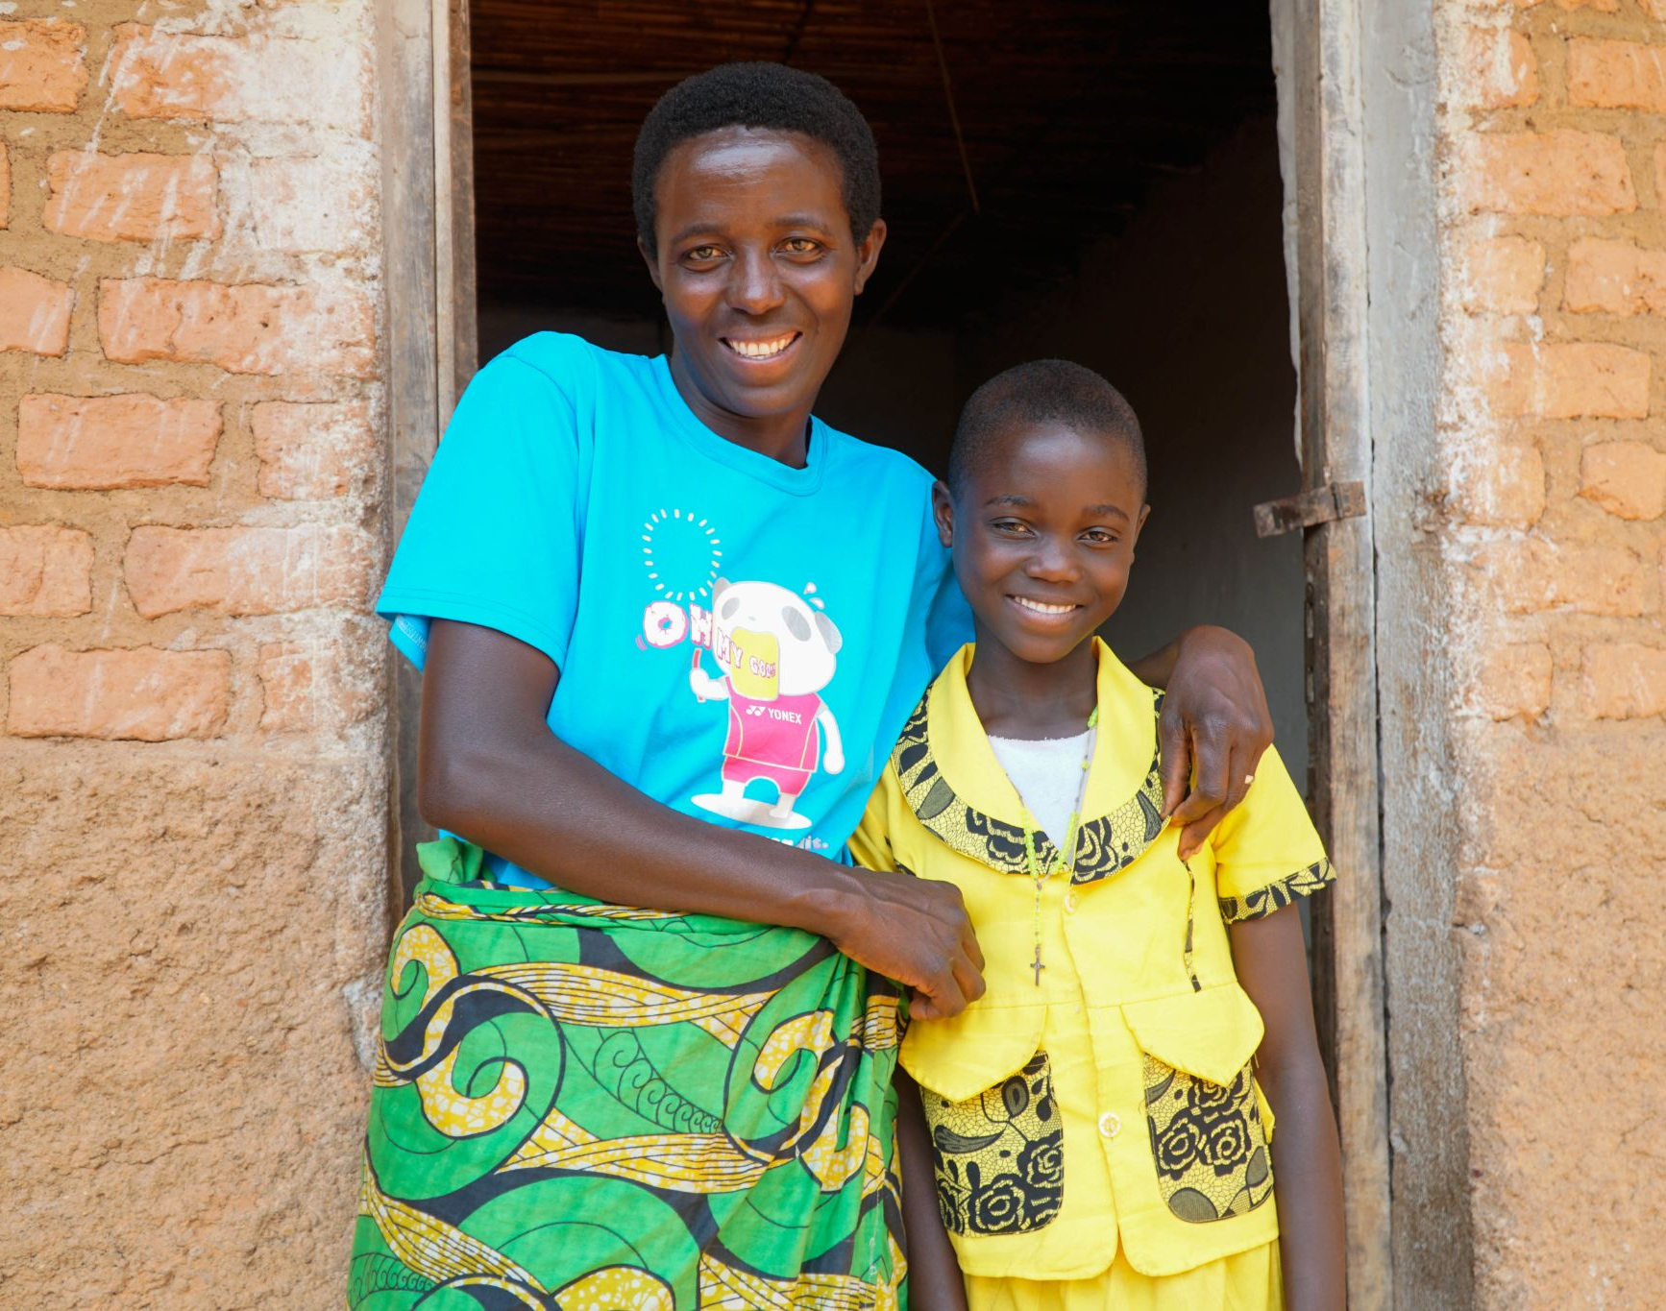
Station six: celebration and thanksgiving
We often hear about about crises in the news when they happen, but rarely about the solutions; these take time and are difficult to report. But God is always moving and there are countless stories of answered prayers and of God’s goodness that we can delight in. Like in Burundi.
In one year alone more than 200 children in the community of Matana were sick – all due to malnutrition. This was in part due to the climate crisis changing weather patterns, meaning even less food to go around.
The Anglican Diocese of Matana, working with Tearfund, turned this around by offering support and training in farming techniques. Through this, the community of Matana has completely eradicated hunger.
‘Our mentality and behaviour have changed – who could have thought that the people who didn’t have enough food for their children nine years ago could be doing so well today? We are grateful to God!’ shares Diane.
Spend time praising God. You could listen to worship music as you do this, dancing and singing the Lord’s praises, bringing all glory to him.
Diane and her daughter Chanelle are celebrating as Chanelle has overcome malnutrition.
Photo credit: Diane Igrimbabazi /Tearfund.

