Slide 1
Speaker Training 2022

Slide 2
Welcome!
The history of Tearfund and spirituality of fundraising
Theology of poverty
Public speaking, how to engage and inspire with confidence
Why Awakened

Slide 3
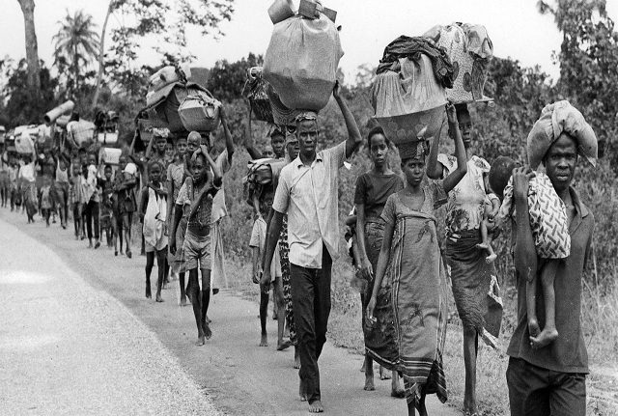
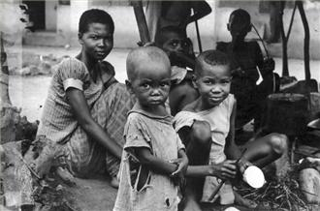
History of Tearfund
Notes:
During the two and half years of the war, there were about 100,000 overall military casualties, while between 500,000 and 2 million Biafran civilians died of starvation. In mid-1968, images of malnourished and starving Biafran children saturated the mass media of Western countries. Tearfund started in 1968, because for the first time ever, people were able to see on their television sets and newspapers, in graphic detail, the horrifying images of the famines in Africa, particularly the Biafra crisis.
And it shocked our nation and the church in the UK cried out, with a massive heart cry THIS IS WRONG,. So they started to send money into the Evangelical Alliance.

Slide 4
Global Poverty statistics
10 percent of the world’s population lived on less than US$1.90 a day
736 million people lived on less than $1.90 a day, down from 1.85 billion in 1990.
Approximately 9 million people die of world hunger each year according to world hunger statistics; more than the death toll for malaria, AIDs and tuberculosis combined in 2012.
2 million children a year/5000 a day die from poor water and sanitation.
A child is trafficked once every 30 seconds, 3300 per day, 1.2 million per year in the sex or slave trade every single year.

Slide 5
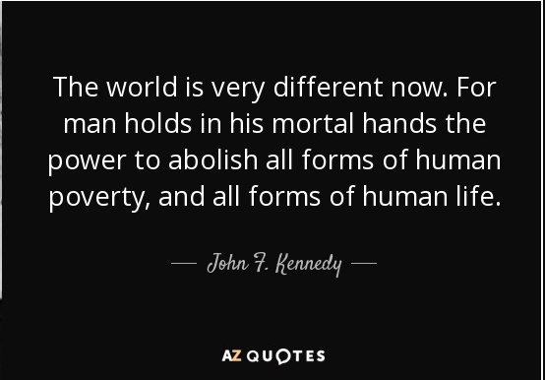
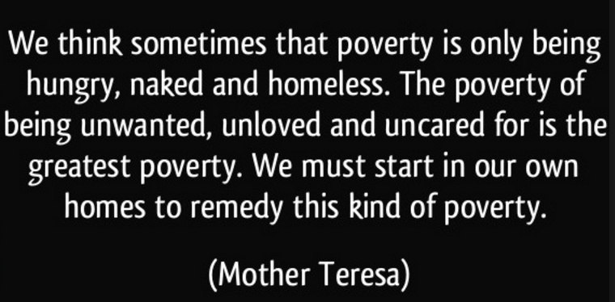
When Helping Hurts

Slide 6
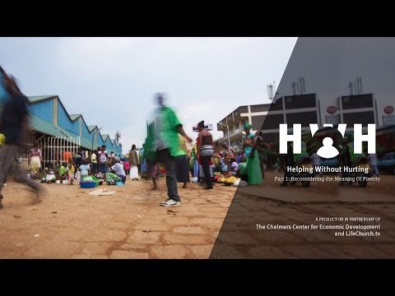
When Helping Hurts

Slide 7
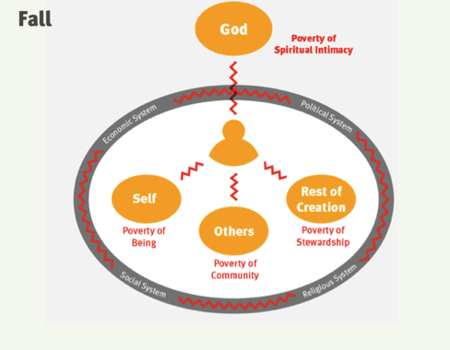
When Helping Hurts
Notes:
Broken relationships with self with God,

Slide 8
When Helping Hurts
Purpose
What is poverty alleviation?
A process in which people, both the materially poor and non-poor, move closer to living in right relationship with God, self, others, and the rest of creation.
Loved
Self-value

Slide 9
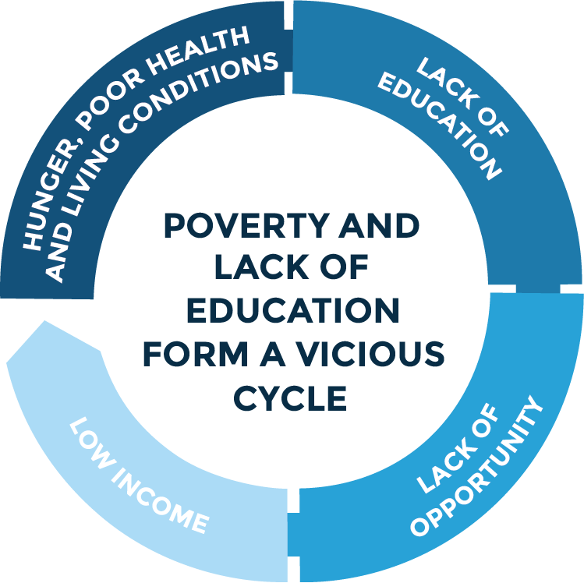
CCT
Life to the fullest
Empower
CCMP

Slide 10
CCT - What’s that and what DO we do??
CCT
CHURCH & COMMUNITY TRANSFORMATION
Children at Risk
SHGs - Self help groups
Peace and reconciliation
Water, Sanitation & Hygiene
Disasters/ Cash grants
Food security
Advocacy
Sexual and gender based violence

Slide 11
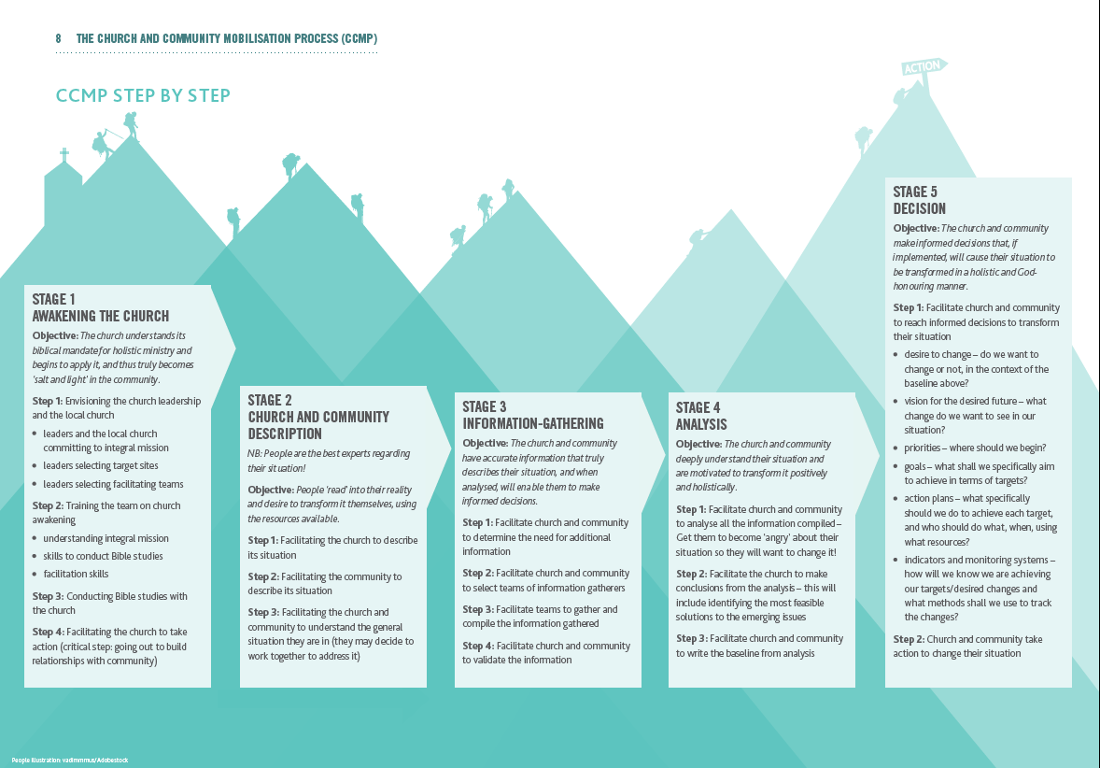
CCT

Slide 12
CCT
Provider-receiver dynamic
‘give to’ ‘done for’
Relief
‘Doing with’
Shared process
Rehabilitation
‘Walking with’
Process over time
Development

Slide 13
CCT in action

Slide 14
CCT
Benefits of Long Term development
Sustainable
Generational
Encourages creativity
Ownership
Gods way of caring - walks and remains with us
Builds community
Benefits of working through the church
Church will have opportunity for discipleship
Show me your faith with works - Practical application of faith
Understands the culture and language in a way we never could
Addresses the psychological and spiritual needs not just the material and physical needs
Allows us to go beyond political or geographical borders
Mobilises millions of volunteers around the world in helping their neighbours

Slide 15
CCT - further reading
Tearfund Learn - Umoja
CCT in Africa breakdown.
When Helping Hurts
Impact and Learning report
What we do and where
Self help groups
Self help groups ROI
Be a part of something beautiful

Slide 16
Tearfund’s theology of poverty
Why theology?
Understanding poverty - biblical insights
Responding to poverty - churches role & responsibility

Slide 17
Why theology?
Part of Tearfund’s vision is to see churches around the world adopt a holistic approach to poverty and mission. We want to see the global church fully participating in God’s mission to restore and redeem the whole of creation, with local churches contributing to whole life transformation in their communities.
The Theology & Network Engagement Team exists in pursuit of this vision. We share thinking and critical analysis on key theological and development issues for discussion, reflection and application. We also work to inspire and strengthen regional and global Christian development movements and networks across Africa, Asia and Latin America – seeking to influence, support, collaborate and learn.

Slide 18
Understanding poverty
Generally, poverty is understood as a state of being in which a person lacks the income (or other means of support) to reliably meet their basic personal needs, such as food, shelter, and clothing.
Multidimensional poverty encompasses the various deprivations experienced by poor people in their daily lives – such as poor health, lack of education, inadequate living standards, disempowerment, poor quality of work, the threat of violence, and living in areas that are environmentally hazardous, among others.
Conflicts and climate change causes and exacerbates poverty.
Tearfund views poverty as broken relationships (God, others, ourselves and the environment) and broken systems.

Slide 19
Biblical insights
The big story /narrative arc of the Bible
Act One
— Creation: In the beginning
Act Two
— The Fall: Human rebellion
Act Three
— Israel: A chosen people

Slide 20
Biblical insights
Act Four
— Jesus: Saviour of the world
Act Five
— Church: The new community of hope
Act Six
— New Creation: A new heaven and a new earth

Slide 21
Questions for discussion
What is your understanding of global poverty?
What are the causes of poverty in different parts of the world?
How do you think broken relationships impact poverty in different parts of the world?
How can the church respond to global poverty?

Slide 22
Poverty isn't part of God's plan. You are.

Slide 23
Public Speaking -
What do i do?

Slide 24
Who is a Good Public Speaker to you?
I’ll give you some of my examples of great public speakers/communicators in my opinion:
TD Jakes
Barack Obama
Kier Starmer
Denzel Washington
Dave Chappelle
He who shall not be named (Not Voldermort)
And Why?

Slide 25
A Great public speaker = A great storyteller
Notes:
A great public speaker, tells a great story. They take you on a journey. They make you feel like time is just passing by rather than an endured task. That is the key to inspiring others. You bring them into what will feel like your personal space as if you’re talking to them 1 to 1 in a living room. You allow each person to feel as if it is JUST them you are speaking to in that moment. A beautiful skill when utilised can inspire millions of people.
The ability to inspire is by the person themselves. Network marketing advice ‘people don’t buy the product, they buy the person’ what will separate you from another charity representative?

Slide 26
3 C’s
Coherent
Confident
Conviction

Slide 27
Coherent
Know your material
Take your time (Don’t Rush)
Voice projection
Notes:
Know the material - Let it be ONE with you, so it feels like your own story that flows from your tongue.
Take you time (don’t rush) - more often than not you will talk faster than usual so consciously take your time.
Project voice
I sometimes practice in front of a mirror - nothing wrong with practicing.

Slide 28
Confident
You are in control
Physical expressions need to appear confident
Humour *
KNOW YOUR MATERIAL
Notes:
Confident
You are in control - this is not meant to intimidate you, but take ownership of the moment. You dictate the mood, the pace, the atmosphere so choose everything you do wisely
Physical expression - you want to look relaxed. Not lazy, but think about, do I walk a little bit
Humour - ONLY if this is a natural thing to you.
KNOW YOUR MATERIAL - you won’t be confident unless you know what you are talking about inside and out.

Slide 29
Conviction
Does this mean something to you?
Is there a personal attachment you can find
Do you really care?
Know your material
Notes:
KNOW YOUR MATERIAL - the essence of the message has to be part of you.
Find a personal attachment to the story
A Person once said to me - people don’t buy the product, they buy the person. Is what you’re ‘appealing’ to people about believable in YOU?
The person has to be believable.

Slide 30
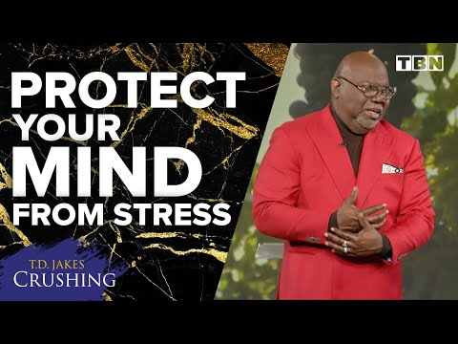
Watch this

Slide 31
What did you notice?...
Strong introduction
Personal connection with audience
Vocal inflection, tone variety
Emotional pull - as he closed the point

Slide 32
Remember your audience
Black Majority Churches
Are they warm to the ‘justice’ space?
Room for spontaneity?

Slide 33
As much as you are representing ‘The Well’
BRING YOURSELF TO THE TABLE
Notes:
Learn the model talk but also know the story in 2 kings 4 well for yourself, how can it impact you personally so that it comes out in delivery.

Slide 34
Awakened….Why do we have church speaking engagements?
To inspire, get involved, help improve the lives of those living in poverty, through Giving, Acting or Praying
Promote self help groups (SHG) to Black majority church
Church and community transformation
Volunteers have the opportunity to do God's work in ending poverty
“One of the benefits of being in a self-help group is socialising and learning from other members, sharing ideas, and self-development through group savings. I am also able to borrow money from this group that I joined”

Slide 35
Following Jesus where the need is greatest”
Tearfund’s is passionately committed
Disasters are increasing frequency
Impacts of climate change
The Awakened campaign spotlight on the disaster response from Tearfund
Achievements
29,584 low-income families
941 small businesses
1,532 self-help group members have invested in livestock and bicycles
578 local churches have been mobilised
Objectives
Sign up to give £10 a month, as less becomes inefficient use of resources
Through Church speaking engagements and other events in 2022, we have a dream to help provide for those where the need is greatest.
Why regular giving
In debt don't give
Between £10 to £50 a month
Your goal is to touch the heart of many

Slide 36
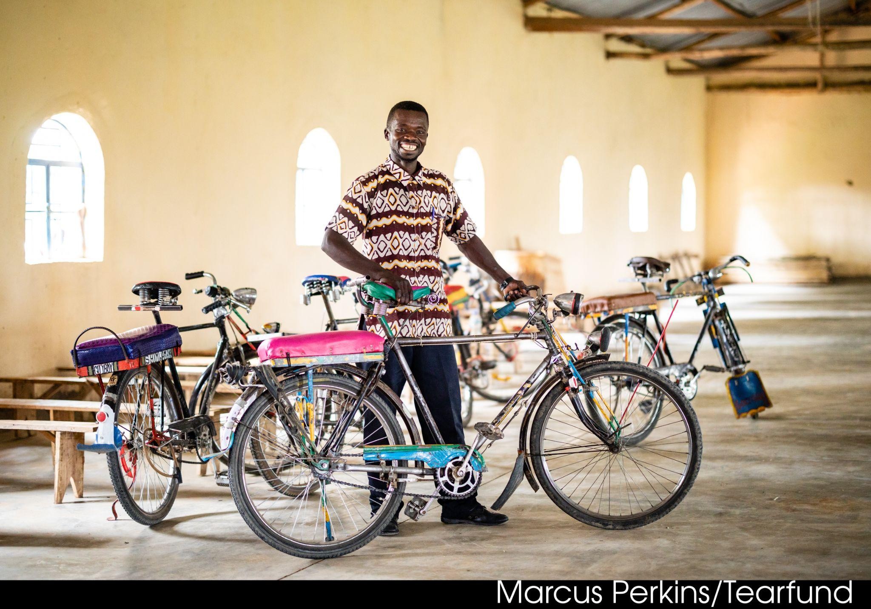
Managing your speaking engagement…Prepare prepare prepare
Set expectations
Stick to the plan don’t run out of time
Project confidence
Vary your tone and style
Make eye contact
Humour can build rapport

Slide 37
Hints & Tips - Everybody communicates but not everybody connects!
A - Attention
E - Empathy
I - Insight
O - Options
U - You
F - Facts
O - Opinions
A - Anecdotes
M - Metaphors
PRAY PRAY PRAY

