Slide 1
Notes:
Slideshow for you to use ‘pick and mix’ style, taking the slides you want to use, and editing them as you see fit.

Slide 3
Setting the scene
Climate change in the news
Statistic which impacted you
Story from the local area
Notes:
Space for you to add in ‘scene setting’ stories from the news, statistics which have resonated with you, or something maybe from the local area of the church.
Inspiration in our climate factsheet.

Slide 4
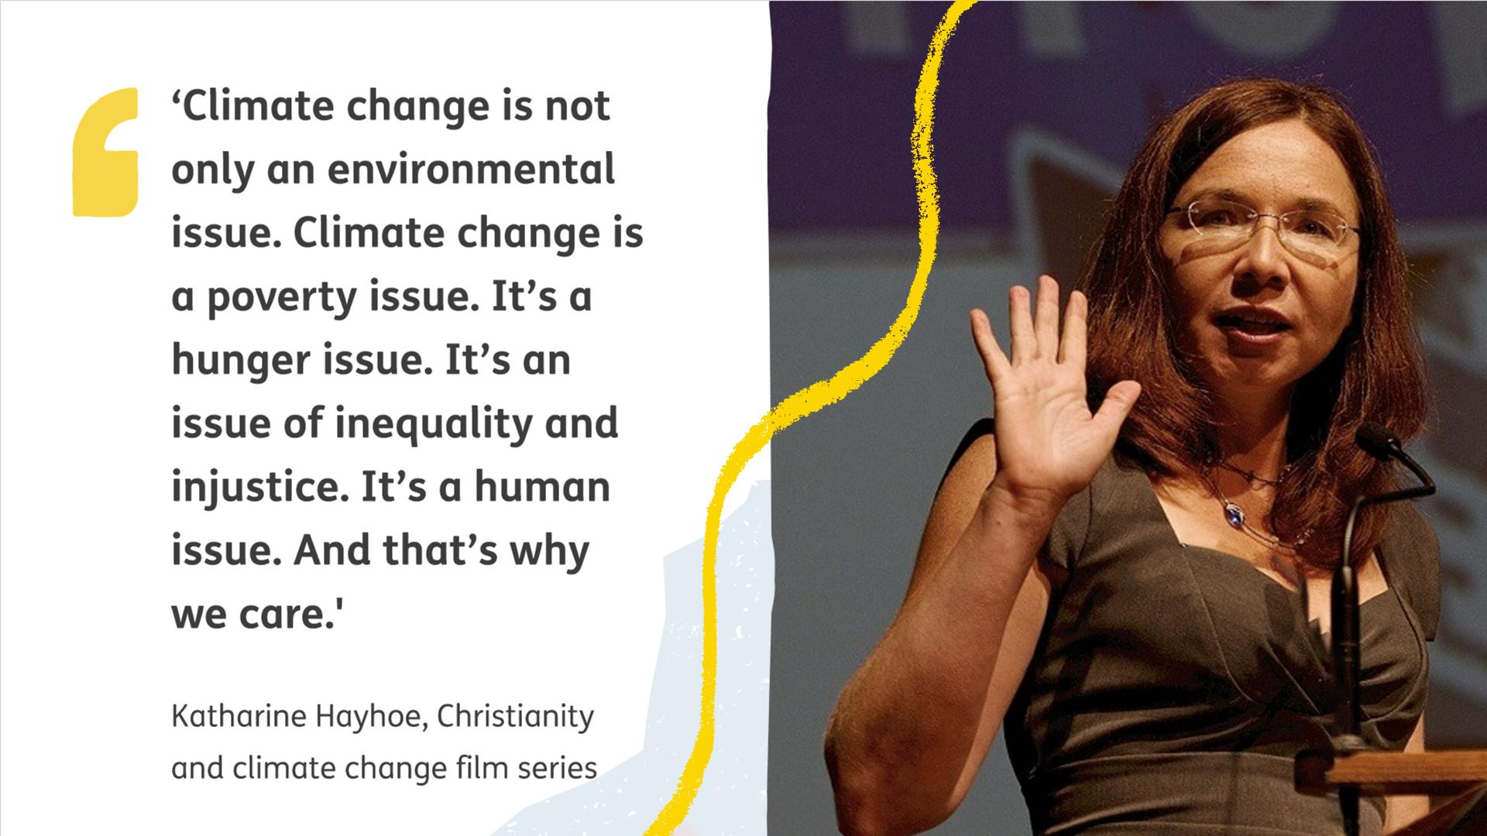
Notes:
A quote from Katharine Hayhoe, Christian climate scientist who completed a 9-part film series with Tearfund; Christianity and Climate Change, in 2021.

Slide 5
Genesis 1:28
The beginning
28 God blessed them and said to them, “Be fruitful and increase in number; fill the earth and subdue it. Rule over the fish in the sea and the birds in the sky and over every living creature that moves on the ground.”

Slide 6
Psalm 19:1-4
The heavens declare the glory of God
1 The heavens declare the glory of God; the skies proclaim the work of his hands. 2 Day after day they pour forth speech; night after night they display knowledge. 3 There is no speech or language where their voice is not heard. 4 Their voice goes out into all the earth, their words to the ends of the world.

Slide 7
Mark 12:31
Love thy neighbour
31 The second is this: ‘Love your neighbor as yourself.’ There is no commandment greater than these.”

Slide 8
Romans 12:1-2
A Living Sacrifice
12 Therefore, I urge you, brothers and sisters, in view of God’s mercy, to offer your bodies as a living sacrifice, holy and pleasing to God—this is your true and proper worship. 2 Do not conform to the pattern of this world, but be transformed by the renewing of your mind. Then you will be able to test and approve what God’s will is—his good, pleasing and perfect will.

Slide 10
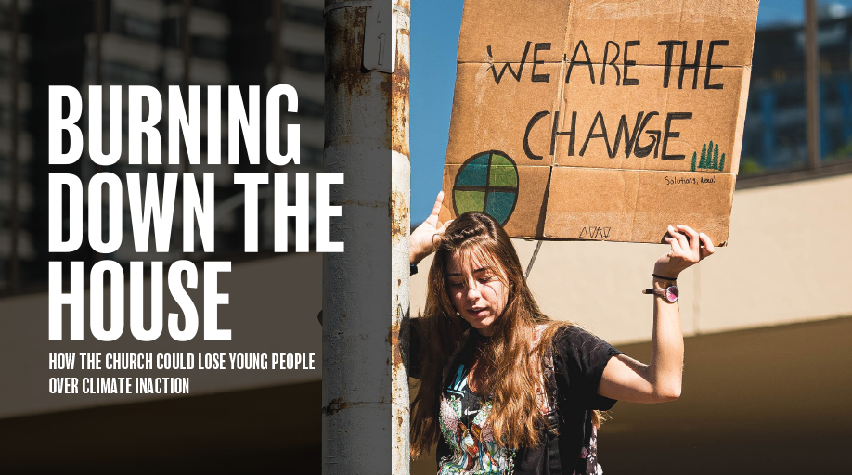
Notes:
In 2020 We Are Tearfund and Youthscape surveyed young Christians from the UK, asking 14-19 year olds about their thoughts on the climate, the church and their faith.
Quote from the research:
“When the world looks back at the church in two hundred years’ time, will they think the church helped to stop climate change or were part of the problem? will they view the church as a positive part of society which is a catalyst of change, or negative and outdated?”
Links to the research and ‘Moved by Faith’ launch video can be found at www.tearfund.org/speakerscorner

Slide 11
Notes:
The topline results:
9/10 Christian teenagers surveyed are concerned about climate change.
1/10 Christian teenagers think their church is doing enough.
8/10 Christian teenagers think Christians should respond to climate.
Links to the research and ‘Moved by Faith’ launch video can be found at www.tearfund.org/speakerscorner

Slide 12
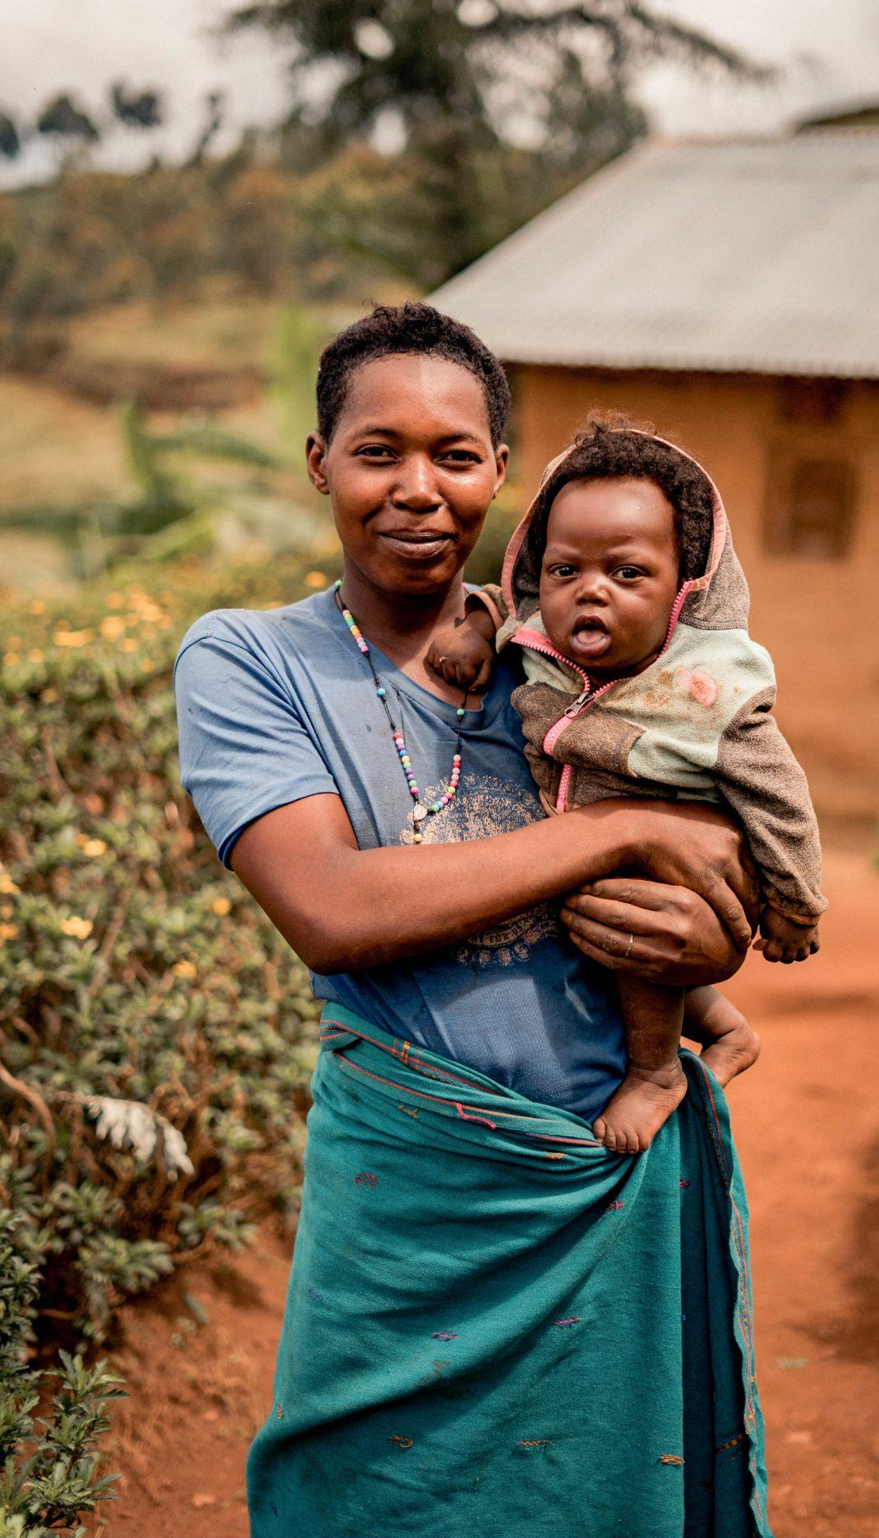
Notes:
(From left to right). Loyara; Burkina Faso, Orbisa; Ethiopia, Stidia; Uganda
More information about these women:
Loyara (video and image from 2021)
Orbisa (video and image from 2020)
Stidia (video from 2009, image from 2019, see next slide for updated info)

Slide 13
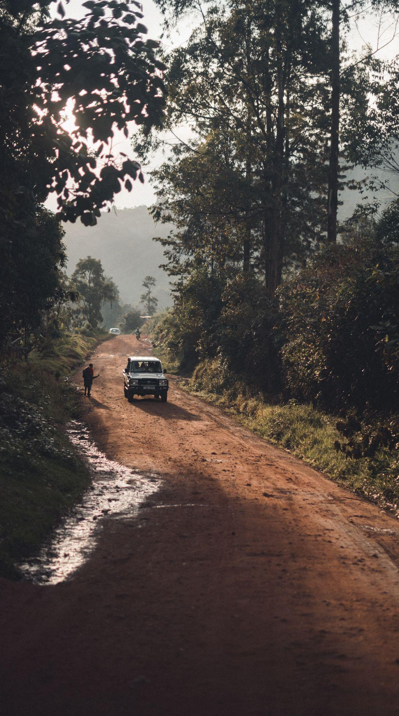
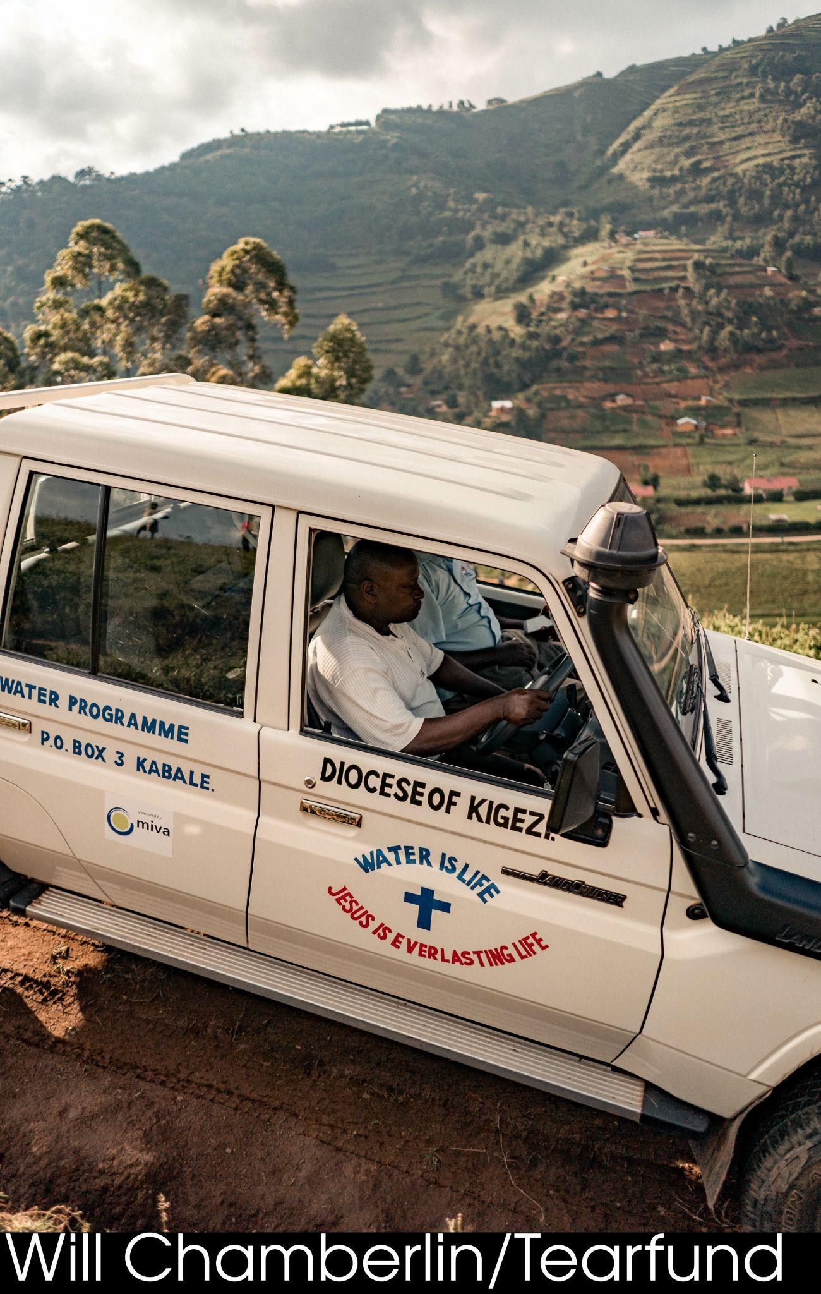
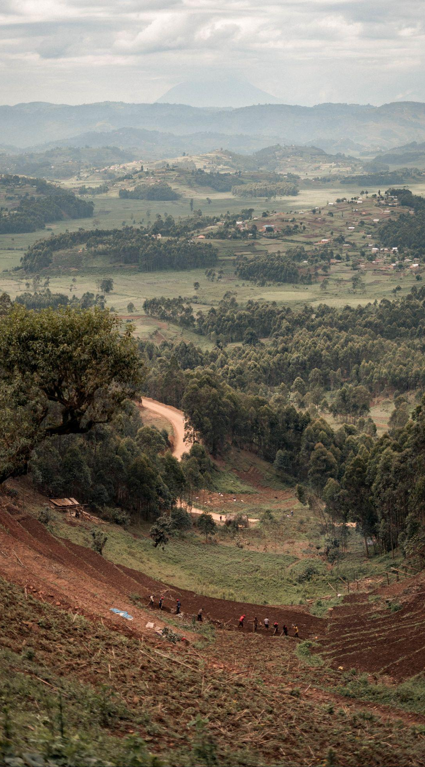
Notes:
Diocese of Kigezi, Uganda; Water is life. Jesus is everlasting life.
783 million people in the world do not have access to clean water. That problem can be seen starkly in south-west Uganda, a land of hills and valleys. Most villages are on top of the hills, whilst the water sources are at the bottom. Traditionally the children collect water, usually the girls; but the journey is fraught with danger.
In this area of Uganda, there is also a lack of knowledge about the dangers of unclean water and bad hygiene practices. People don’t know that not washing your hands before preparing food or after going to the toilet spreads disease. As a result there are high rates of water borne diseases like diarrhoea, particularly amongst children. Climate change has also led to unpredictable seasons and events like landslides, floods, and soil erosion. For a well off community these would be difficult challenges, but for the rural poor of Uganda, they are catastrophic.
The Kigezi Diocese Water and Sanitation Programme (KDWSP) - or Kigezi for short - works with rural communities in the south west of Uganda to change this story. They want to see communities of people being able to collect water close to their homes. They want to see them using that water well, implementing hygiene practices that keep people safe, and adapting to climate change.
Kigezi succeeds in this life-transforming mission by working through the local church, uniting the whole community around a common goal. They teach everyone about the importance of hygiene, and challenge practices that have led to disease and illness. They work with communities to help them identify the resources they have and what they are able to do. Their aim is always to leave communities more united.
KDWSP provides practical help to enable people to access safe water. Simple harvesting tanks store rainwater that gathers on roofs and gutters. These have the advantage of being constructed close to people’s homes, removing the need to travel to collect safe water.
In order to bring such tanks to communities, KDWSP provides the materials needed and trains people in constructing tanks. This means that they have not only been empowered to change their own situation but they also have developed skills that impact the rest of the community. As others see the benefits of tanks demand for them grows, creating paid work for the trained group. KDWSP also helps protect existing water springs and installs gravity flow schemes. Gravity flow schemes are spring-fed pipelines that bring water to communal tap stands. Communal tap stands serve several households from a central location where people can collect water. These are used rather than boreholes in Kigezi, where the terrain makes drilling difficult.
Link to a blog about how the gravity flow systems work with Kigezi.

Slide 18
Notes:
Let’s Change the Climate - spoken word from Fiona Stewart video which can also be found at www.tearfund.org/speakerscorner

Slide 19
Notes:
Just £16 a month, over a year, has the ability to help restore an entire community that has been devastated by the climate crisis.

Slide 20
Notes:
Just £16 a month, over a year, has the ability to help restore an entire community that has been devastated by the climate crisis.

