Slide 1
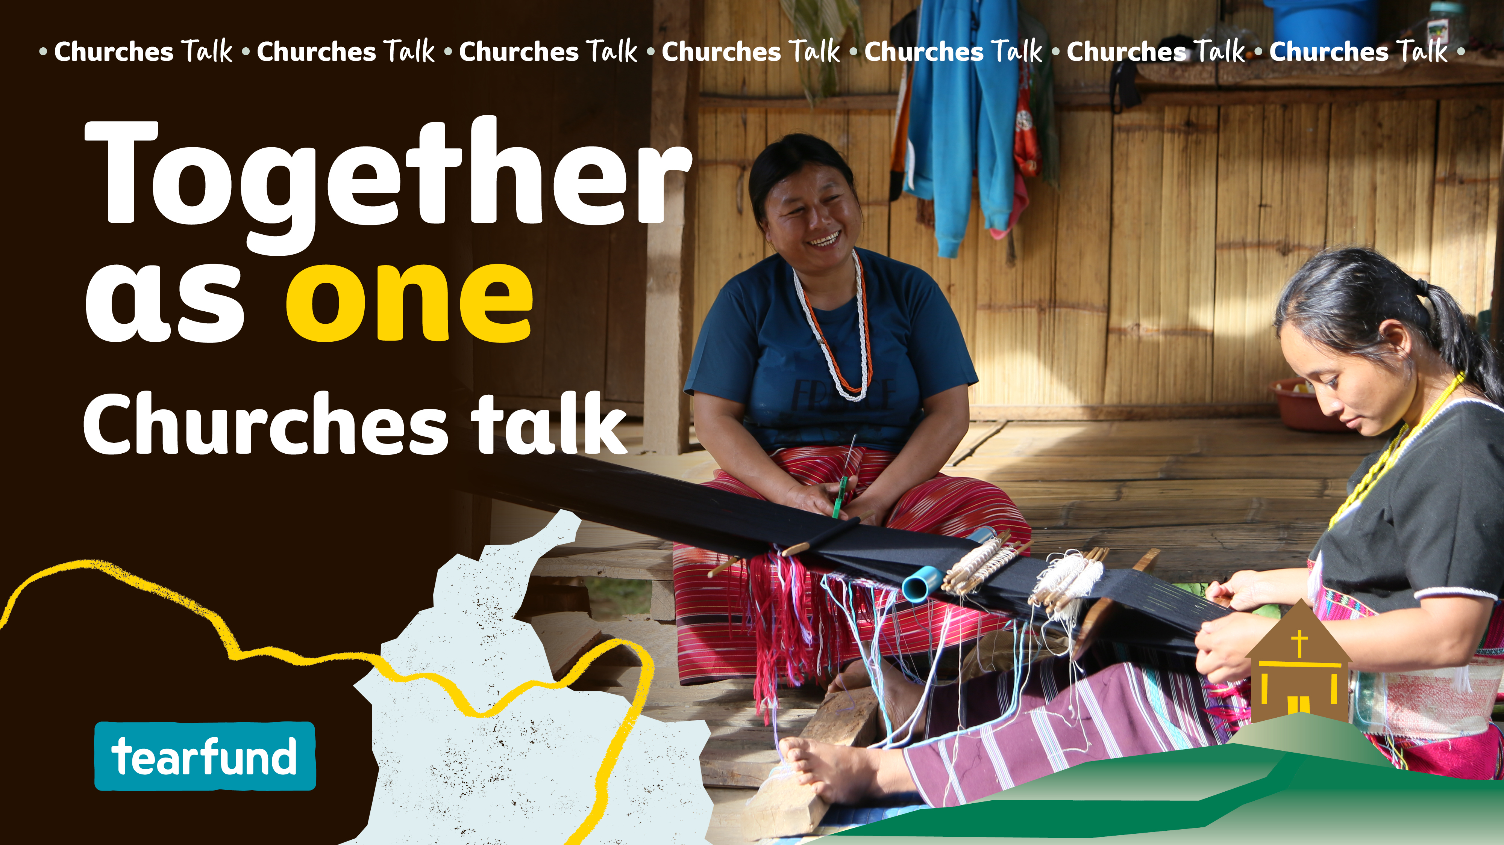
Notes:
Tearfund partners with local churches and communities in more than 50 countries across the world, to help ensure that everyone has the opportunity to fulfil their God-given potential. Poverty is not God’s plan for the world, and the church plays a vital role in equipping people to lift themselves out of poverty.
Through Tearfund’s Transforming Communities programme, we can work together as one to see an end to extreme poverty and injustice, and see lives transformed in the name of Jesus.
Extreme poverty impacts every aspect of a person’s life, devastating families, destroying local businesses and draining communities of their resources and hope.
When God created the world, humans experienced perfect relationships and harmony with God, with ourselves, with others and with creation. But in Genesis, we learn that the Fall caused these relationships to break. And Tearfund believes that this brokenness is the root of all poverty and injustice. Through Jesus’ sacrifice on the cross, God is restoring his relationship with humanity, which is leading to the restoration of the other three relationships too. Tearfund’s work focuses on tackling poverty at its root – healing these broken relationships – in the belief this will lead to lasting transformation.
Today, let's take the opportunity to join with our fellow believers – the global church – to look towards the restoration of all things. Together as one, the church at work to bring whole-life transformation.

Slide 2
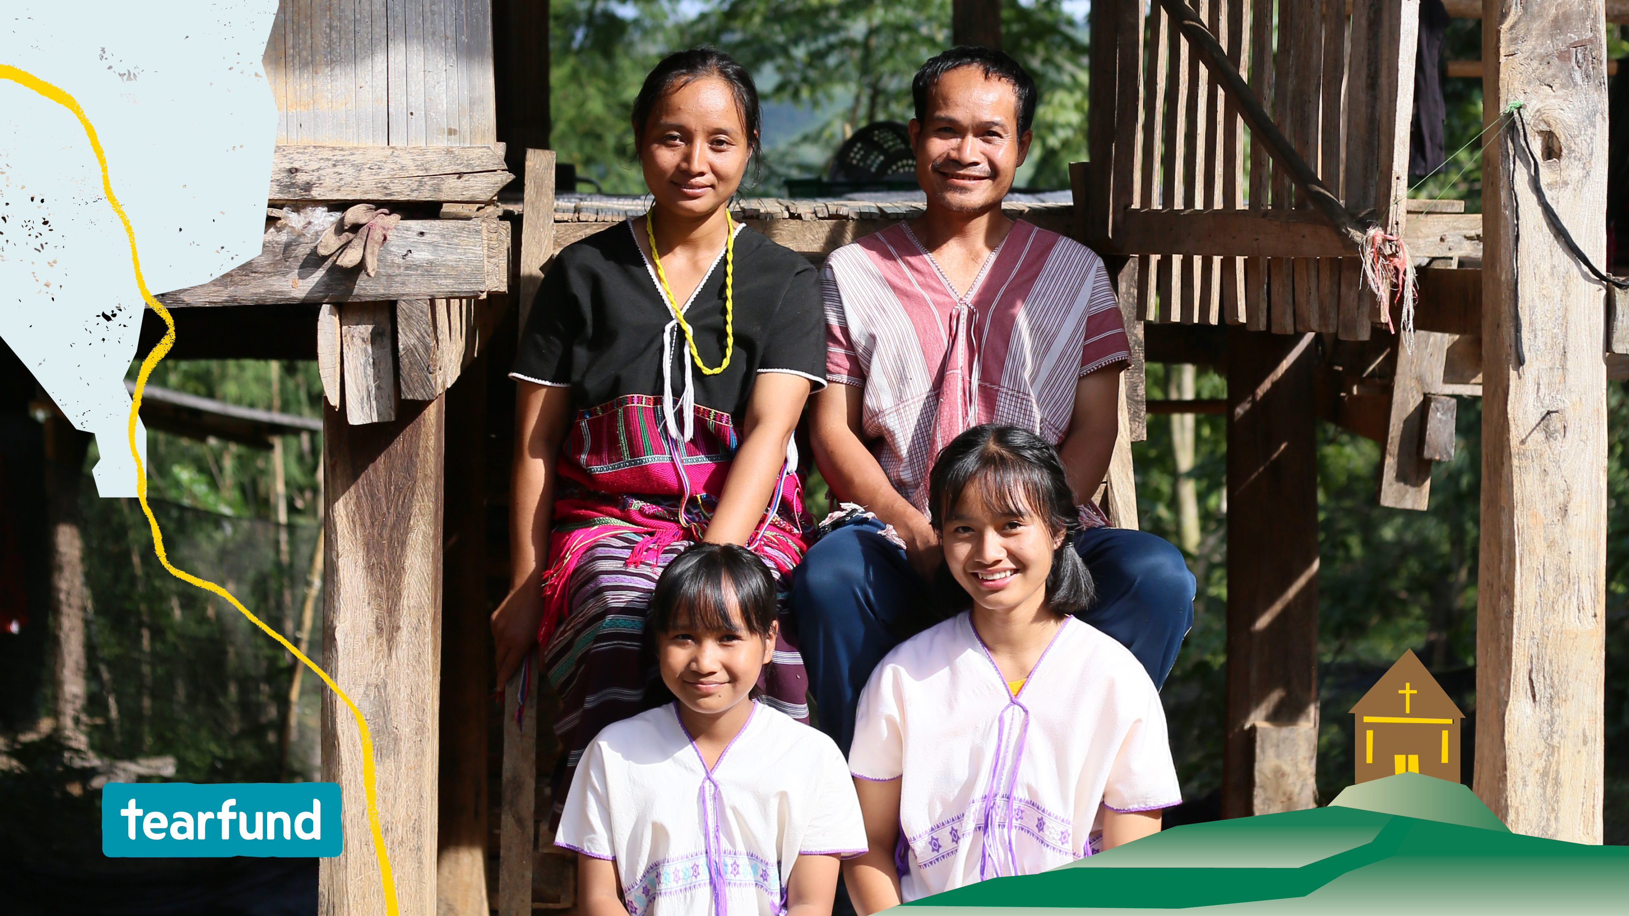
Notes:
Transforming communities around the world
Tearfund has been working in Thailand for over 45 years. Today it focuses on supporting faith-based organisations and local churches to respond to the needs of their communities. Church leaders are encouraged to lead development projects in their communities by making use of local resources, caring for creation and addressing the needs of the most vulnerable.
Addressing local problems, locally
Mrs Wan and her husband, Mr Surat, live in a remote, rural village in the heart of Chiang Mai province, in northern Thailand.
They tried their best to raise their two teenage daughters against the backdrop of poverty. They had very little income, sporadic access to clean water, a shortage of food and no money to pay for their daughters' education. Mr Surat led the small village church, but keeping the men and older boys in the congregation was a struggle. Opium and other drugs were luring them away from their faith, offering escapism from their hardship.
Their village of about 22 families was deeply impoverished. There was little hope among them.
At least, that was, until the Thailand Karen Baptist Convention (TKBC) came to their village and introduced various development initiatives with the community. Supported by Tearfund’s only staff member in Thailand, Tui, the Convention had learnt how to assist communities in reducing their levels of poverty, through Tearfund’s Transforming Communities programme. Guided by Tui, they showed the community ways to care for their environment and develop their income.
Mrs Wan took part in various activities with women from her village. They learnt about waste management, better farming practices, community micro-financing groups, water and sanitation issues, and small business management. They also learnt how to advocate with the government about their rights to manage their land and local resources.

Slide 3
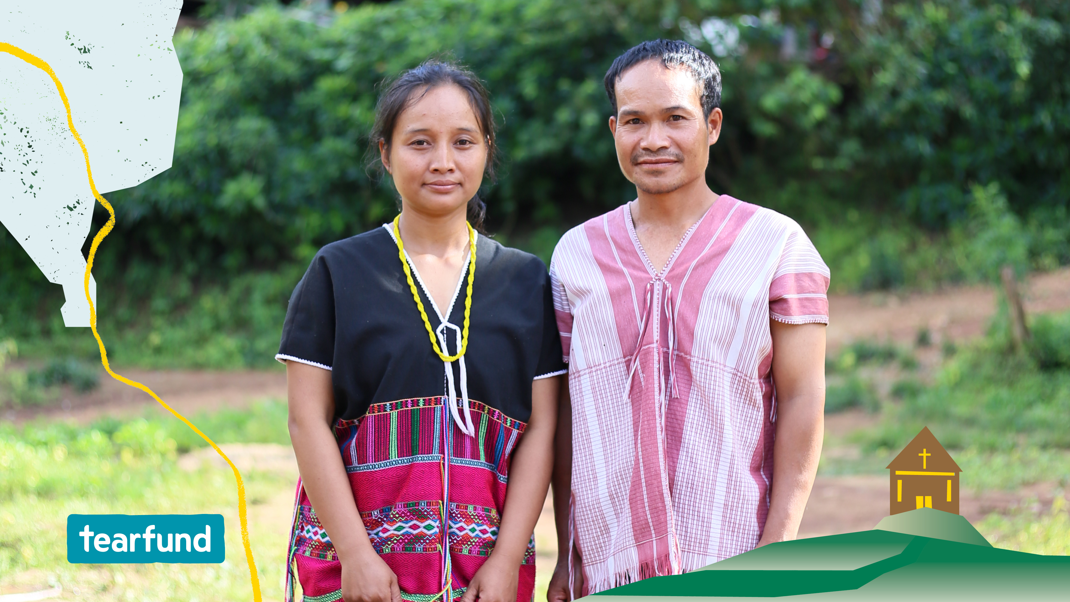
Notes:
Mr Surat also took part in training organised by Tui and the Convention. He learnt how to rear pigs, grow herbs and vegetables, and carry out agroforestry. He trained in shop management and accounting too. This helped him start a new business and diversify the family’s income.
Together, the community identified that a lack of water was one of their greatest concerns. And so, Tui arranged for water technicians to visit Mr Surat’s village. A team of men from the village were taught how to create dams to maximise the availability of natural spring water from the mountain.
Through this training, Mr Surat learnt how to install pipes which run from the mountain spring to homes in the village. The group also laid pipes to irrigate a new community garden to help feed families in need.
Authentic outreach from the church
As Tui explains, ‘Tearfund’s Transforming Communities programme in Thailand, and around the world, is significantly impacting poverty reduction. By enabling local churches and communities to collaborate, use their own resources and engage in advocacy, the Transforming Communities programme promotes sustainable development and enhances the quality of life.’
Mr Surat, his wife and the rest of their congregation now have the knowledge they need to help their village to flourish. They understand that by helping their neighbours, they are demonstrating God’s love. By caring for their environment, they are able to reap greater harvests. By uniting their voices, they can successfully advocate for local government support. And by sharing resources, they can build small businesses and increase their income.

Slide 4
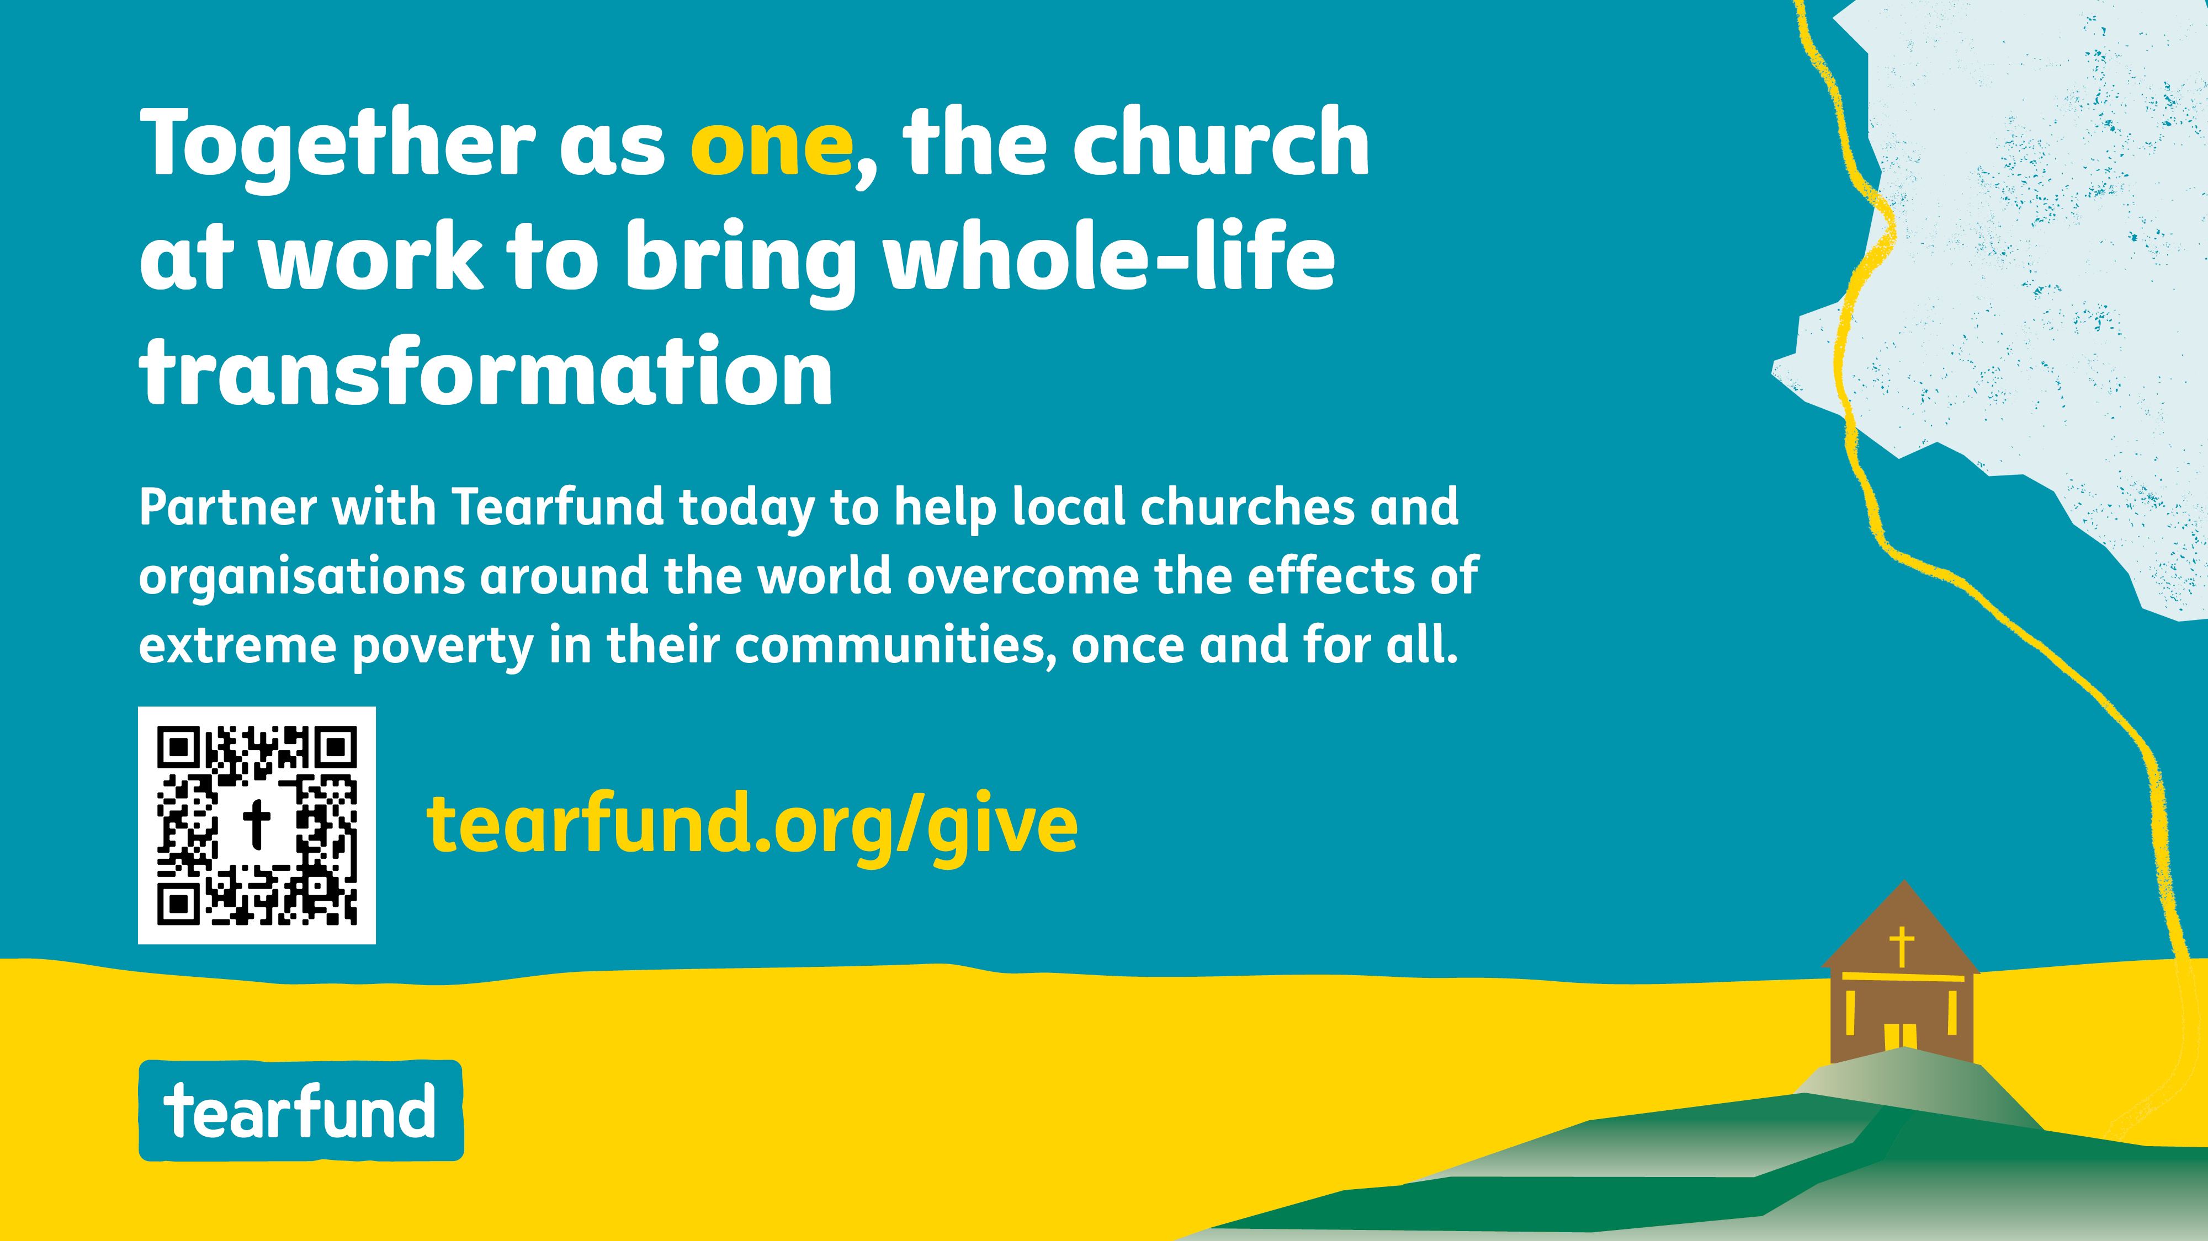
Notes:
Supporting a hope-filled future
When local churches learn how to respond to the needs of those around them, amazing changes occur. Hope is restored, damaged relationships are healed, trust grows and the cycle of physical, emotional, mental and spiritual poverty is broken. Churches such as Mr Surat’s are already seeing the power of uniting, of using what little they have to grow something far bigger. Now every single person in the village is prospering.
Such change is self-perpetuating. Communities experiencing this kind of transformation will never go back. As the younger generation begin to attend school, hope for a better future takes hold.
Together as one, the church at work to bring whole-life transformation
By 2030, Tearfund has a vision to collaborate with 250,000 churches to equip 44 million people to combat the devastating effects of poverty, through the Transforming Communities programme.
Poverty is not God’s plan. We are.
Together, we can partner with Tearfund today and beyond to help local churches and organisations around the world overcome the effects of extreme poverty in their communities, once and for all.

Slide 5

Notes:
Let us pray.
Dear Lord,
Thank you for Jesus’ sacrifice on the cross that is restoring your relationship with humanity, and restoring our relationships with ourselves, others and creation.
Thank you for all you are doing through your church in Thailand and around the world today. Thank you that suffering is being reduced and hope restored, as a result of the work that you are doing through Tearfund and its local partners. We give thanks for the relationships and networks being created among churches throughout Thailand and across the world.
We ask that you will continue to strengthen the bonds between your body of believers. We pray that many communities will be enabled to prosper through the work carried out in the year ahead. Please strengthen Tearfund staff in their roles, and help them to discern where to channel their energy and efforts.
Help us, Lord, to join together as one as the global church to work towards the restoration of all things to bring whole-life transformation.
In Jesus’ name,
Amen

