Slide 3
Photo: Alphonse Mata/Tearfund
‘No one can serve two masters. Either you will hate the one and love the other, or you will be devoted to the one and despise the other. You cannot serve both God and money.’
Matthew 6:24

Slide 4
Photo: Alphonse Mata/Tearfund
‘God wishes to put all things into the service of people and ultimately to bring forth the flourishing of creation through the flourishing of people. Mammon wants to put all people into the service of things and ultimately to bring about the exploitation of all of creation.’
Andy Crouch, Partner for Theology and Culture at Praxis

Slide 5
Watch Ruth Valero film

Slide 6
Do you think the Bible has anything to say about consumerism and how we can live well in our world as people of God?
What would it mean for us to live simply as Christians?
What are some of the barriers to us living this way? How can we overcome these?
In the film, Ruth says consumerism is about the search for happiness and fulfilment – but it misdirects our desires towards the wrong things. What would it look like for us to live life to the full? What should we desire instead of stuff?

Slide 7
Ruth says living simply can be a way of positively resisting consumerism. What are you already doing in your own life to live more simply? Share ideas and tips with your table to inspire and encourage each other.
In response to ‘detachment’, Ruth challenges us to speak up and to reconnect – to put things back in their story as a way of loving our neighbours. How would this help?

Slide 8
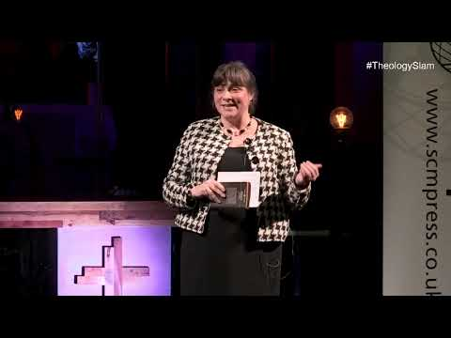

Slide 9
Eve highlights that consumerism constantly pushes us to acquire more and more stuff. What might the consequences be of this attitude? Can you think of impacts at a local, national and global level?
The video dates the birth of consumerism right to the beginning of our Bibles, to the second that Adam and Eve adorned themselves with fig leaves, in order to show who they were, who they belonged to and who they wanted to be. Have you ever thought about this connection before? What are some of the ways that we use stuff to present an identity to the world, and what impact might this be having on us?

Slide 10
In the video, Eve asks the question: ‘How do we ensure that we’re muscular enough spiritually to be able to wean ourselves back onto God, and make sure our desire is focused on God and not on mammon?’ What do you think?
How can we vote for God and not mammon with our bank statements – in the things we purchase and consume, the brands we support?
If you were to audit your bank statement, what kind of colour breakdown do you think it would have? (Remember we’re all on this journey together – so there’s no judgement!)

Slide 12
Photo: Alphonse Mata/Tearfund
Today, half of all plastic is designed to be used just once before being discarded.
And yet some 2 billion people in low- and middle-income countries don’t have access to solid-waste collection.
They have little option but to burn or dump it.

Slide 13
‘To “do justice” means to render to each what each is due. Justice involves harmony, flourishing, and fairness, and it is based on the image of God in every person—the imago Dei—that grants all people inalienable dignity and infinite worth.’
Eugene Cho, Pastor and CEO of the Christian advocacy group Bread for the World.
Photo: Grace Lomas/Tearfund

Slide 14
Watch campaign film

Slide 15
Were you aware of the impact of plastic pollution on people living in poverty?
Now that you’ve heard more about it, how does it make you feel?
Do you find it easy or difficult to locate yourself within this story? Have you ever paused to think where your rubbish or recycling goes after you’ve finished with it? Where do you think “away” is when we throw things away? And what impact might that have?

Slide 16
What actions, if any, have you taken in your own life in response to the injustice of plastic pollution?
What actions might you be inspired to take following our discussion?
What do you think the role of the church should be in resisting consumerism and tackling plastic pollution?

Slide 17
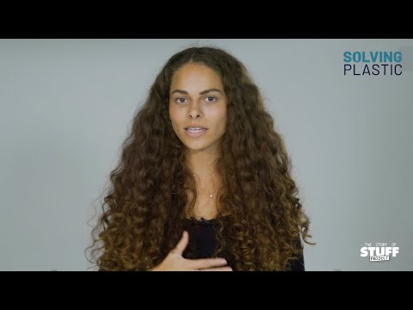

Slide 18
We’ve talked about how change can happen, and some stories of hope where we have seen actions have an impact. How do you feel about taking action in your own life? Whatever the emotion, it's OK – whether that is hope, passion, or detachment or disappointment.
We’ve talked about different types of action we can take to tackle the issue of plastic pollution in our own lives. Are there any of these actions you feel particularly passionate about, or any that you would have reservations about undertaking?

Slide 19
How can we act as encouragers to one another within our communities when we become weary of doing good?
Are there any experiences in your own life, or stories from a group or organisation, where you have been encouraged by seeing change happen?

Slide 20
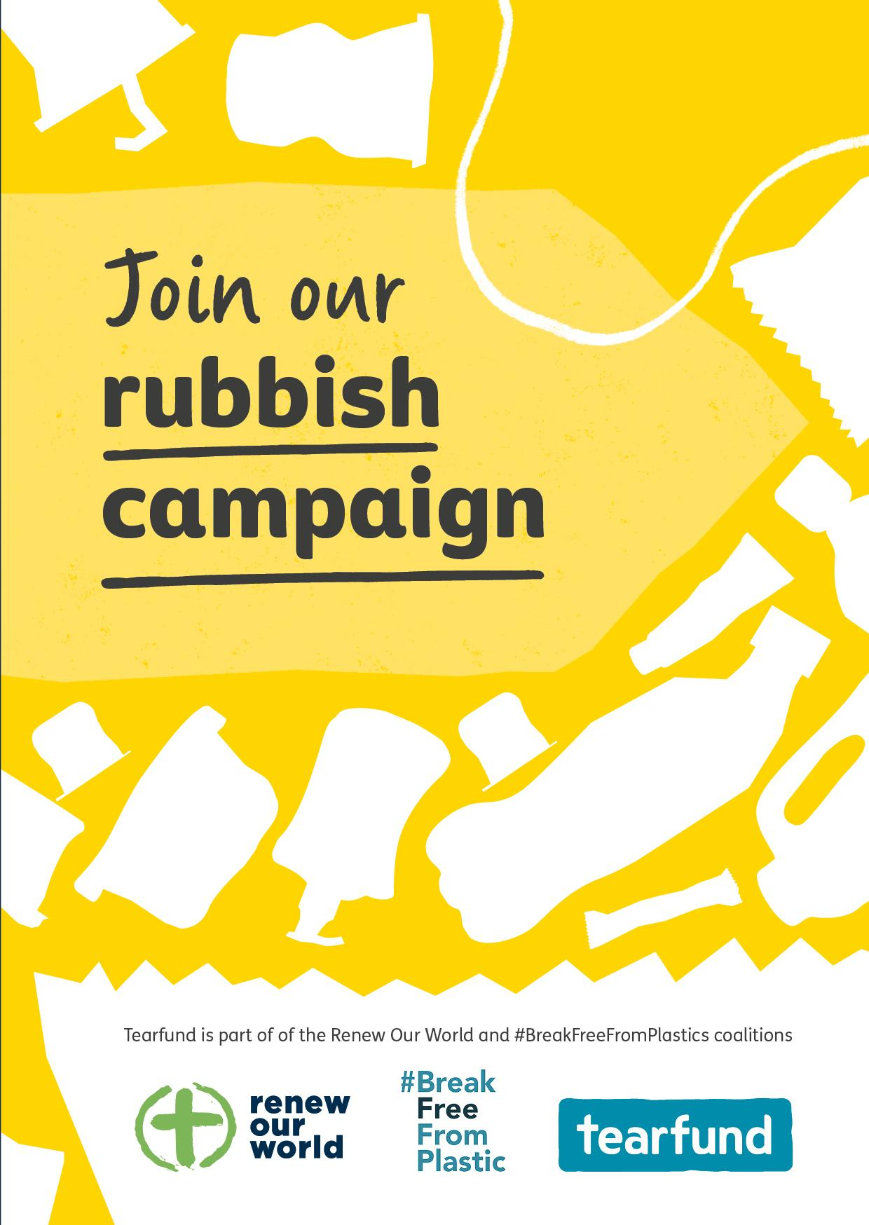
Sign a campaign card and for more, visit tearfund.org/rubbish

Slide 22
Watch Zero Waste Brazil film

Slide 24
Example template slide using a long title over two lines
Bullet points could go here.
Bullet points could go here.
Bullet points could go here.
Bullet points could go here.
Bullet points could go here.

Slide 26
Example template slide
Bullet points could go here.
Bullet points could go here.
Bullet points could go here.
Bullet points could go here.
Bullet points could go here.

Slide 27
Example template slide using a long title over two lines
Bullet points could go here.
Bullet points could go here.
Bullet points could go here.
Bullet points could go here.
Bullet points could go here.

