Slide 1
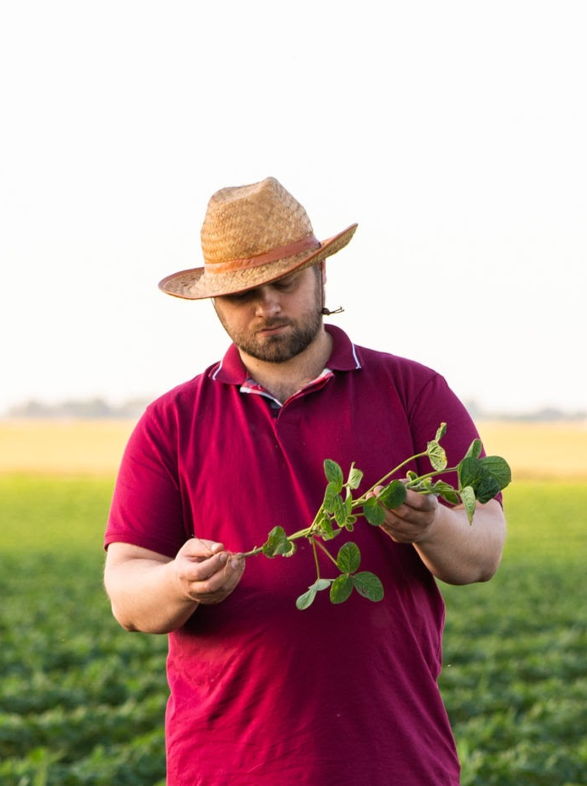
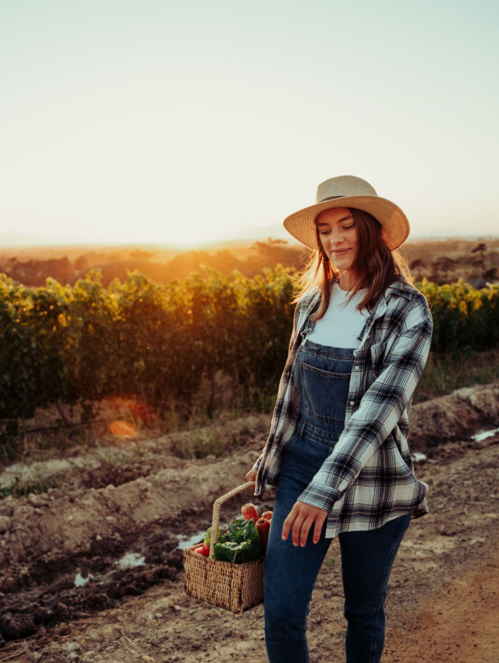
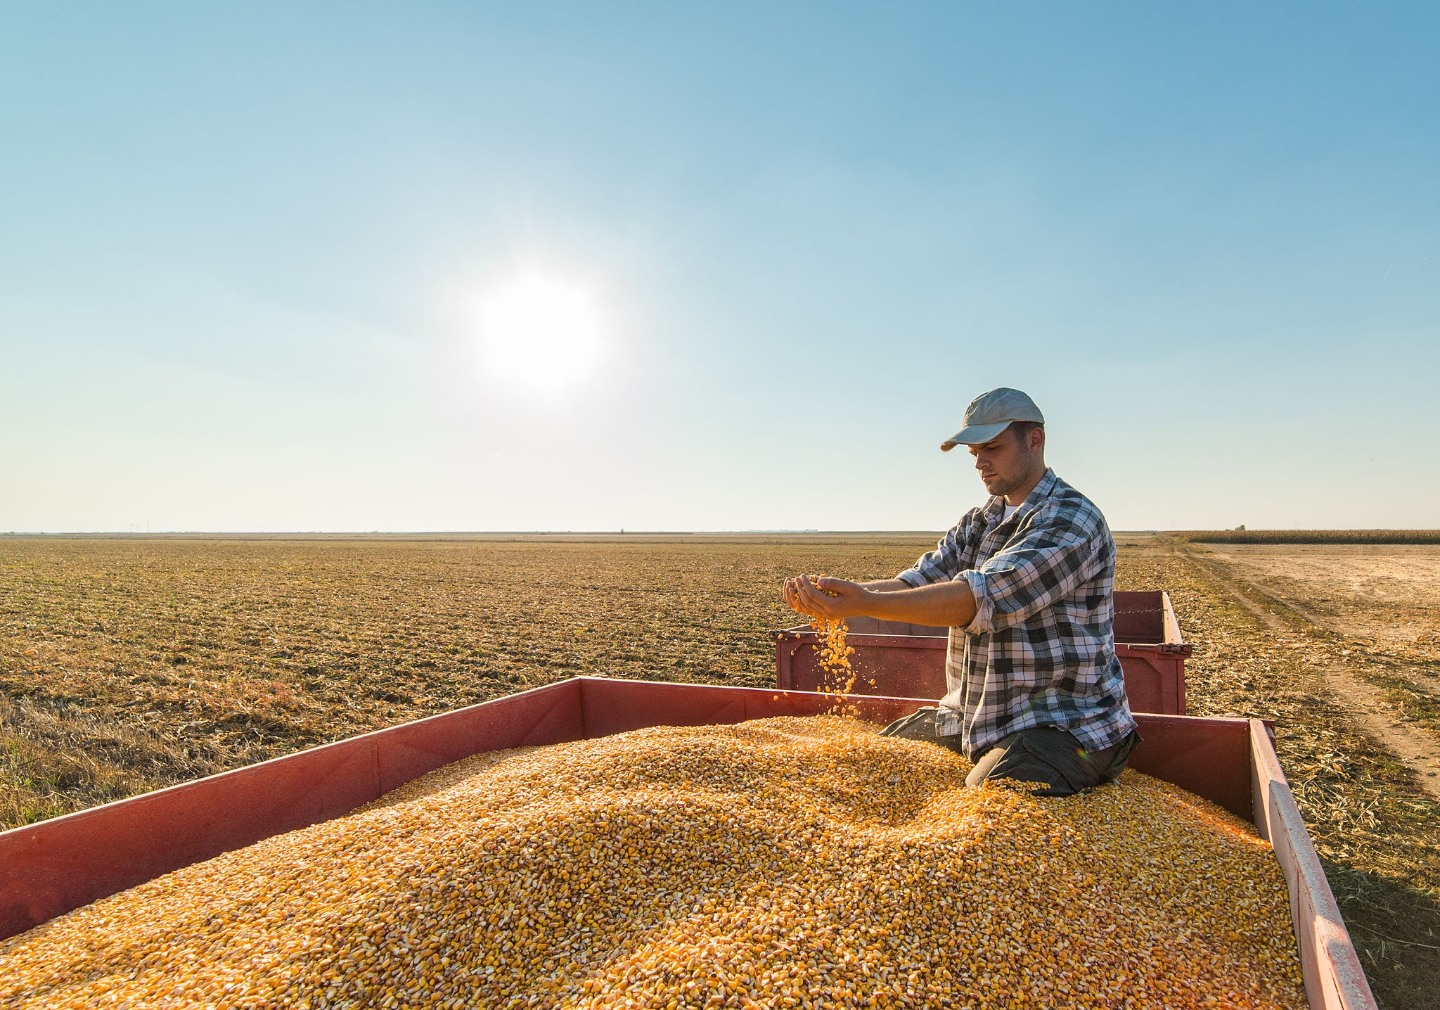
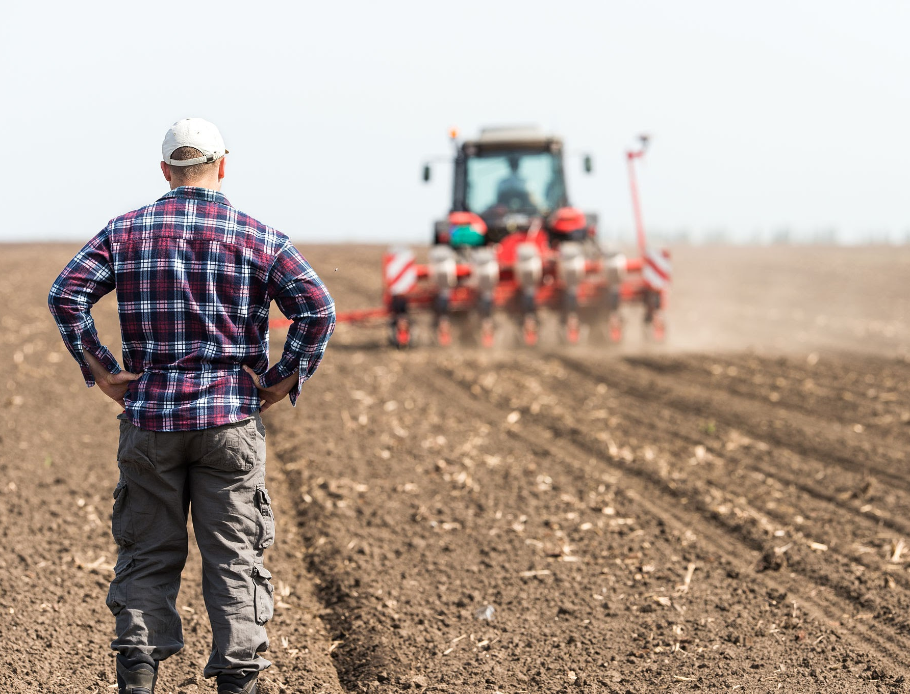
What does a farmer look
like to you?
Notes:
What do you imagine when I ask you to picture a farmer? We might all picture someone different, perhaps a loved one or someone we know.
Perhaps someone one a tractor, dealing with the British weather.
Maybe a man in a hat tending to chickens in a field.
Or maybe you think about a famous farmer like Jeremy Clarkson or the farmer from Shaun the Sheep.

Slide 2
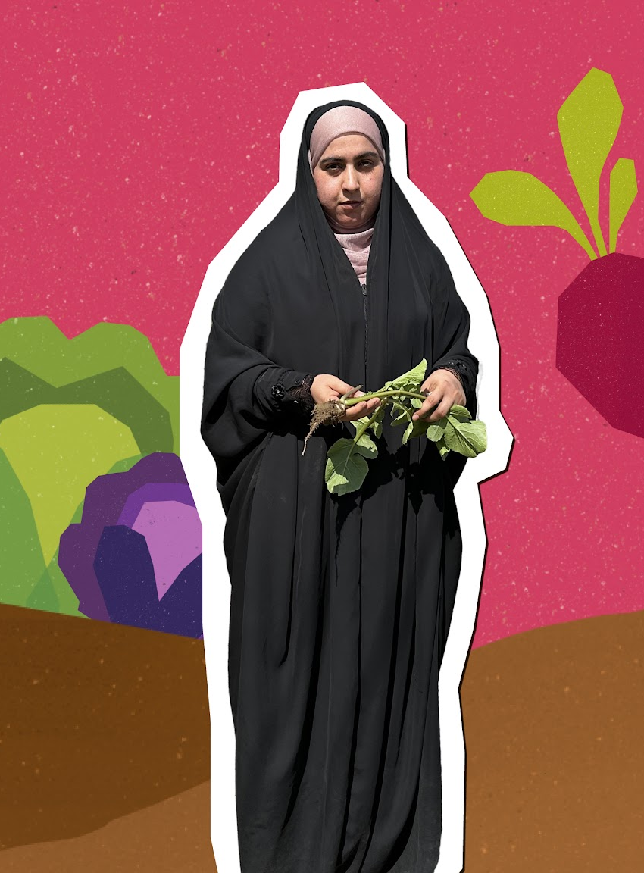
Stand with women farmers
This Harvest, we’re walking alongside women smallholder farmers who often get cropped out of the picture by unfair food systems. Farmers like Afroza, Beli and Zainab (pictured).
So, this Harvest Sunday, join churches across the UK to pause and pray for farmers around the world.
Notes:
But this Harvest, we’re thinking about farmers that usually get cropped out the picture. Over the past two weeks, Tearfund supporters have walked the farm with three amazing women smallholder farmers – Afroza, Beli and Zainab. And this Harvest Sunday, we are joining churches across the UK to pause and pray for farmers around the world.

Slide 3
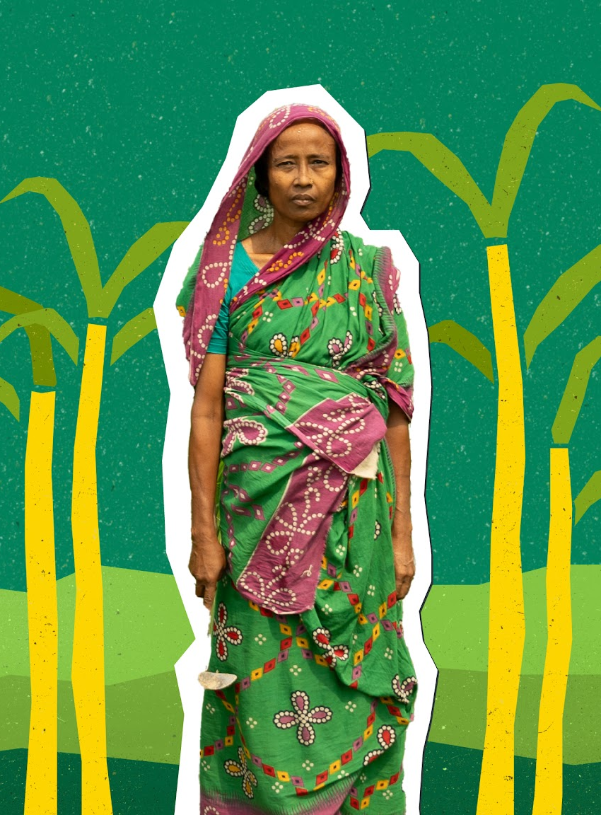
A Harvest
Sunday prayer
Father God,
We come before you with thanks
this Harvest.
Thanks for your blessings, for your provision, for your constant love.
We take a moment now to pause
and be grateful.
Continued…
Notes:
Read the prayer on the screen.

Slide 4
A Harvest
Sunday prayer
God of the harvest,
We think of families near and far who don’t have enough.
In this season, we ask you to sow
the seeds.
Sow seeds of abundant harvests for farmers around the world.
Continued…
Notes:
Read the prayer on the screen.

Slide 5
A Harvest
Sunday prayer
Sow seeds of change for the policies and systems that stop them from flourishing.
Sow seeds of determination in us to see fairness restored to our food systems through our prayers and actions.
And sow seeds of obedience in us to follow where Jesus’ love leads.
Amen.
Notes:
Read the prayer on the screen.

Slide 6
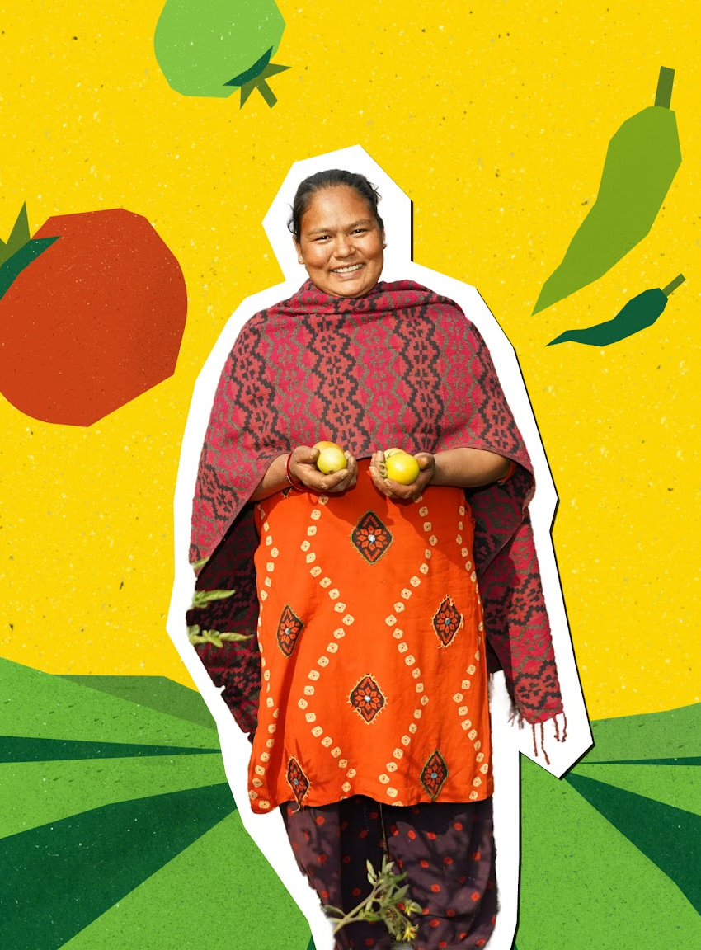
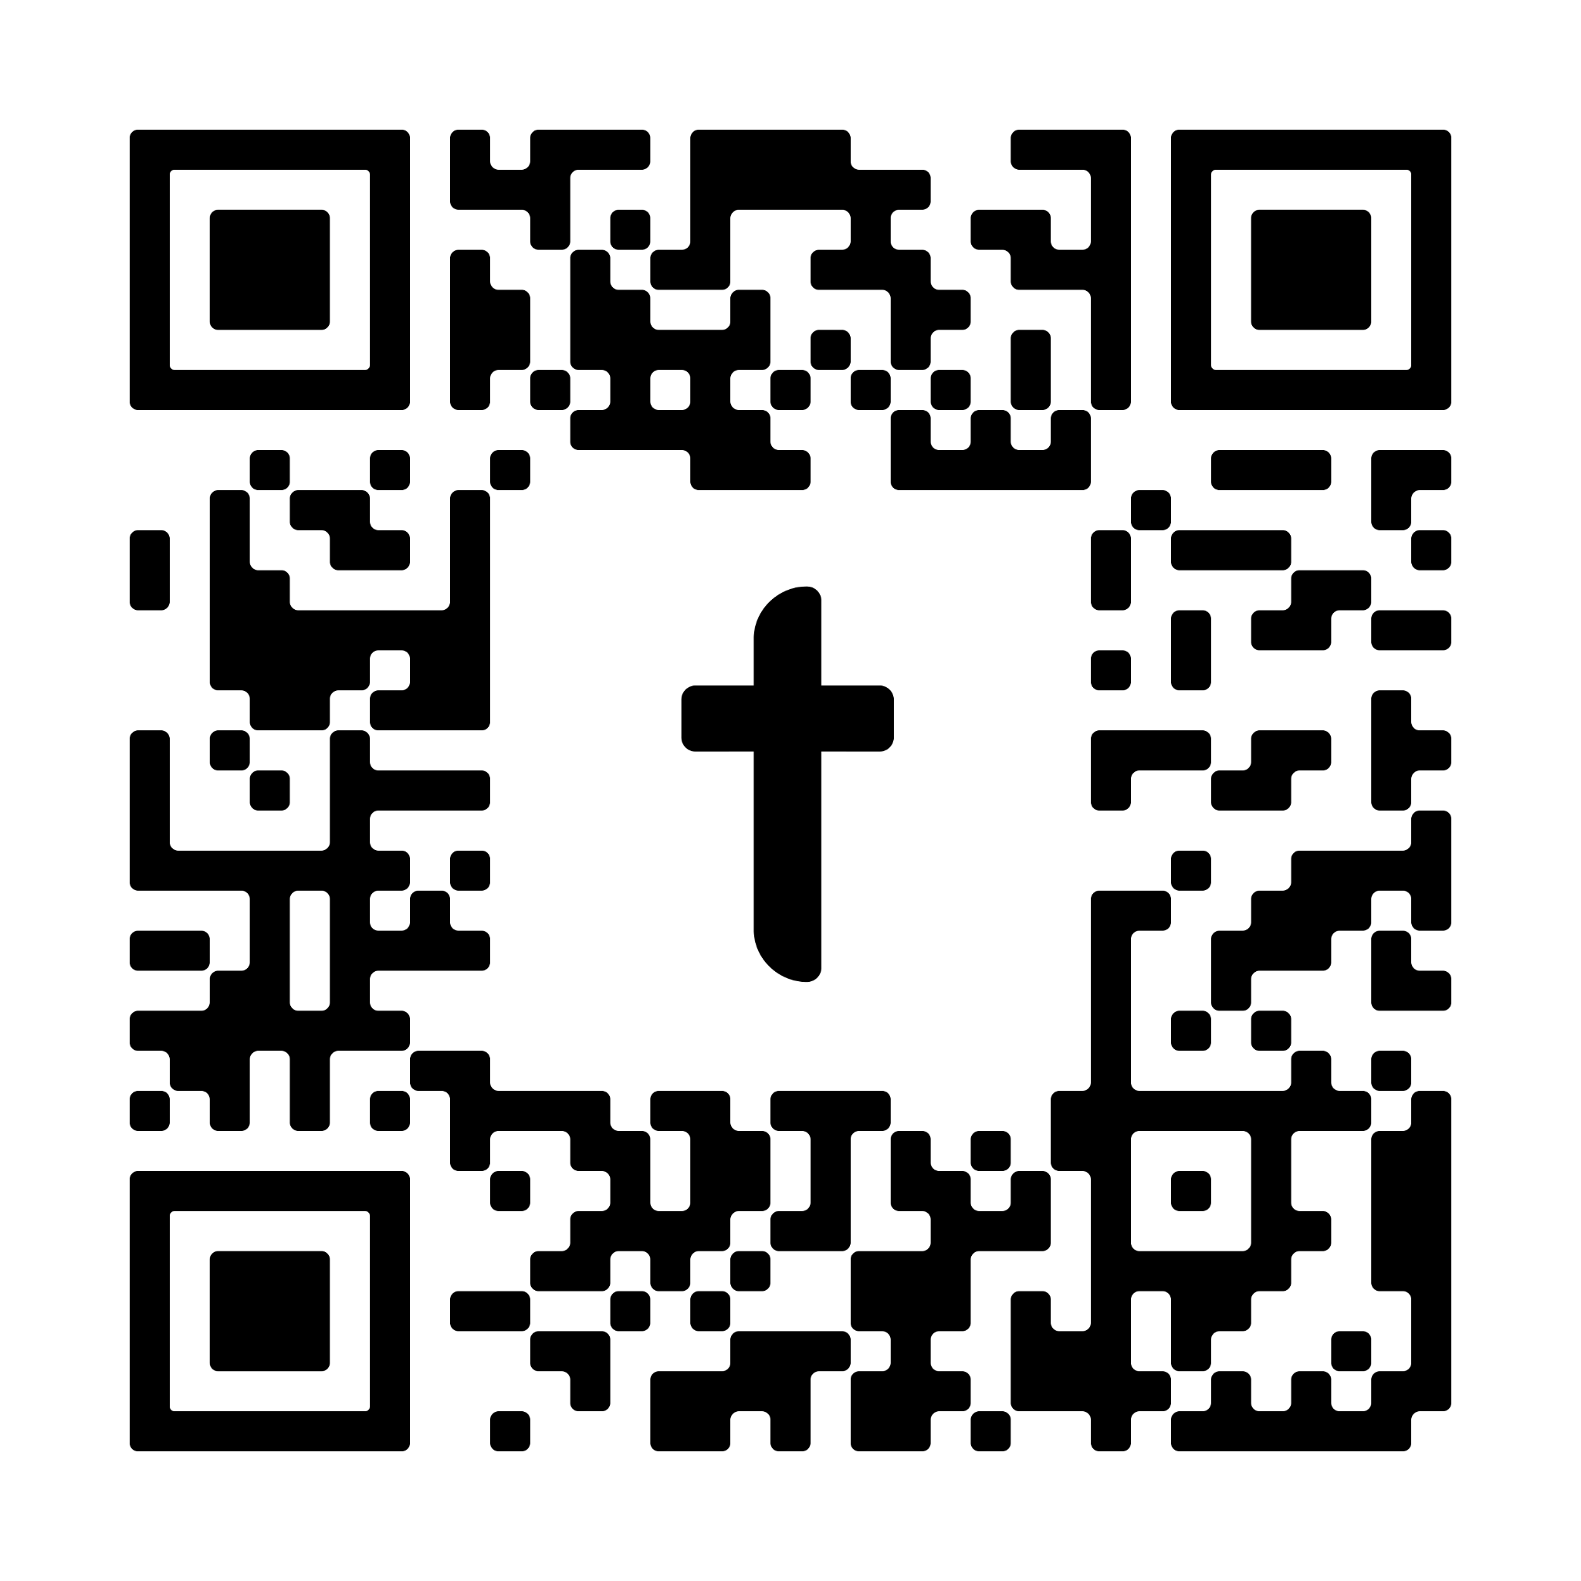
Don’t let Beli be cropped out.
Women smallholder farmers like Beli (pictured) grow 60 to 80% of food in lower income countries, yet are the most exposed to climate shocks and food insecurity.
Don't let them be cropped out of the picture. Find out more today by scanning the QR code or going to tearfund.org/farmer

