Slide 1
Prayer walk guide
Praying about global poverty

Slide 2
What is a prayer walk?
A prayer walk is simply spending some time praying and talking to God as you go on a walk. Getting outside and going for a walk can give you a new perspective, and the things you come across during your walk can also prompt and guide your prayers.
Be flexible: There is no set way to do a prayer walk. You could go on a walk with friends and pray together, or you may prefer to pray alone. You could take a familiar route or explore somewhere new. Do whatever works best for you.
Praying as a group: If you are in a group, you could split off into smaller groups to do different activities, or you can go through each of the five activities together. Use the guide as a starting point for further discussion and prayer. Please note: if you are doing this as a church, you may need to carry out a risk assessment.
What will I need?
There are some optional activities throughout this prayer walk guide and the following items may be useful:
A notebook and pen
A camera or camera phone
Something you can listen to music on
Suitable clothing!

Slide 3
Your prayers make a difference
‘Defend the weak and the fatherless;
uphold the cause of the poor and the oppressed.’ (Psalm 82:3)
Praying for an end to extreme poverty can seem like a daunting task. You may feel overwhelmed or unsure where to begin. But your prayers can truly make a difference in the lives of people around the world (James 5:16).
Throughout scripture, God repeatedly asks his people to care for and stand up for those in need. Praying is one way that we can ‘uphold the cause of the poor and the oppressed’ (Psalm 82:3). And when you start a conversation with God about the issue of global poverty, he can start to guide your prayers and highlight specific issues to you.
Your prayers make a difference as Tearfund and our partners go into challenging situations to support some of the most vulnerable communities around the world. Not everyone can go to these places in the world, but everyone can play a part through prayer.
This prayer walk guide has five prayer stops which explore some of the root causes of poverty, such as the climate crisis and conflict, as well as looking at the ways in which poverty impacts people and how they can be empowered. Thank you for joining us in praying for people living in poverty.

Slide 4
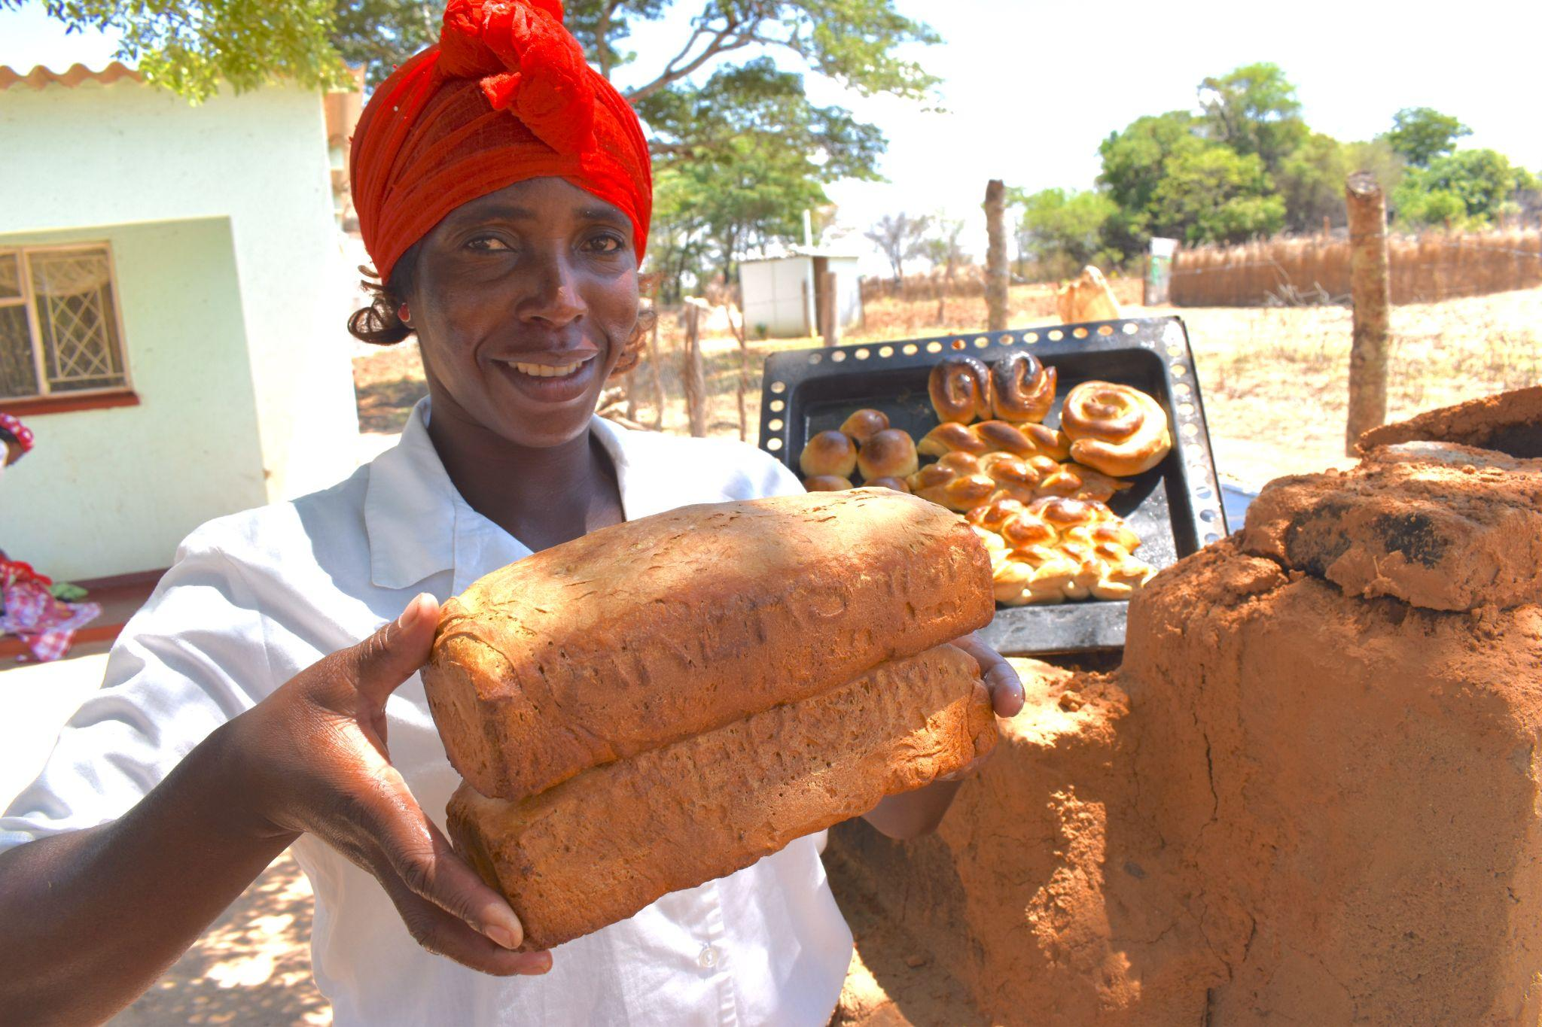
Praying for community transformation
When people come together to support one another and pursue common goals, we see them thrive. Idah is a perfect example of this in action. Read her story and be inspired.
Idah’s story
Idah always had a dream to start her own bakery, but never had the resources to make it happen.
During the coronavirus pandemic, the usual traders stopped coming to Idah’s village in Zimbabwe and there was a widespread shortage of bread. Idah approached her self-help group, run by Tearfund’s local church partner, and they were able to give her a small loan and support her to set up a bakery.
Soon, Idah was baking bread for the whole neighbourhood. ‘Most of the men here are not employed and with the lockdown it was difficult for them to find small jobs, so the little money we earned helped,’ says Idah. ‘The dream is to pass on the bakery from one generation to the next.’
Thank God for Idah and her bakery and pray that it will continue to thrive. Ask God to reveal how your own skills and passions can be used to help others.
Idah with her baked goods. Photo: Stewart Muchapera/Tearfund.

Slide 5
Praying for refugees
What happens when communities are torn apart by violence? Conflict has forced millions of people from their homes and into poverty. They will often spend years in crowded camps, with limited resources.
Look around you as you walk, notice the things you can see around you (eg houses/shops/fields). Imagine what life would be like if those things were suddenly taken away.
Thank God for the things you have noticed around you. Thank him for something specific that you may see or experience every day but usually take for granted.
Pray for refugees who have been forced to leave behind their homes and communities and now have very limited resources. Allow your observations of your surroundings to guide your prayers.

Slide 6
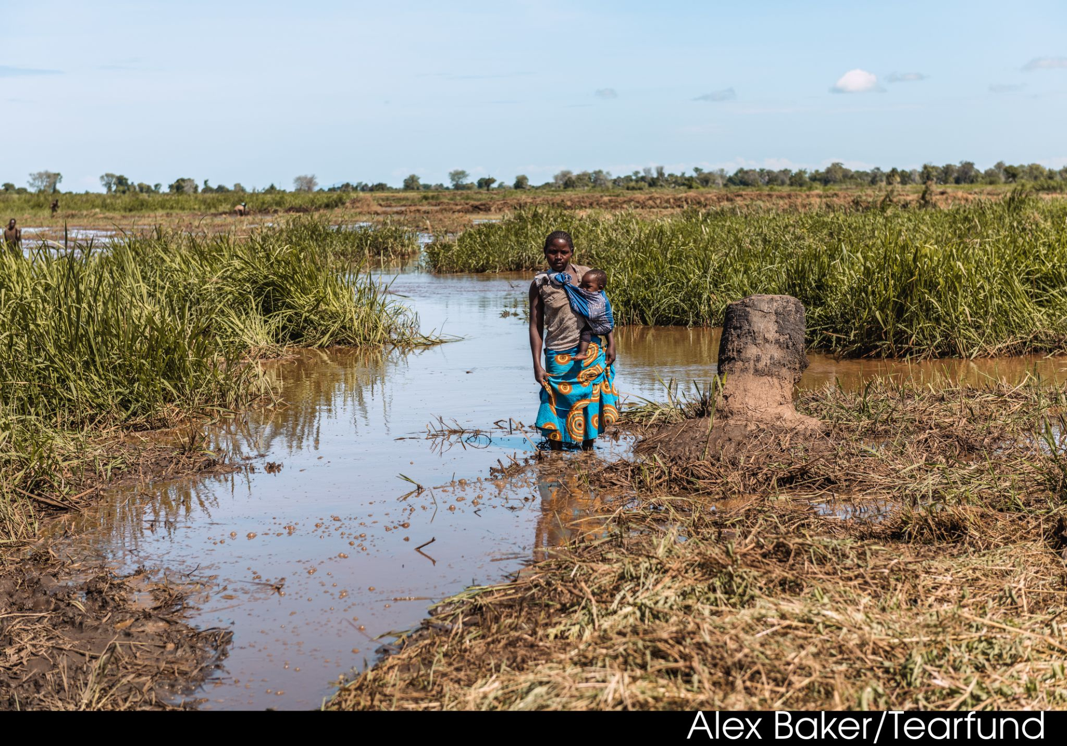
Praying for the climate crisis
The climate crisis is pushing people further into poverty. Changing weather patterns are making it harder to grow food, and extreme weather events are destroying communities and forcing people from their homes.
Stop and spend some time enjoying the nature around you. If you brought a camera with you, try to find something new or unusual to capture.
Praise God for his wonderful creation. If you can, listen to a worship song as you do this.
Lament for the ways in which we have destroyed and damaged our world instead of protecting it, and the impact that is having on some of the world’s poorest people.
Pray for people who are suffering due to the effects of the climate crisis.
Ask God what you can do to make a difference.
Photo: Alex Baker/Tearfund

Slide 7
Praying for children
When children grow up in poverty, they often have limited access to education, nutritious food and healthcare. This leaves them extremely vulnerable to disease and exploitation such as child labour or forced marriage.
Join us in praying this prayer for children. Maybe read it through several times, or speak it out loud:
Lord, we lift up children around the world who are growing up in poverty. We pray that you will protect them and provide for their needs.
Lord, hear our prayer.
We lift up children who have been traumatised by violence. We pray that they will know your comfort, and receive the emotional support they need to heal.
Lord, hear our prayer.
We ask that children will have safe spaces to play and enjoy their childhoods.
Lord, hear our prayer.
We pray that all children will have opportunities to access education and break the cycle of poverty.
In Jesus’ name we pray, amen.

Slide 8
A time to reflect
Find a quiet place to sit down and reflect on all you have seen and prayed for during your prayer walk.
Reflect: What impacted you the most? What did God reveal to you? What do you want to commit to praying for on a regular basis? What actions have you been prompted to take?
Journal: If you have a notebook with you, write down your thoughts and prayers in response to these questions. If you are in a group, you can discuss these questions together.
Pray: Spend some time praying as the Holy Spirit leads you.
Photo: Unsplash

