Slide 1
Praying for the global church

Slide 2
What is a prayer room?
A prayer room is a space in your church (or other building) that’s dedicated to helping and inspiring people to pray. It will normally feature a number of prayer ‘stations’, each with a different prayer prompt or activity.
Some churches choose to have their prayer rooms open 24/7, others on specific days/times. Prayer rooms can be open for anyone to use when they like, or you can implement a booking system, where people can book a hour slot to have the room to themselves.
You can tailor your prayer room to whatever you feel will best suit your church or group.
Everyone has their own preferred style of prayer. Prayer rooms enable people to pray however they like: whether through writing, drawing/painting, praying out loud, or simply sitting in silence.

Slide 3
Praying for the global church
‘And pray in the Spirit on all occasions with all kinds of prayers and requests. With this in mind, be alert and always keep on praying for all the Lord’s people.’ (Ephesians 6:18)
We are not members of ‘a’ church, we are members of ‘the’ church: we are part of a global body of believers – united in Christ. But the experiences of people in different churches around the world can be radically different from our own. The diversity of the global church can make it hard to know where or how to start in praying for it.
This prayer room will help you to focus your prayers on specific issues faced by churches around the world, and inspire you to think beyond your local borders.
There are six ideas for prayer stations, which you can either print off to put in your prayer room or use as inspiration for your own ideas. You can use all of these, mix and match, or come up with your own!

Slide 4
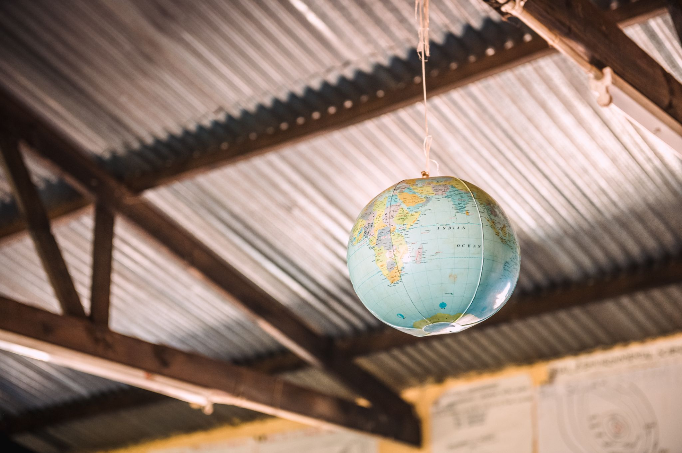
Station one: prayer map
This station will help you pray for churches in specific countries around the world. You will need a map or a globe.
Place your hands on the map/globe, take some deep breaths, and ask God to place a particular country on your heart.
Once you have chosen a country, pray the following three things over the church there:
Multiplication. Pray that the gospel will spread in that nation, and that church numbers will grow.
Leadership. Lift up church leaders in that nation, and pray for wisdom, courage and compassion for them.
Strength and protection. Pray for protection upon the church and its members in that nation; pray for comfort and strength for any trials that they might be going through.
Photo credit: Alex Baker/Tearfund

Slide 5
Station two: praying for churches around the world
The church is called to share God’s love and hope in tangible ways. At Tearfund, we partner with local churches around the world as they provide practical and spiritual support to people in need. Read this liturgy out loud three times to thank God for the global church. Then, write your own prayer of thanksgiving for churches.
God of love,
We thank you for your church.
We thank you for all the ways that local churches serve their communities and offer the hope of Christ, particularly during challenging times.
Lord, bless your church.
God of comfort,
We pray for church leaders, staff and volunteers who are giving so much of themselves to the needs of their communities.
Bring your peace, your comfort and your strength.
Lord, bless your church.
God of hope,
There is so much uncertainty about the future.
We pray that, whatever circumstances they face, local churches will continue to be salt and light to the world.
Lord, bless your church.

Slide 6
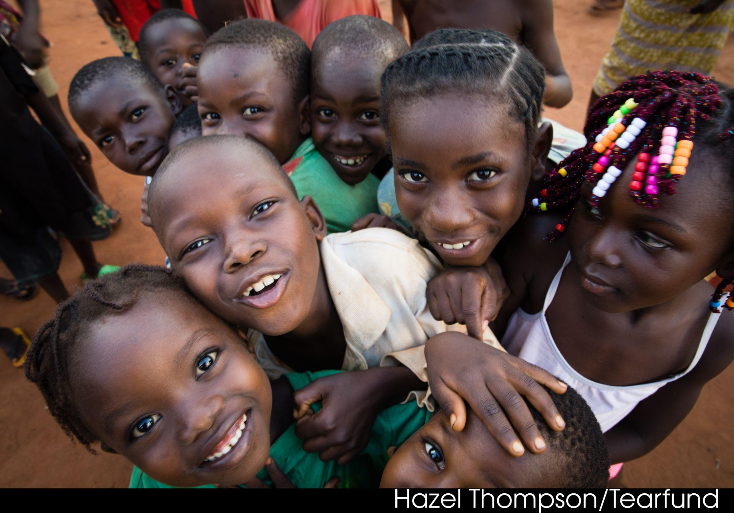
Station three: peacebuilding
Churches have a vital role to play in helping bring peace to communities and to whole nations. This can be crucial around elections when tensions are high and there is a risk of violence.
You will need post-it notes for this station, and a space where you can stick them (eg a wall or whiteboard).
Ask God to highlight a country to you. Write this down on a post-it note. As you do this declare Matthew 5:9 over it and stick it on the wall or whiteboard.
Ask God to highlight a conflict to you. Follow the above steps again.
Declare Matthew 5:9 over some of the other post-it notes already there.
‘Blessed are the peacemakers, for they will be called children of God.’ (Matthew 5:9)

Slide 7
Station four: churches transforming communities
Tearfund believes that working through local churches is the best way to transform communities. The following story is a great example of why that is the case. Read through the story and be inspired.
In Indonesia, when lockdown restrictions were imposed in Pastor Astin’s village to help stop the spread of coronavirus, she knew the needs of her community had changed. So, she adapted the support that her church offered to help those in need. Pastor Astin started cultivating land so that she could grow vegetables to feed the community. She planted shallots, chillies, corn, tomatoes and cassava. Tearfund’s local partner donated seeds to help bring this to fruition.
‘Everyone benefited greatly [from this] during the coronavirus pandemic, because we cannot leave the village, so this harvest is very helpful for the needs of the congregation,’ Pastor Astin says. She has been helping to keep communal areas in the village clean by spraying disinfectant. She’s also signed up to lead support sessions that Rebana runs to help vulnerable and marginalised groups in the community. Through this, she is able to offer emotional and spiritual support to people who feel outcast and lonely.
‘Preaching does not always have to be in the pulpit, but doing an action is a living sermon,’ Pastor Astin shares.
Pray for all those whose actions are a living sermon. And pray for God to inspire you to take an action – big or small – to make a difference to the people around you.

Slide 8
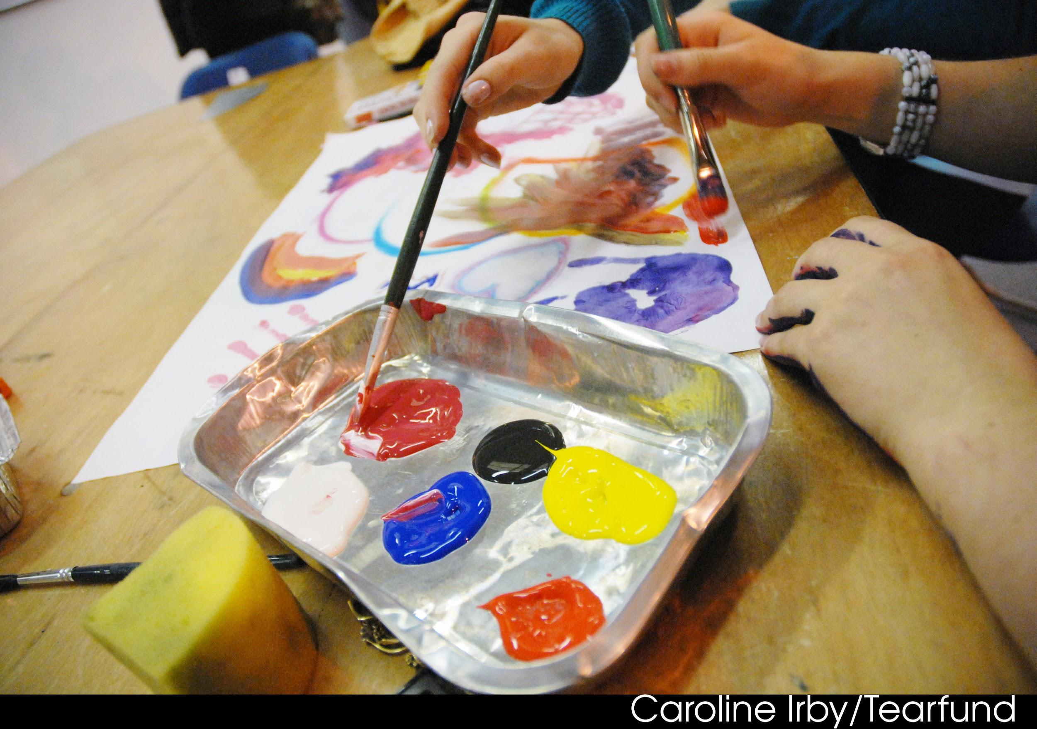
Station five: drawing and painting
Creative arts can be a brilliant way of expressing ourselves in prayer.
Have plenty of blank paper, pens and, if possible, painting equipment ready to use.
Spend some time reflecting prayerfully on what comes to mind when you think of ‘the global church’.
Ask the Holy Spirit to help you draw or paint an interpretation of whatever your response is.

Slide 9
Station six: imaginative writing
The following is based on an Ignatian spiritual practice that helps us to pray by engaging creatively with a particular Bible passage.
Read the account of Pentecost (Acts 2:1-13). Read through it a few times so that the the details of the story become familiar.
Close your eyes and reconstruct the scene in your imagination. Imagine what is going on in the story. What did the people look like? How does everyone react? What are the people saying to one another? What emotions fill their words?
Then, imagine yourself in the scene. Perhaps you are one of the disciples, or one of the crowd outside. Play out the story in your imagination.
As it comes to you, write the story down.
When finished, spend a little time talking with God about the experience and what was being said to you through it.

