Slide 1
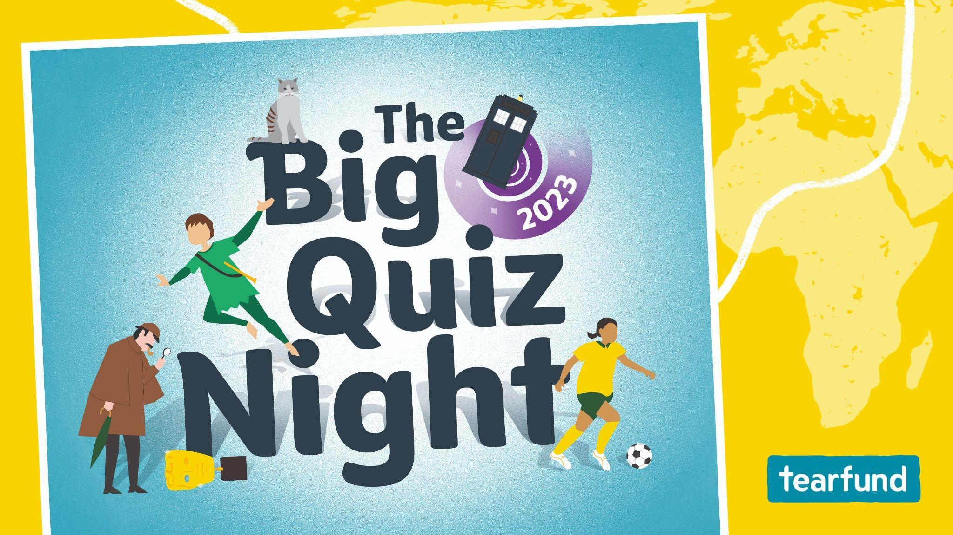

Slide 2
1. Who was named BBC Sports Personality of the Year in 2022? A: Beth Mead B: Eve Muirhead C: Jessica Gadirova
2. In July last year, the UK hit its highest record temperature ever. What was it? A: 38.3 degrees B: 40.3 degrees C: 42.3 degrees
3. Amy Broadhurst won a gold medal in the Women's World Boxing Championships in May 2022. What country is she from?
4. Rwandan-Scottish actor Ncuti Gatwa was announced as the new lead character in which long-running science-fiction series?
5. Which Welsh town became a city in September 2022?
6. Which veteran pop singer released his first dedicated Christmas album in almost two decades last year?

Slide 3
1. Which British artist is known for an exhibit featuring a shark preserved in formaldehyde?
2. Which American playwright wrote the stage plays A Streetcar Named Desire and Cat on a Hot Tin Roof?
3. Which west African country was novelist Chinua Achebe born in?
4. Wilbur is the name of the pig in which children’s book by E. B. White?
5. Which British-Australian comedian, actor, writer and musician wrote the original songs for Matilda the Musical?
6. Which Italian Renaissance artist and inventor created the mural The Last Supper?

Slide 4
1. What name links a famous painting in the Louvre with Elvis Presley’s daughter?
2. What geographical feature links the location of Tutankhamun’s tomb with one of the hottest place on earth?
3. What name is shared by the first person to fly solo across the Atlantic Ocean and Professor Xavier from the X-Men?
4. What word links the lyrics of the song Bohemian Rhapsody with the person who discovered the four largest moons of Jupiter?
5. What name links the first female prime minister of India with another famous leader from that country?
6. What year links the Watergate scandal with the name of a hit song by James Blunt?

Slide 5
1. Humans only use 10 per cent of their brains – fact or fiction?
2. Turkey meat is high in tryptophan, and so causes more drowsiness after eating than other meats – fact or fiction?
3. Sharks can smell a drop of blood a mile away – fact or fiction?
4. Seeds are the spiciest part of chilli peppers – fact or fiction?
5. Camels store water in their humps – fact or fiction?
6. Bats are blind – fact or fiction?

Slide 6
1. Which south-east African country has a flag depicting a rifle to represent defence and vigilance?
2. The majority of the flags at the London 2012 Olympics were made in which other western European country? A: Belgium B: France C: Germany
3. Only two national flags are square. One is Vatican City’s, the other belongs to which western European country?
4. An eagle with a snake features on the flag of which country in the southern portion of North America?
5. Which country in the Mediterranean Sea features the map of the island with two olive branches underneath?
6. Which way does the dragon face on the Welsh flag?

Slide 7
1. What is the most popular dog breed in the UK?
2. How long do cats sleep on average during the day? A: 10 hours B: 15 hours C: 17 hours
3. What was the name of the dog that was famous for spending 14 years guarding the grave of his owner in Edinburgh?
4. What country has the largest population of cats?
5. What is a group of kittens called? A: Kindle B: Kitties C: Catkins
6. What is the name of the cat who has served as Chief Mouser to the Cabinet Office at 10 Downing Street since 2011?

Slide 8
1. What warm night-time drink is made from malt, milk and eggs, flavoured with cocoa?
2. What type of beans are baked beans?
3. HP sauce is named after which famous London landmark?
4. A flowering plant in the daisy family is used to make what kind of tea?
5. Tonic water contains quinine, which can be used as a treatment for babesiosis and what other disease?
6. Which London department store claims to have invented the Scotch egg? A: Fortnum & Mason B: Harrods C: Selfridges

Slide 9
1. If you were to add up the number of starting players from a rugby union, rugby league and rugby sevens team, how many would there be? A: 35 B: 37 C: 30 D: 40
2. ‘Gridiron’ is a term that refers to which sport? A: American football B: Ice hockey C: Badminton D: Croquet
3. Which of the following sports is not considered one of the ‘Gaelic games’? A: Gaelic football B: Hurling C: Rounders D: Dodgeball

Slide 10
4. The first football World Cup was held in 1930. Who won it? A: USA B: England C: Japan D: Uruguay
5. Which of the following sports personalities has not been made a knight or dame? A: Andy Murray B: Kelly Holmes C: Rory McIlroy D: Jessica Ennis-Hill
6. Which of these sports was not held at both the ancient and modern Olympic Games?
A: Boxing B: Swimming C: Discus throwing D: Pentathlon

Slide 11
This slide is for your own bonus round. There are some fun ideas on page 5 of your Quizmaster Pack to get you started. (Delete this note before using this slide.)
1. Add question here…
2. Add question here…
3. Add question here…
4. Add question here…
5. Add question here…
6. Add question here…

Slide 12
1. Which pop star performed a virtual concert on Fortnite in 2022? A: Taylor Swift B: Ariana Grande C: Tones and I
2. In the 2021 computer-animated film Encanto, who is the person one of the songs states that ‘we don’t talk about’?
3. What is the name of a pyramid-shaped speed cube?
4. In Minecraft, what are Creepers scared of? A: The dark B: Spiders C: Ocelots
5. What is the name of the 2022 album by Harry Styles?
6. What are the popular plush toys that are named partly after a type of soft sweet called?

Slide 13
7. Diper Överlöde is the 17th book in which series by author Jeff Kinney?
8. Which CBBC television series is presented by twin brothers Dr Chris and Dr Xand, and (unrelated) Dr Ronx?
9. Complete the next three words from the lyrics to this D Billions song: ‘My name is Chicky…?’
10. What is the name of the live-action comedy film released last year on Disney+ that is a sequel to the 2007 film Enchanted?

Slide 14
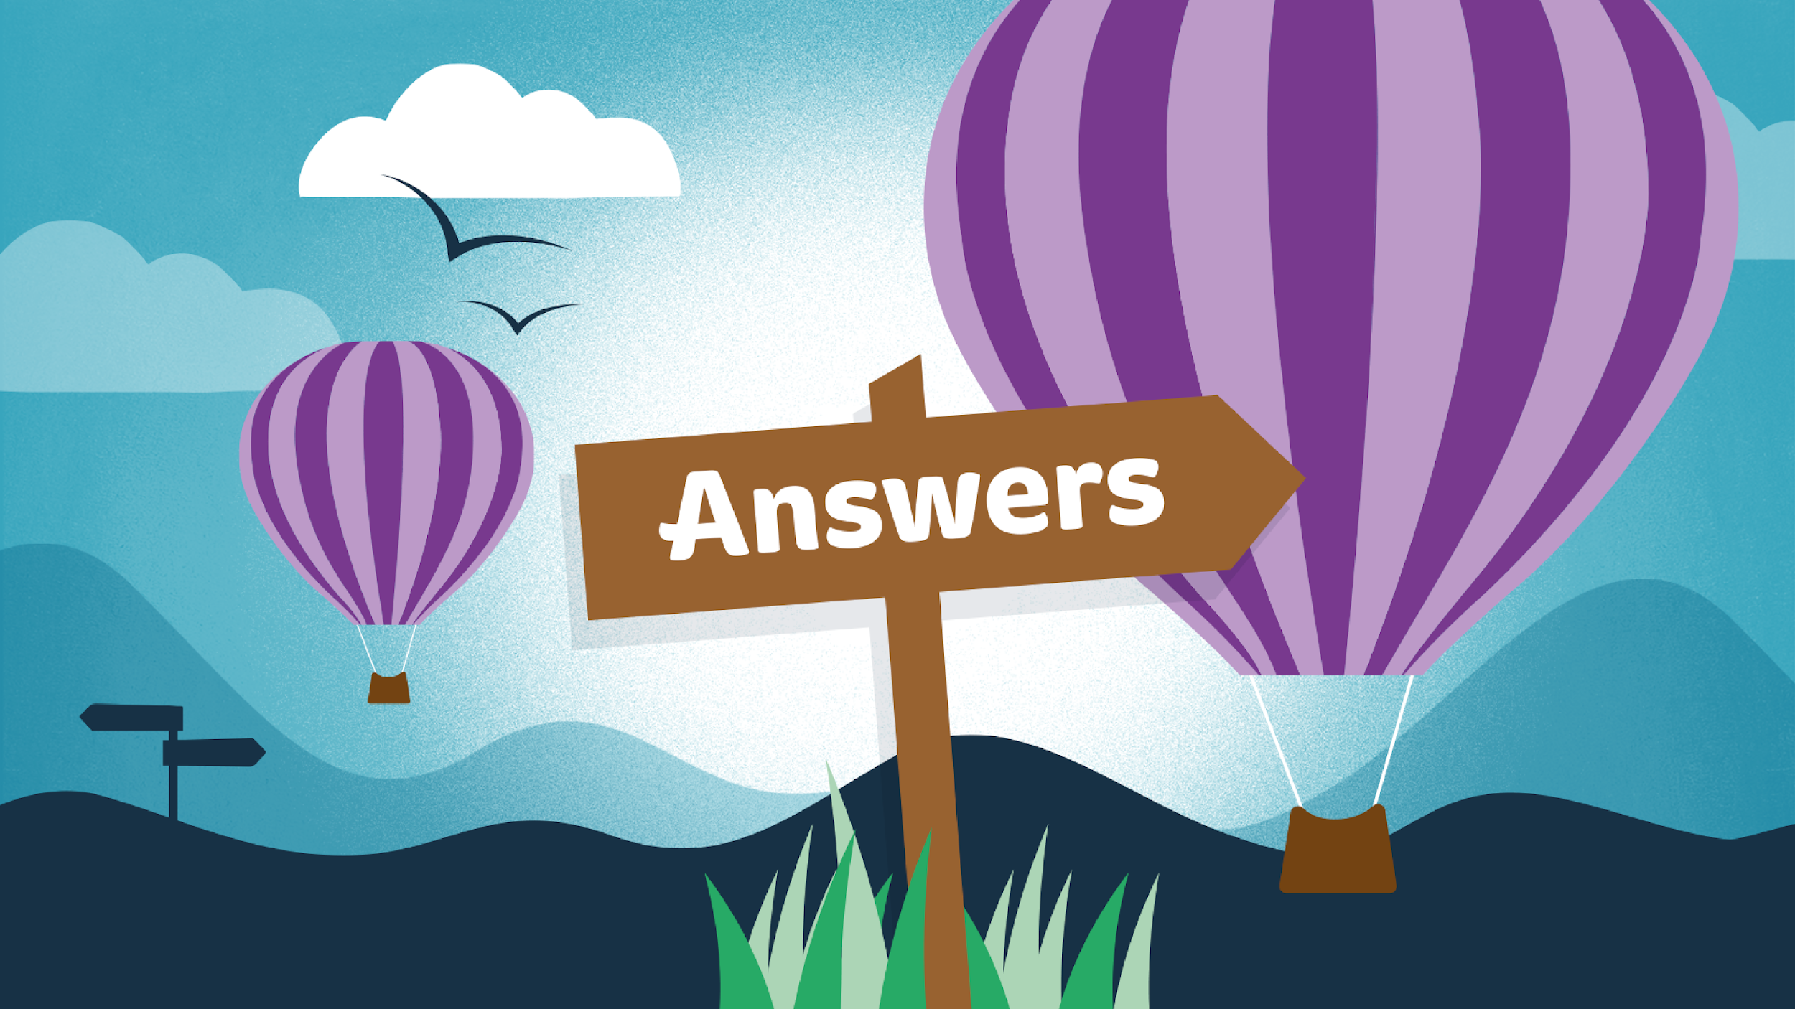

Slide 15
IMPORTANT Note: Please do not delete anything from the answer pages. Questions and answers both appear on the slide but when viewed as a slideshow they are animated to appear with each click. (Delete this note before using this slide.)
1. Who was named BBC Sports Personality of the Year in 2022? A: Beth Mead B: Eve Muirhead C: Jessica Gadirova
A: Beth Mead
2. In July last year, the UK hit its highest record temperature ever. What was it? A: 38.3 degrees B: 40.3 degrees C: 42.3 degrees
C: 40.3 degrees
3. Amy Broadhurst won a gold medal in the Women's World Boxing Championships in May 2022. What country is she from?
Ireland
Doctor Who
4. Rwandan-Scottish actor Ncuti Gatwa was announced as the new lead character in which long-running science-fiction series?
Wrexham
5. Which Welsh town became a city in September 2022?
6. Which veteran pop singer released his first dedicated Christmas album in almost two decades last year?
Sir Cliff Richard

Slide 16
1. Which British artist is known for an exhibit featuring a shark preserved in formaldehyde?
Damian Hirst
Tennessee Williams
2. Which American playwright wrote the stage plays A Streetcar Named Desire and Cat on a Hot Tin Roof?
3. Which west African country was novelist Chinua Achebe born in?
Nigeria
4. Wilbur is the name of the pig in which children’s book by E. B. White?
Charlotte’s Web
Tim Minchin
5. Which British-Australian comedian, actor, writer and musician wrote the original songs for Matilda the Musical?
Leonardo da Vinci
6. Which Italian Renaissance artist and inventor created the mural The Last Supper?

Slide 17
Lisa (Mona Lisa and Lisa Marie Presley)
1. What name links a famous painting in the Louvre with Elvis Presley’s daughter?
Valley (Valley of the Kings and Death Valley)
2. What geographical feature links the location of Tutankhamun’s tomb with one of the hottest place on earth?
Charles (Charles Lindbergh and Charles Xavier)
3. What name is shared by the first person to fly solo across the Atlantic Ocean and Professor Xavier from the X-Men?
Galileo (‘Gallileo Figaro, magnifico’ and Galileo Galilei)
4. What word links the lyrics of the song Bohemian Rhapsody with the person who discovered the four largest moons of Jupiter?
Gandhi (Mahātmā Gandhi and Indira Gandhi)
5. What name links the first female prime minister of India with another famous leader from that country?
1973
6. What year links the Watergate scandal with the name of a hit song by James Blunt?

Slide 18
Fiction
1. Humans only use 10 per cent of their brains
2. Turkey meat is high in tryptophan, and so causes more drowsiness after eating than other meats
Fiction
Fact
3. Sharks can smell a drop of blood a mile away
Fiction
4. Seeds are the spiciest part of chilli peppers
Fiction
5. Camels store water in their humps
Fiction
6. Bats are blind

Slide 19
1. Which south-east African country has a flag depicting a rifle to represent defence and vigilance?
Mozambique
2. The majority of the flags at the London 2012 Olympics were made in which other western European country? A: Belgium B: France C: Germany
B: France
Switzerland
3. Only two national flags are square. One is Vatican City’s, the other belongs to which western European country?
4. An eagle with a snake features on the flag of which country in the southern portion of North America?
Mexico
5. Which landlocked country in the Mediterranean Sea features the map of the island with two olive branches underneath?
Cyprus
Left
6. Which way does the dragon face on the Welsh flag?

Slide 20
Labrador (Retriever)
1. What is the most popular dog breed in the UK?
C: 17 hours
2. How long do cats sleep on average during the day? A: 10 hours B: 15 hours C: 17 hours
3. What was the name of the dog that was famous for spending 14 years guarding the grave of his owner in Edinburgh?
Greyfriars Bobby
United States of America
4. What country has the largest population of cats?
A: Kindle
5. What is a group of kittens called? A: Kindle B: Kitties C: Catkins
Larry
6. What is the name of the cat who has served as Chief Mouser to the Cabinet Office at 10 Downing Street since 2011?

Slide 21
1. What warm night-time drink is made from malt, milk and eggs, flavoured with cocoa?
Ovaltine
Haricot
2. What type of beans are baked beans?
3. HP sauce is named after which famous London landmark?
Houses of Parliament
4. A flowering plant in the daisy family is used to make what kind of tea?
Chamomile
5. Tonic water contains quinine, which can be used as a treatment for babesiosis and what other disease?
Malaria
6. Which London department store claims to have invented the Scotch egg? A: Fortnum & Mason B: Harrods C: Selfridges
A: Fortnum & Mason

Slide 22
1. If you were to add up the number of starting players from a rugby union, rugby league and rugby sevens team, how many would there be? A: 35 B: 37 C: 30 D: 40
A: 35 (15 + 13 + 7)
A: American football
2. ‘Gridiron’ is a term that refers to which sport? A: American football B: Ice hockey C: Badminton D: Croquet
3. Which of the following sports is not considered one of the ‘Gaelic games’? A: Gaelic football B: Hurling C: Rounders D: Dodgeball
D: Dodgeball
4. The first football World Cup was held in 1930. Who won it? A: USA B: England C: Japan D: Uruguay
D: Uruguay
5. Which of the following sports personalities has not been made a knight or dame? A: Andy Murray B: Kelly Holmes C: Rory McIlroy D: Jessica Ennis-Hill
C: Rory McIlroy
6. Which of these sports was not held at both the ancient and modern Olympic Games? A: Boxing B: Swimming C: Discus throwing D: Pentathlon
B: Swimming

Slide 23
1. Which pop star performed a virtual concert on Fortnite in 2022? A: Taylor Swift B: Ariana Grande C: Tones and I
C: Tones and I
Bruno
2. In the 2021 computer-animated film Encanto, who is the person one of the songs states that ‘we don’t talk about’?
Pyraminx
3. What is the name of a pyramid-shaped speed cube?
C: Ocelots
4. In Minecraft, what are Creepers scared of? A: The dark B: Spiders C: Ocelots
Harry’s House
5. What is the name of the 2022 album by Harry Styles?
6. What are the popular plush toys that are named partly after a type of soft sweet called?
Squishmallows

Slide 24
7. Diper Överlöde is the 17th book in which series by author Jeff Kinney?
Diary of a Wimpy Kid
8. Which CBBC television series is presented by twin brothers Dr Chris and Dr Xand, and (unrelated) Dr Ronx?
Operation Ouch
9. Complete the next three words from the lyrics to this D Billions song: ‘My name is Chicky…?’
‘Chicky, Chicky, Chicky’
10. What is the name of the live-action comedy film released last year on Disney+ that is a sequel to the 2007 film Enchanted?
Disenchanted

