Slide 1
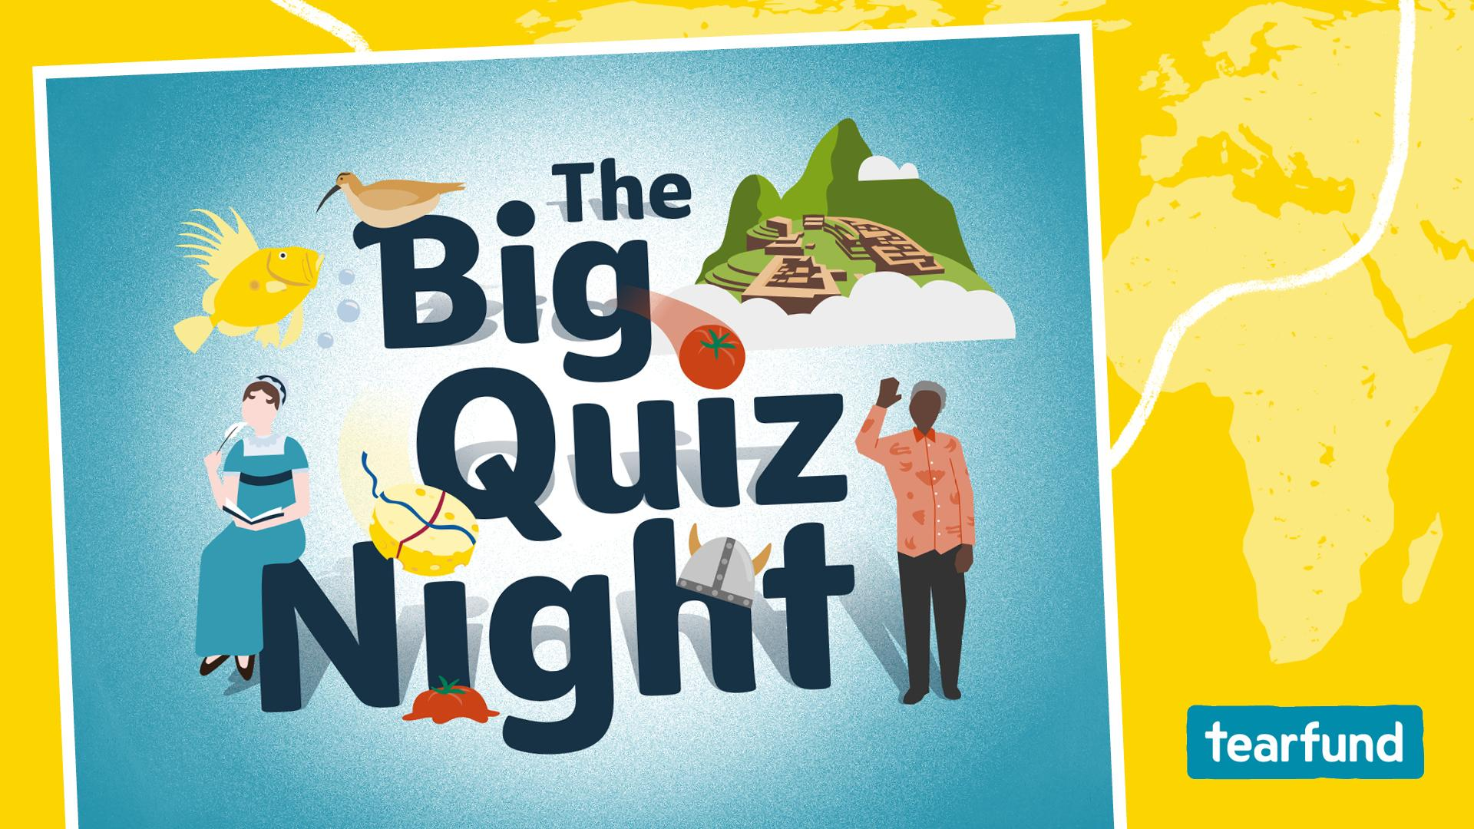

Slide 2

1. What was the name of David Attenborough’s famous actor and film director older brother?
2. What was the name of Jane and Peter Fonda’s famous actor father?
A: Harry B: Henry C: Peter Snr
3. Which iconic mother-daughter duo starred together in Maid, with the mother known for Four Weddings and a Funeral and the daughter for Once Upon a Time in Hollywood?

Slide 3
4. Three Culkin brothers all went into the acting profession: Macaulay, Rory and what other brother?
A: Declan B: Kirk C: Kieran
5. Which famous fashion duo started as child stars and have a younger sister who joined the Marvel Universe as Wanda Maximoff?
6. Fergus, Farkle and Felicia are the triplets of a famous animated couple in which successful movie franchise?

Slide 4

1. In which county in the East of England would you find the village of Stilton that the famous blue cheese is named after?
A: Lincolnshire B: Cambridgeshire C: Bedfordshire
2. What is the name of the North Yorkshire cheese that the claymation double act Wallace and Gromit are so fond of?
3. What popular cheese, consumed worldwide, is named after a British landmark nestled in the Mendip Hills?

Slide 5
4. What snack from Jacob’s introduced new flavours including Red Leicester in 2017?
5. What crumbly white cheese with a tangy flavour is named after a town in the Rhymney Valley in South Wales, and shares its name with a castle?
6. Wookey Hole cheese gets its distinct rich, nutty flavour from being aged in what?
A: Caves B: Cellars C: Smoke

Slide 6
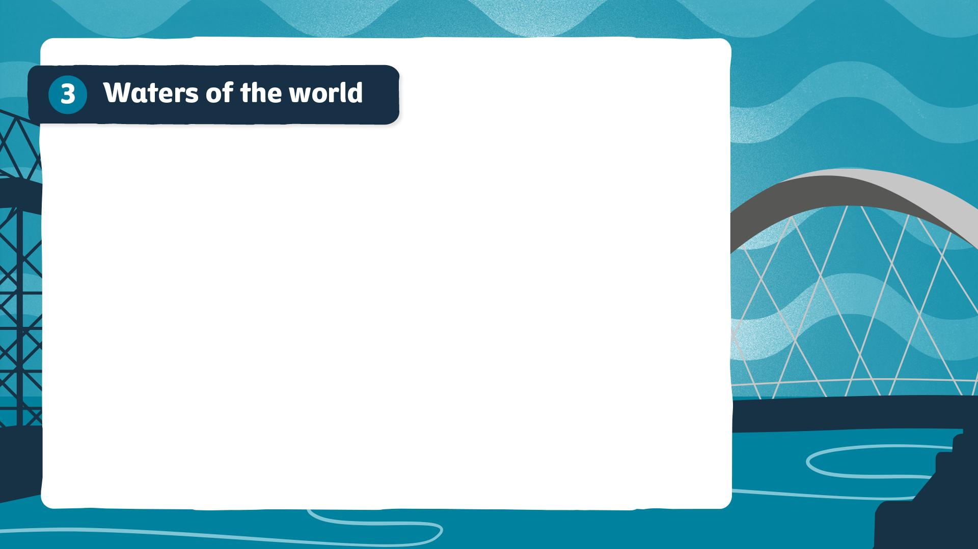
1. Which is the largest ocean on earth?
2. Which river in north-eastern Africa is generally considered to be the longest in the world?
3. Which of these is not one of the Great Lakes of North America?
A: Huron B: Michigan C: Champlain

Slide 7
4. What is the name of Scotland’s longest river, that flows
through Glasgow?
A: Tay B: Wye C: Clyde
5. How much of the earth’s surface is covered with water?
A: 51% B: 71% C: 81%
6. Which of the following is not an example of a man-made body
of water?
A: Lake Superior B: Lake Mead C: Lake Nasser

Slide 8
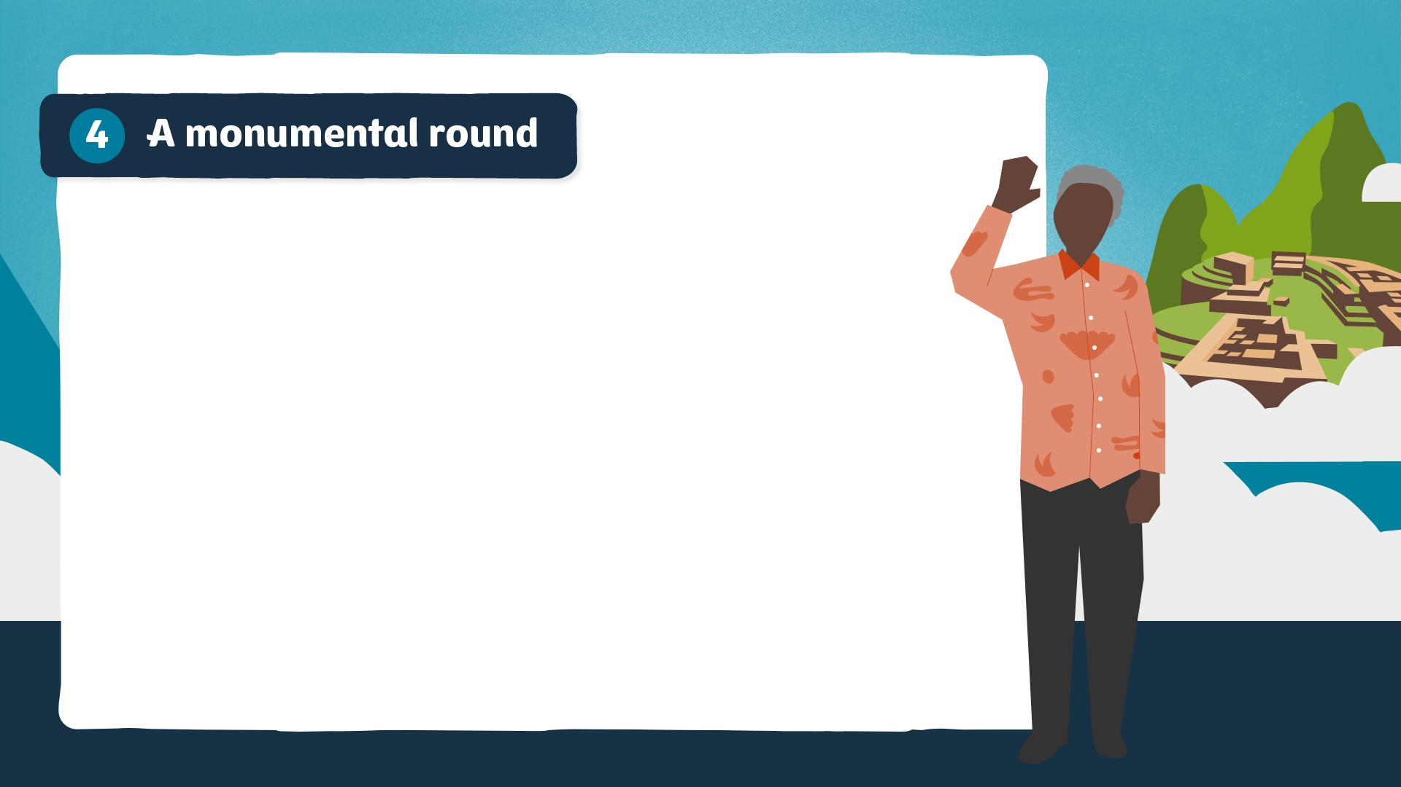
1. In which year did the famous but tragic pro-democracy protests happen in Tiananmen Square in Beijing, China?
A: 1984 B: 1989 C: 1992
2. How many years was Nelson Mandela imprisoned on Robben Island, Table Bay, South Africa?
A: 8 B: 18 C: 25
3. Where in the United States is the
Golden Gate Bridge located?
A: San Francisco B: New York C: San Jose

Slide 9
4. What is the name of the ancient Incan city, high in the Peruvian Andes Mountains, which is a testament to the advanced civilisation that once thrived there?
5. What is the name of the plateau near Cairo, Egypt, that’s home to the pyramids and the Sphinx?
6. Which item of swimwear is named after a group of islands in the Pacific Ocean, famous as the site of numerous United States nuclear weapons tests in the 1940s and 50s?

Slide 10
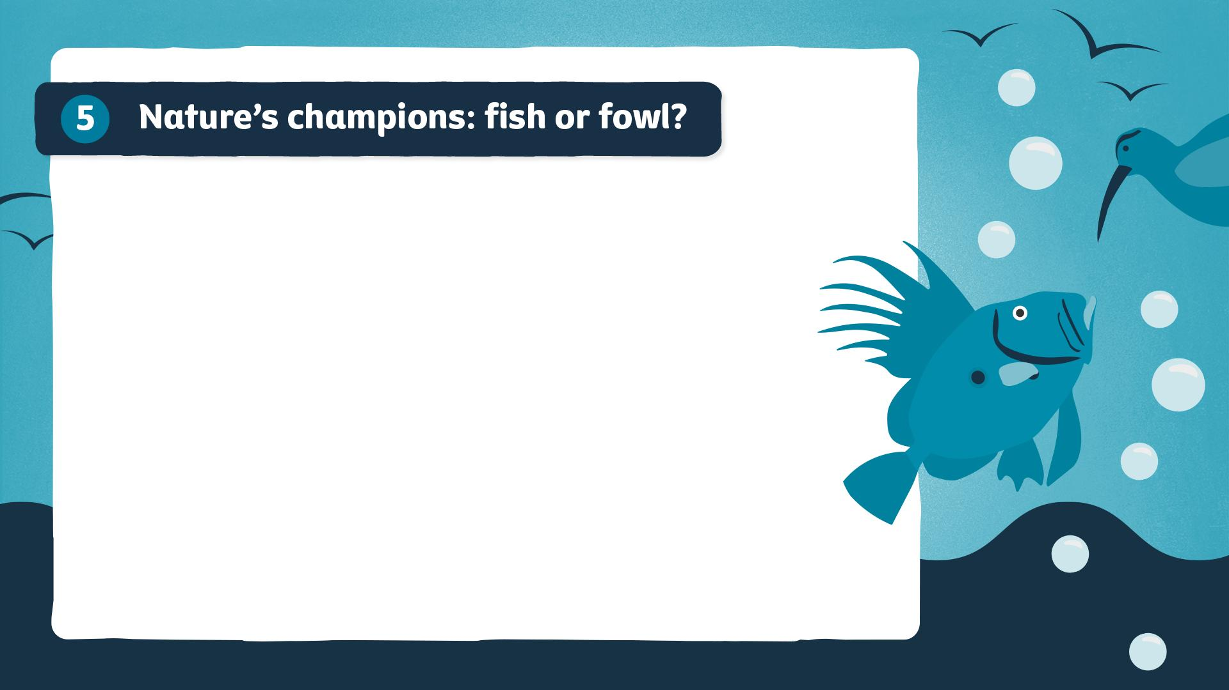
In this round, you have to test your knowledge of fish and birds. Is the answer either a fish or a fowl/bird?
1. The walleye or Sander vitreus is a yellow species native
to most of Canada and the Northern United States,
but is it fish or fowl?
2. Found in temperate, tropical and subtropical places worldwide, is the mahi-mahi, also called the dorado,
fish or fowl?
3. Coloured brownish above and whitish below, this species only breeds in north Scotland in the UK, but is a whimbrel fish or fowl?

Slide 11
4. Also known as St Pierre, is a John Dory fish or fowl?
5. The willet was formally described in 1789 by the German naturalist Johann Friedrich Gmelin, but is it fish or fowl?
6. Commonly found in estuaries from Massachusetts to the Gulf of Mexico, is a croaker fish or fowl?

Slide 12
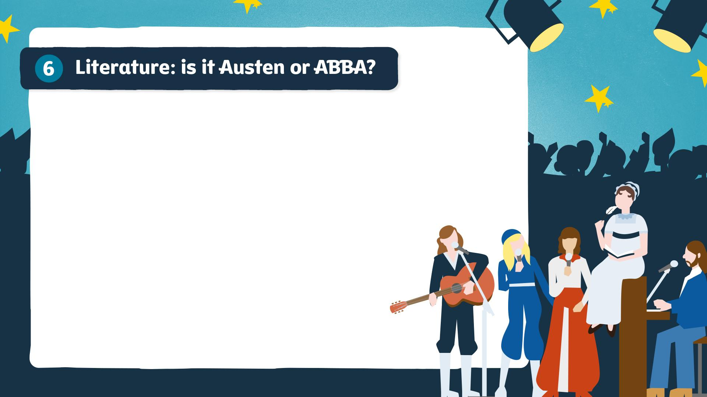
In this round, is the quote Jane Austen or an ABBA lyric?
1. ‘I do not want people to be very agreeable,
as it saves me the trouble of liking them.’
2. ‘The winner takes it all, the loser’s standing small.’
3. ‘Angry people are not always wise.’

Slide 13
4. ‘If I loved you less, I might be able to talk about it more.’
5. ‘I’m nothing special, in fact I’m a bit of a bore.’
6. ‘You pierce my soul. I am half agony, half hope.’

Slide 14
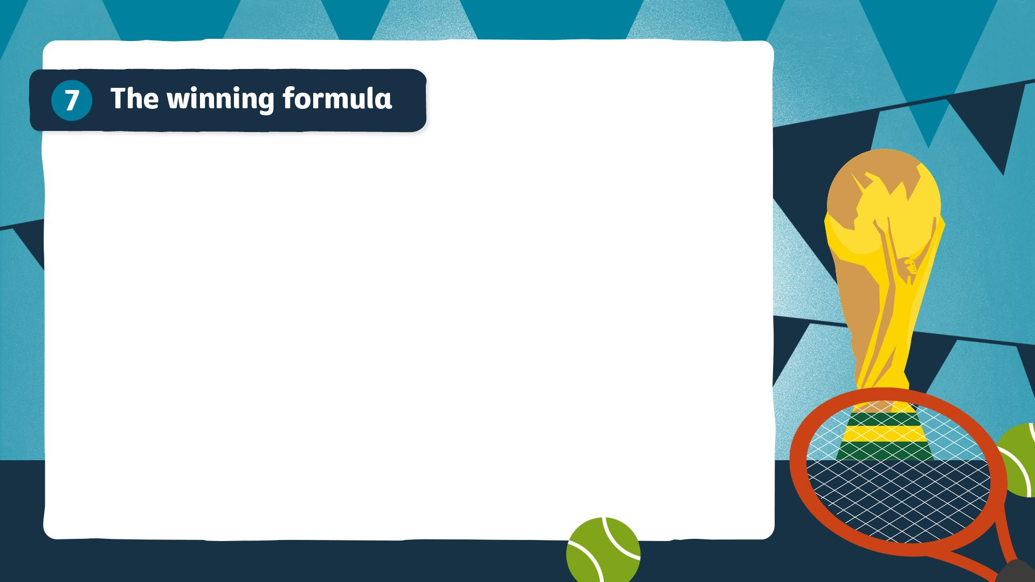
1. On a standard basketball court, how many people are playing in each team at one time?
2. Which of these tennis players has won the most men’s Grand Slam singles titles?
A: Roger Federer B: Rafael Nadal C: Novak Djokovic
3. What is the maximum number of rounds
in a professional boxing match?

Slide 15
4. Which three sports from this list make up the triathlon: swimming, cycling, hurdles, running, gymnastics, long jump and weightlifting?
5. Which country has won the most men’s FIFA World Cups?
6. Which country won the Rugby Union 2024 Women’s Six Nations Championship?

Slide 16

1. In which county in England does the chaotic and messy Cooper’s Hill Cheese-Rolling and Wake take place?
A: Herefordshire B: Gloucestershire C: Kent
2. To celebrate the end of summer, a giant food fight takes place in the town of Buñol, Spain, but what fruit do people throw at each other?
A: Tomatoes B: Grapes C: Figs
3. Which South-East Asian country hosts a Monkey Buffet Festival to thank primates for attracting tourists?

Slide 17
4. Sir Athelstan Joseph Michael Eavis is an English dairy farmer and the co-creator of which festival?
5. On which Scottish island – that has the Scottish Gaelic name Sealtainn – can you attend Up Helly Aa, a fire festival featuring a Viking longship?
6. What is the name of the largest cultural festival in Europe that takes place in the first week of August in Wales?

Slide 18
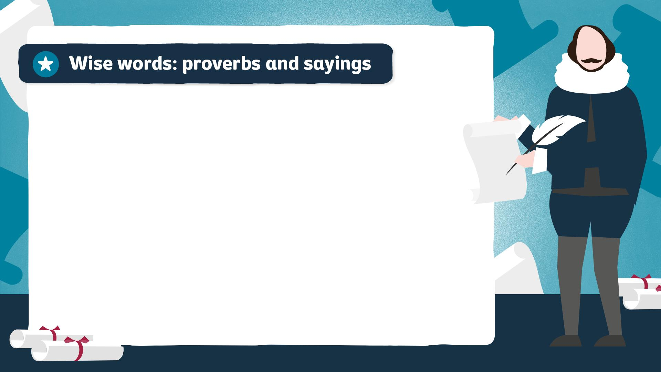
Extra round
(optional)
1. Complete this well-known saying: ‘A nod’s as good as a wink to a blind…’?
A: Bat B: Dog C: Horse
2. According to the popular saying, what do April showers bring forth?
3. If something is functioning well, you would describe it as ‘shipshape and…’ what?

Slide 19
4. According to Shakespeare, what should Julius Caesar beware of on 15 March?
5. How would you classify the phrase,
‘It’s raining cats and dogs’?
A: A proverb B: An idiom C: Neither
6. In Proverbs 26:11 in the Bible (NIV), a fool repeating their folly is like a dog returning to its what?

Slide 20
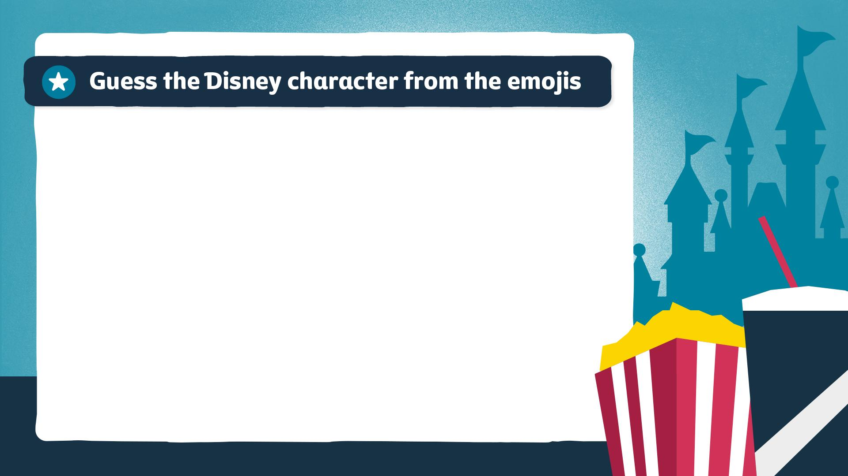



Extra round (optional)
1.
2.
3.

Slide 21



4.
5.
6.

Slide 22

These slides are for your own bonus round. There are some fun ideas in your Quizmaster Pack to get you started. (Delete this note before using this slide.)
1. Add question here…
2. Add question here…
3. Add question here…

Slide 23
4. Add question here…
5. Add question here…
6. Add question here…

Slide 24
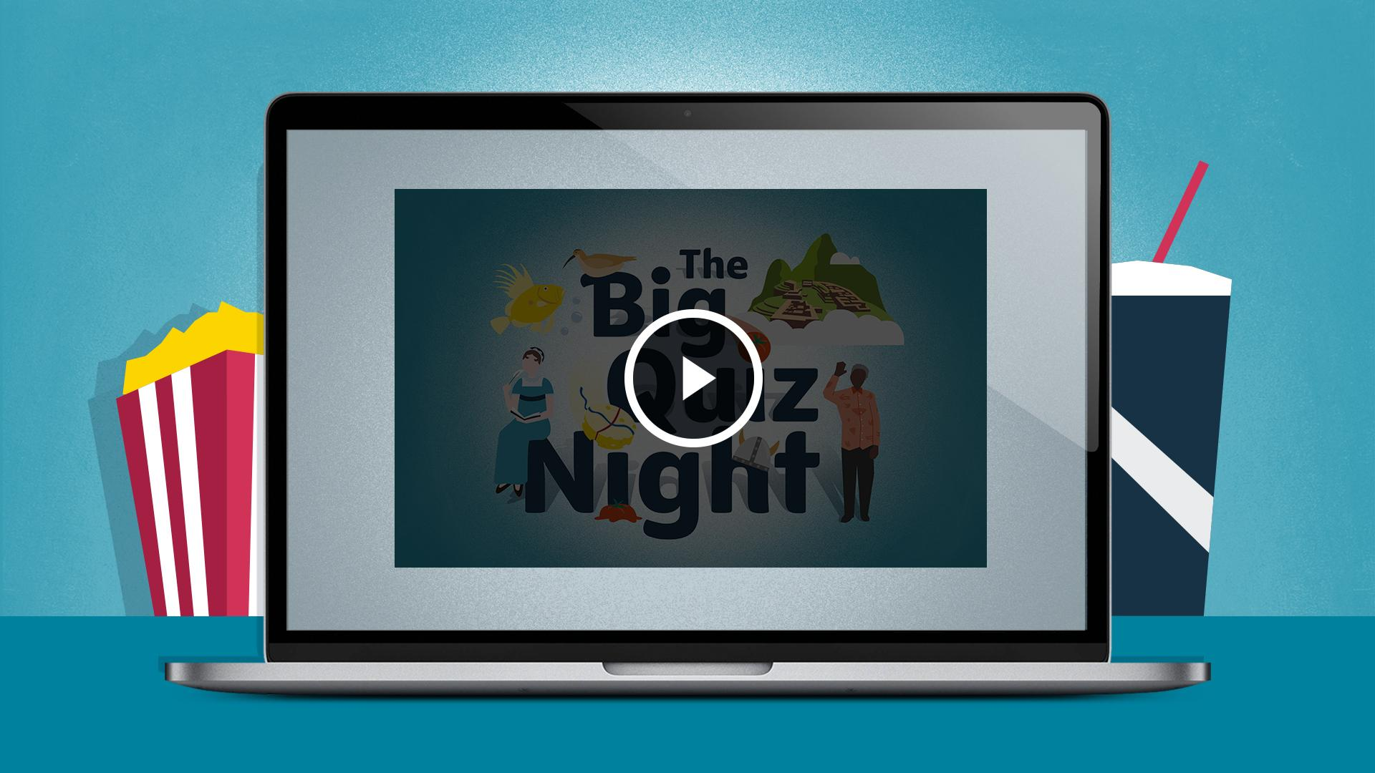

Slide 25
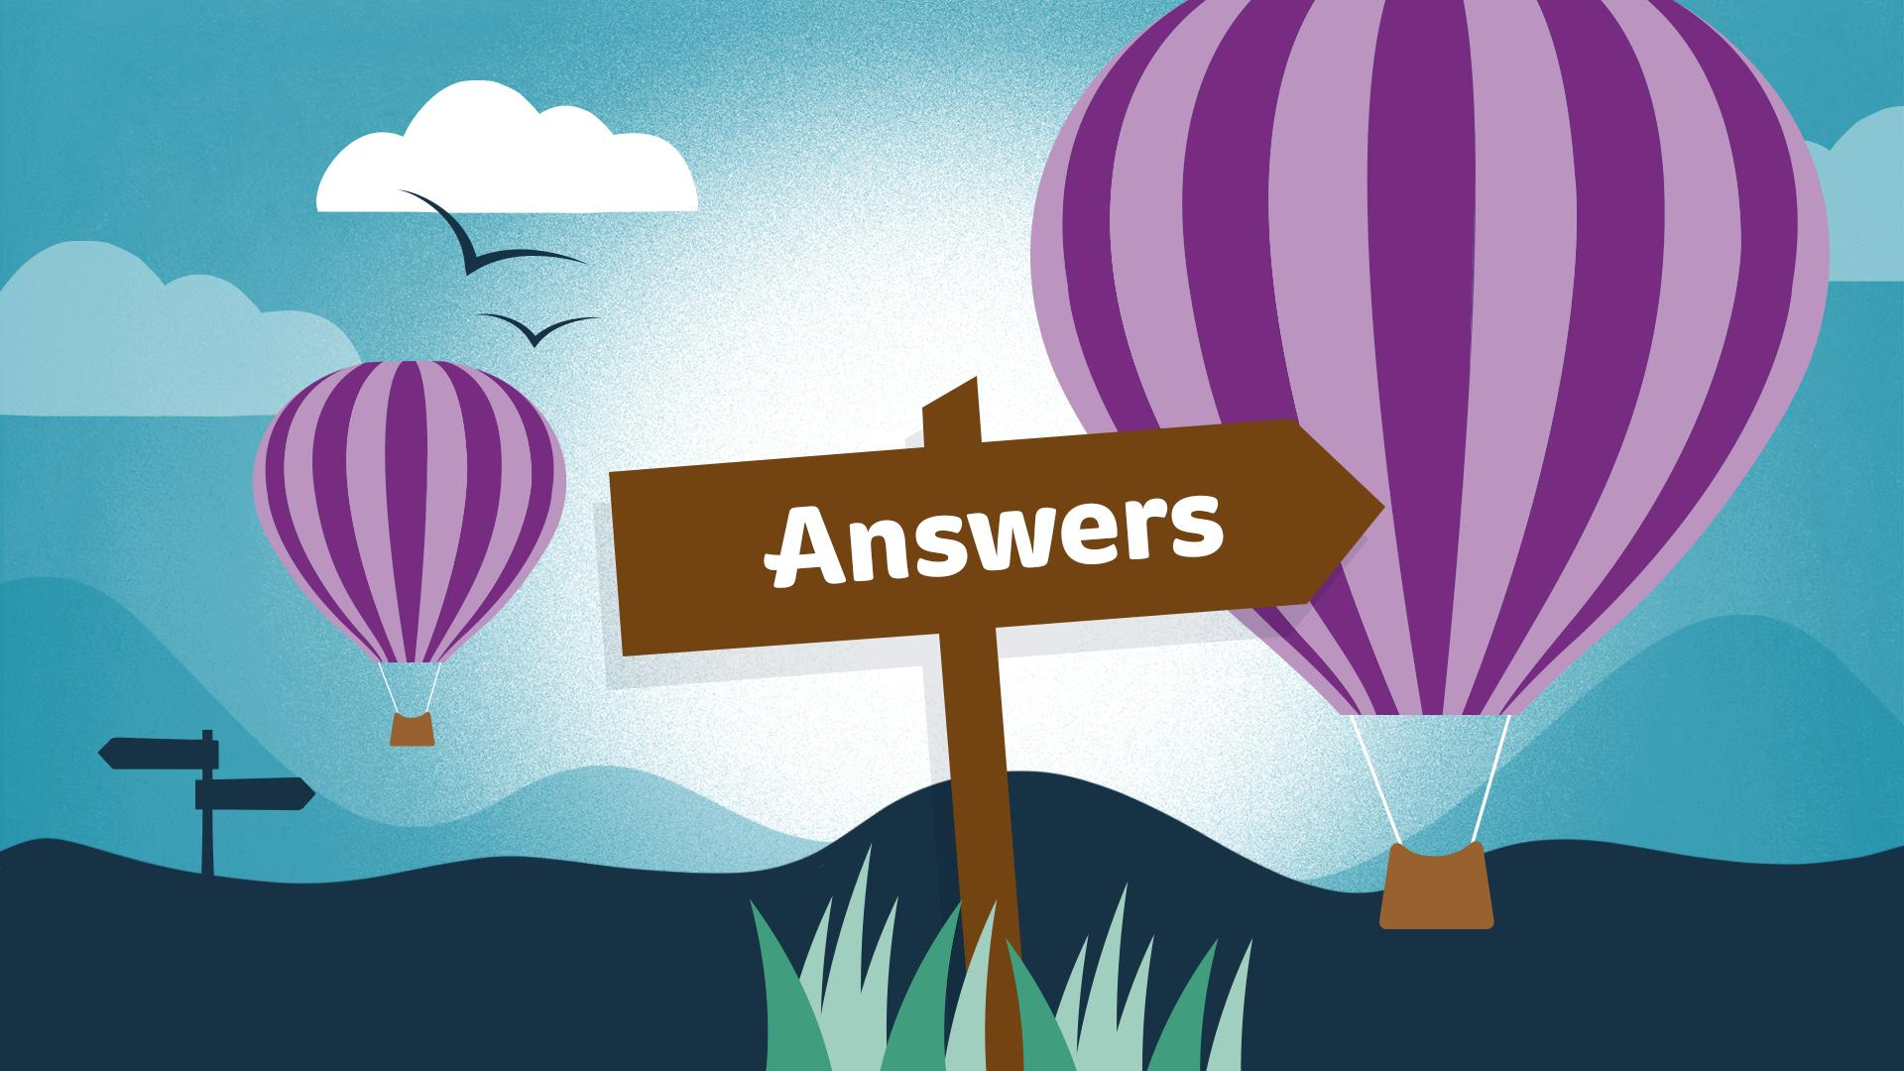

Slide 26
IMPORTANT NOTE: Please do not delete anything from these answer slides. Questions and answers both appear on the slide, but when viewed as a slideshow they are animated to appear with each click. (Delete this note before using this slide.)
1. What was the name of David Attenborough’s famous actor and film director older brother?
Richard (Dickie)
Attenborough
2. What was the name of Jane and Peter Fonda’s famous actor father?
A: Harry B: Henry C: Peter Snr
B: Henry
3. Which iconic mother-daughter duo starred together in Maid, with the mother known for Four Weddings and a Funeral and the daughter for Once Upon a Time in Hollywood?
Andie MacDowell and Margaret Qualley

Slide 27
4. Three Culkin brothers all went into the acting profession: Macaulay, Rory and what other brother?
A: Declan B: Kirk C: Kieran
C: Kieran
Mary-Kate and Ashley Olsen
(the younger sister
is Elizabeth Olsen)
5. Which famous fashion duo started as child stars and have a younger sister who joined the Marvel Universe as Wanda Maximoff?
6. Fergus, Farkle and Felicia are the triplets of a famous animated couple in which successful movie franchise?
Shrek

Slide 28
1. In which county in the East of England would you find the village of Stilton that the famous blue cheese is named after?
A: Lincolnshire B: Cambridgeshire
C: Bedfordshire
B: Cambridgeshire
2. What is the name of the North Yorkshire cheese that the claymation double act Wallace and Gromit are so fond of?
Wensleydale
3. What popular cheese, consumed worldwide, is named after a British landmark nestled in the Mendip Hills?
Cheddar

Slide 29
4. What snack from Jacob’s introduced new flavours including Red Leicester in 2017?
Mini Cheddars
5. What crumbly white cheese with a tangy flavour is named after a town in the Rhymney Valley in South Wales, and shares its name with a castle?
Caerphilly
6. Wookey Hole cheese gets its distinct rich, nutty flavour from being aged in what?
A: Caves B: Cellars C: Smoke
A: Caves

Slide 30
1. Which is the largest ocean on earth?
Pacific
2. Which river in north-eastern Africa is generally considered to be the longest in the world?
Nile
3. Which of these is not one of the Great Lakes of North America?
A: Huron B: Michigan C: Champlain
C: Champlain

Slide 31
4. What is the name of Scotland’s longest river, that flows through Glasgow?
A: Tay B: Wye C: Clyde
C: Clyde
5. How much of the earth’s surface is covered with water?
A: 51% B: 71% C: 81%
B: 71%
6. Which of the following is not an example of a man-made body of water?
A: Lake Superior B: Lake Mead
C: Lake Nasser
A: Lake Superior

Slide 32
1. In which year did the famous but tragic pro-democracy protests happen in Tiananmen Square in Beijing, China?
A: 1984 B: 1989 C: 1992
B: 1989
2. How many years was Nelson Mandela imprisoned on Robben Island, Table Bay, South Africa?
A: 8 B: 18 C: 25
B: 18
3. Where in the United States is the
Golden Gate Bridge located?
A: San Francisco B: New York C: San Jose
A: San Francisco

Slide 33
4. What is the name of the ancient Incan city, high in the Peruvian Andes Mountains, which is a testament to the advanced civilisation that once thrived there?
Machu Picchu
5. What is the name of the plateau near Cairo, Egypt, that’s home to the pyramids and the Sphinx?
Giza
6. Which item of swimwear is named after a group of islands in the Pacific Ocean, famous as the site of numerous United States nuclear weapons tests in the 1940s and 50s?
Bikini

Slide 34
1. The walleye or Sander vitreus is a yellow species native to most of Canada and the Northern United States, but is it fish or fowl?
Fish
2. Found in temperate, tropical and subtropical places worldwide, is the mahi-mahi, also called the dorado,
fish or fowl?
Fish
3. Coloured brownish above and whitish below, this species only breeds in north Scotland in the UK, but is a whimbrel fish or fowl?
Fowl/bird

Slide 35
4. Also known as St Pierre, is a John Dory fish or fowl?
Fish
5. The willet was formally described in 1789 by the German naturalist Johann Friedrich Gmelin, but is it fish or fowl?
Fowl/bird
6. Commonly found in estuaries from Massachusetts to the Gulf of Mexico, is a croaker fish or fowl?
Fish

Slide 36
1. ‘I do not want people to be very agreeable, as it saves me the trouble
of liking them.’
Austen
(Jane Austen’s Letters)
ABBA
(The Winner Takes
it All)
2. ‘The winner takes it all, the loser’s standing small.’
Austen
(Pride and Prejudice)
3. ‘Angry people are not always wise.’

Slide 37
4. ‘If I loved you less, I might be able to talk about it more.’
Austen
(Emma)
ABBA
(Thank You for
the Music)
5. ‘I’m nothing special, in fact I’m a bit of a bore.’
6. ‘You pierce my soul. I am half agony, half hope.’
Austen
(Persuasion)

Slide 38
1. On a standard basketball court, how many people are playing in each team at one time?
5
2. Which of these tennis players has won the most men’s Grand Slam singles titles?
A: Roger Federer B: Rafael Nadal
C: Novak Djokovic
C: Novak Djokovic
3. What is the maximum number of rounds in a professional boxing match?
12

Slide 39
4. Which three sports from this list make up the triathlon: swimming, cycling, hurdles, running, gymnastics, long jump and weightlifting?
Swimming, cycling and running
5. Which country has won the most men’s FIFA World Cups?
Brazil
6. Which country won the Rugby Union 2024 Women’s Six Nations Championship?
England

Slide 40
1. In which county in England does the chaotic and messy Cooper's Hill Cheese-Rolling and Wake take place?
A: Herefordshire B: Gloucestershire C: Kent
B: Gloucestershire
2. To celebrate the end of summer, a giant food fight takes place in the town of Buñol, Spain, but what fruit do people throw at each other?
A: Tomatoes B: Grapes C: Figs
A: Tomatoes
3. Which South-East Asian country hosts a Monkey Buffet Festival to thank primates for attracting tourists?
Thailand

Slide 41
4. Sir Athelstan Joseph Michael Eavis is an English dairy farmer and the co-creator of which festival?
Glastonbury
5. On which Scottish island – that has the Scottish Gaelic name Sealtainn – can you attend Up Helly Aa, a fire festival featuring a Viking longship?
Shetland
6. What is the name of the largest cultural festival in Europe that takes place in the first week of August in Wales?
The (National) Eisteddfod

Slide 42
1. Complete this well-known saying: ‘A nod’s as good as a wink to a blind…’?
A: Bat B: Dog C: Horse
C: Horse
2. According to the popular saying, what do April showers bring forth?
May flowers
3. If something is functioning well, you would describe it as ‘shipshape and…’ what?
Bristol fashion

Slide 43
4. According to Shakespeare, what should Julius Caesar beware of on 15 March?
The Ides
(of March)
5. How would you classify the phrase,
‘It’s raining cats and dogs’?
A: A proverb B: An idiom C: Neither
B: An idiom
6. In Proverbs 26:11 in the Bible (NIV), a fool repeating their folly is like a dog returning to its what?
Vomit

Slide 44
1.
Dumbo (Dumbo)
Simba
(The Lion King)
2.
Mickey Mouse
3.

Slide 45
4.
Mirabel (Encanto)
Riley
(Inside Out)
5.
Lumière
(Beauty and
the Beast)
6.

Slide 46
1. Add question here…
Answer
2. Add question here…
Answer
Answer
3. Add question here…

Slide 47
4. Add question here…
Answer
5. Add question here…
Answer
Answer
6. Add question here…

