Slide 1
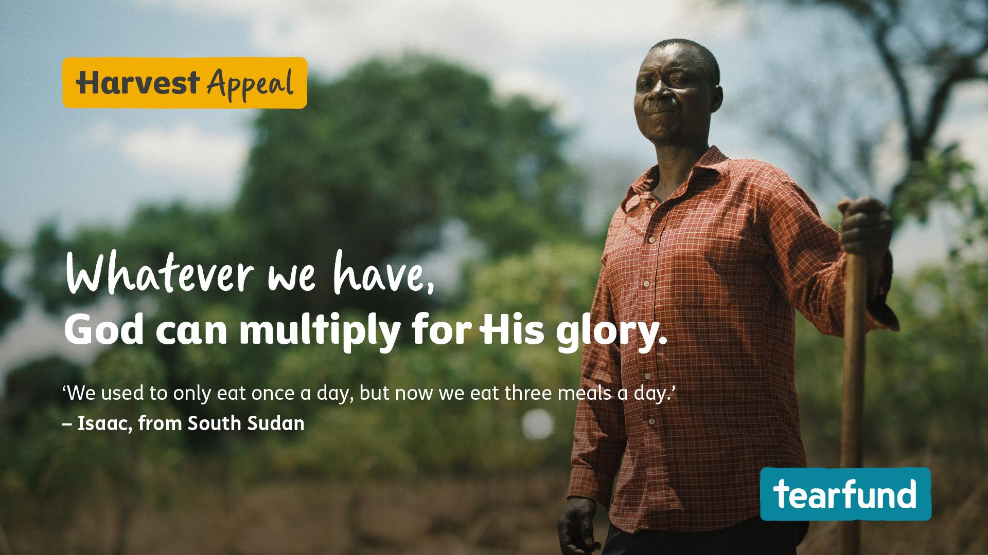
Notes:
This harvest, we’ll be using Tearfund’s resource to focus on the incredible truth that God can multiply our gifts. When we give him the small things we hold in our hands, he takes them and uses them for his glory.
We’ll be hearing how Isaac from South Sudan experienced this first hand. He turned his life around after taking part in Tearfund’s Transforming Communities training.
N.B This would be a good moment to show the film of Isaac’s story.

Slide 2
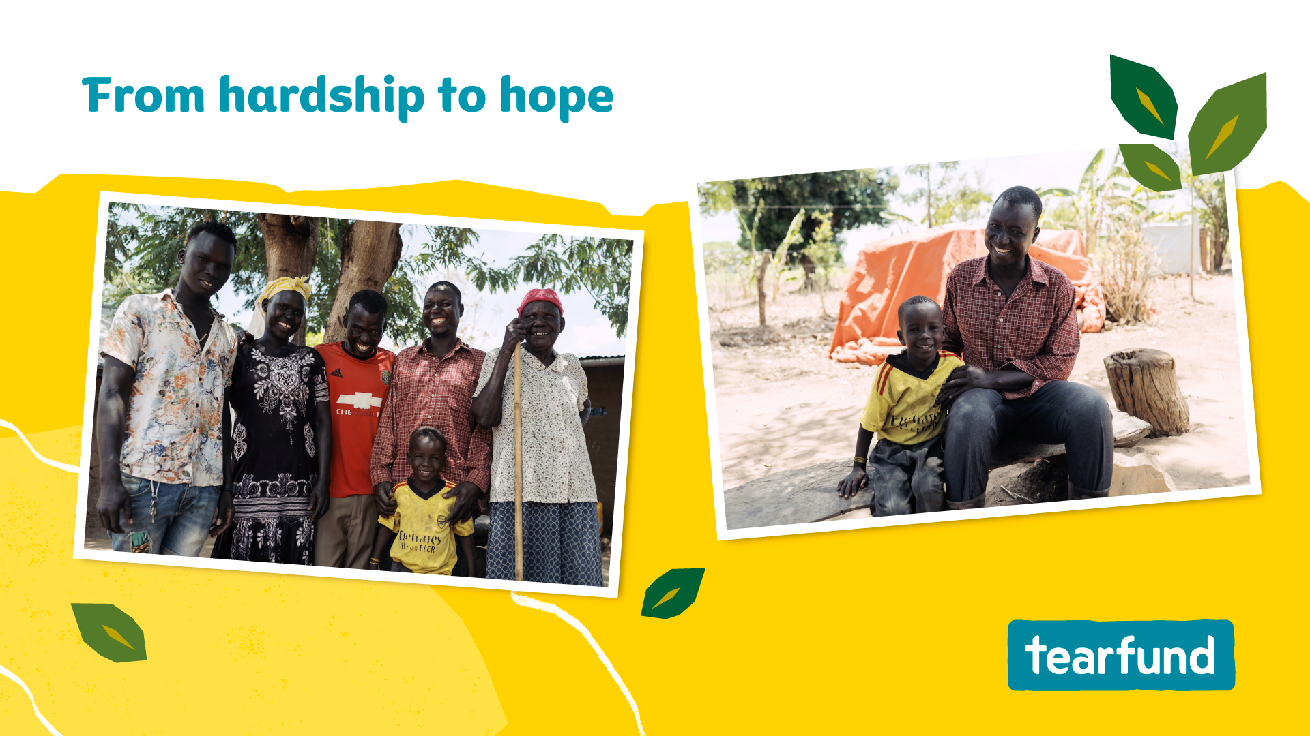
Notes:
Earlier we read the story of the little boy who gave Jesus his five loaves and two fish. Jesus took this small gift and multiplied it beyond all we could imagine.
This Bible story connects very closely with Isaac’s own life. He had lost everything. He felt like he had nothing to support his family. But as Isaac took part in Tearfund’s Transforming Communities programme he looked at the small things he held in his hand differently. As he offered them to God, he was filled with new ideas and fresh courage to start a new chapter.

Slide 3
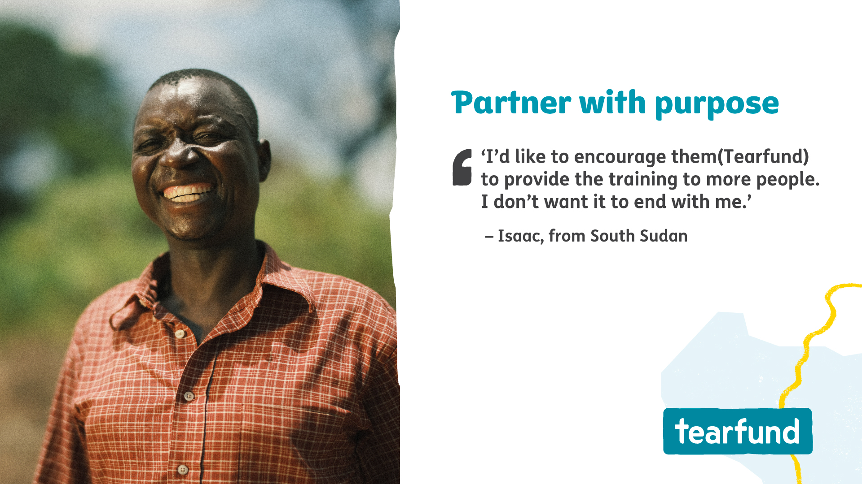
Notes:
Tearfund’s Transforming Communities programme is not about giving short-term aid. It’s about equipping local churches to lead long-term change. Tearfund trains churches to work with the community to identify resources as well as challenges.
This approach supports communities to rewrite their own stories, building a future filled with hope and opportunity.

Slide 4
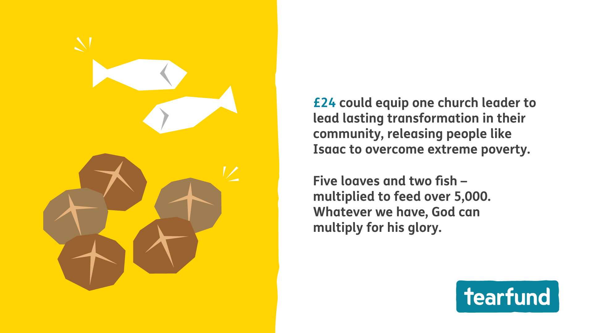
Notes:
A gift from our church can help stop poverty from devastating lives. Our donation is an investment in local people ready to lead change and lift their community out of poverty.

Slide 5
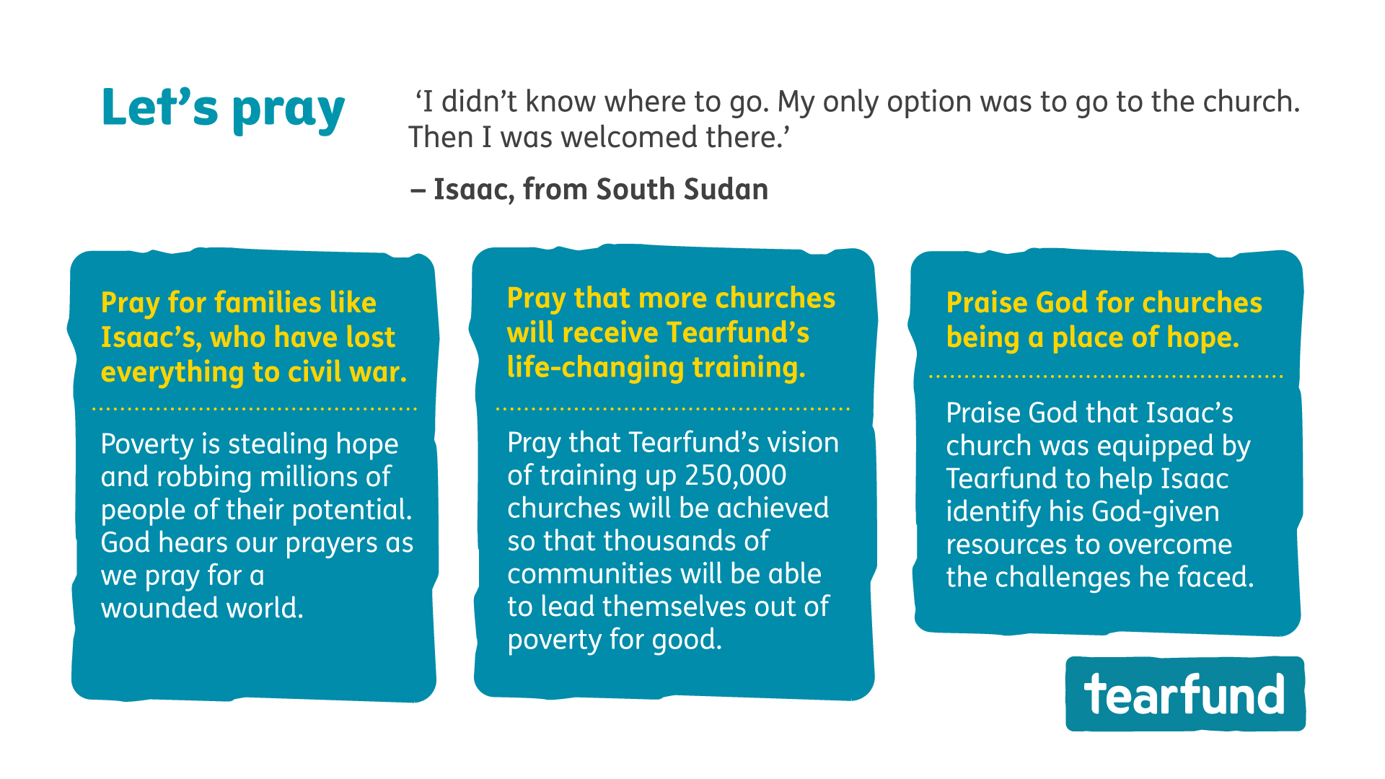

Slide 6


