Slide 1
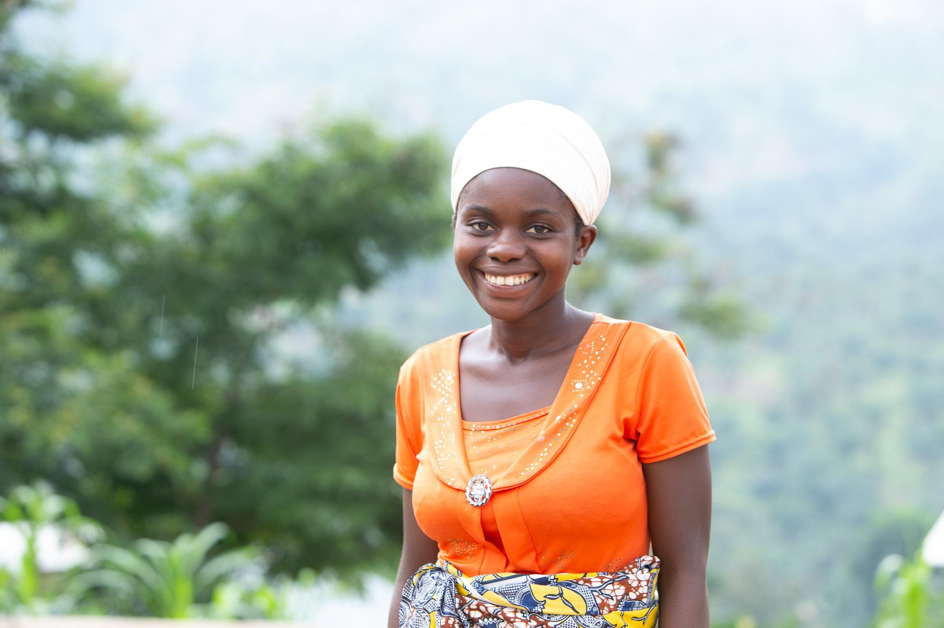


Slide 2
Thank you for your support

Slide 3
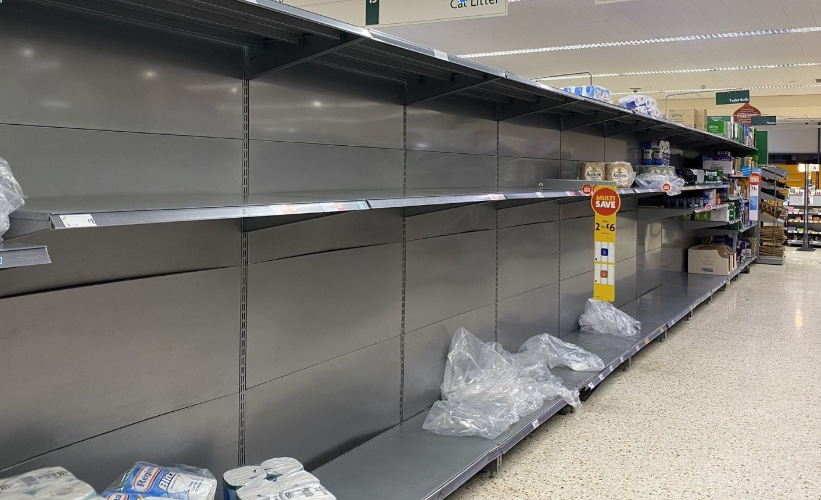
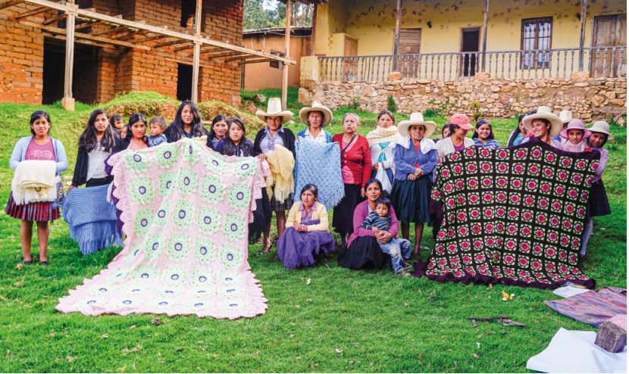
Mindset of scarcity v Theology of Abundance
Notes:
Members of a women’s entrepreneurship project in Cajamarca, Peru, display their traditional weavings to be sold at market. The project aims to improve the livelihoods of women in this indigenous community and supermarket shelves in the UK, 2020

Slide 4
Philippians 2: 3-5

Slide 5
Philippians 2: 3-5
“Do nothing out of selfish ambition or vain conceit. Rather, in humility value others above yourselves, not looking to your own interests but each of you to the interests of the others. In your relationships with one another, have the same mindset as Christ Jesus.”

Slide 6
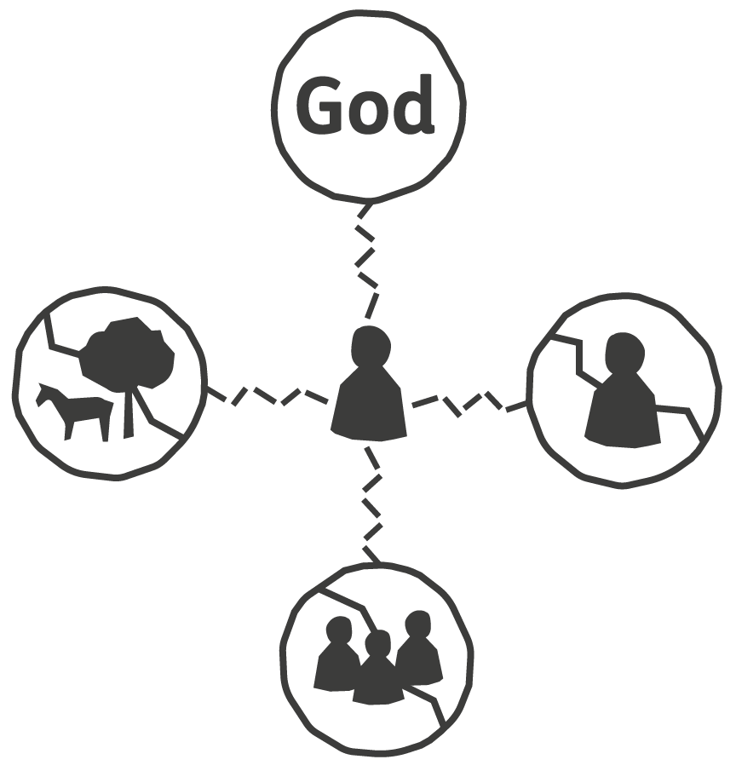
Four broken relationships
We believe that poverty is the result of four broken relationships.
Relationship with:
God
Ourselves
Others
Creation
Notes:
As a Christian organisation, Tearfund believes that poverty is the result of four broken relationships: the broken bond with God, our distorted understanding of self, the unjust ways we connect with others, and our exploitative ties to the environment. We believe that when God created the world, all relationships were in perfect alignment, but in today’s world, these relationships are broken and we see this brokenness as the root cause of poverty.
In the book of John in the Bible (John 10:10), Jesus says: ‘I have come that they might have life, and have it to the full.’ We refer to this fullness of life as whole-life transformation.

Slide 7
Burundi Visit Video

Slide 8
2 Corinthians 8: 11-12
“Now finish the work, so that your eager willingness to do it may be matched by your completion of it, according to your means. For if the willingness is there, the gift is acceptable according to what one has, not according to what one does not have.”

Slide 9
2 Corinthians 8: 13-15
Our desire is not that others might be relieved while you are hard pressed, but that there might be equality. At the present time your plenty will supply what they need, so that in turn their plenty will supply what you need. The goal is equality, as it is written: ‘The one who gathered much did not have too much, and the one who gathered little did not have too little.’

Slide 10
Poverty is not God’s Plan.
You are.
Notes:
The poor you will always have with you,[a] but you will not always have me. - Matt 26:11
Context was about Jesus leaving.
Jesus was actually criticising the condescending way in which this woman was using her finances.

Slide 11
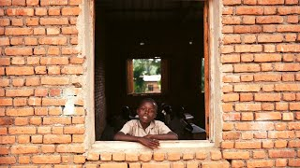
Practise What You Pray Campaign Video

Slide 12
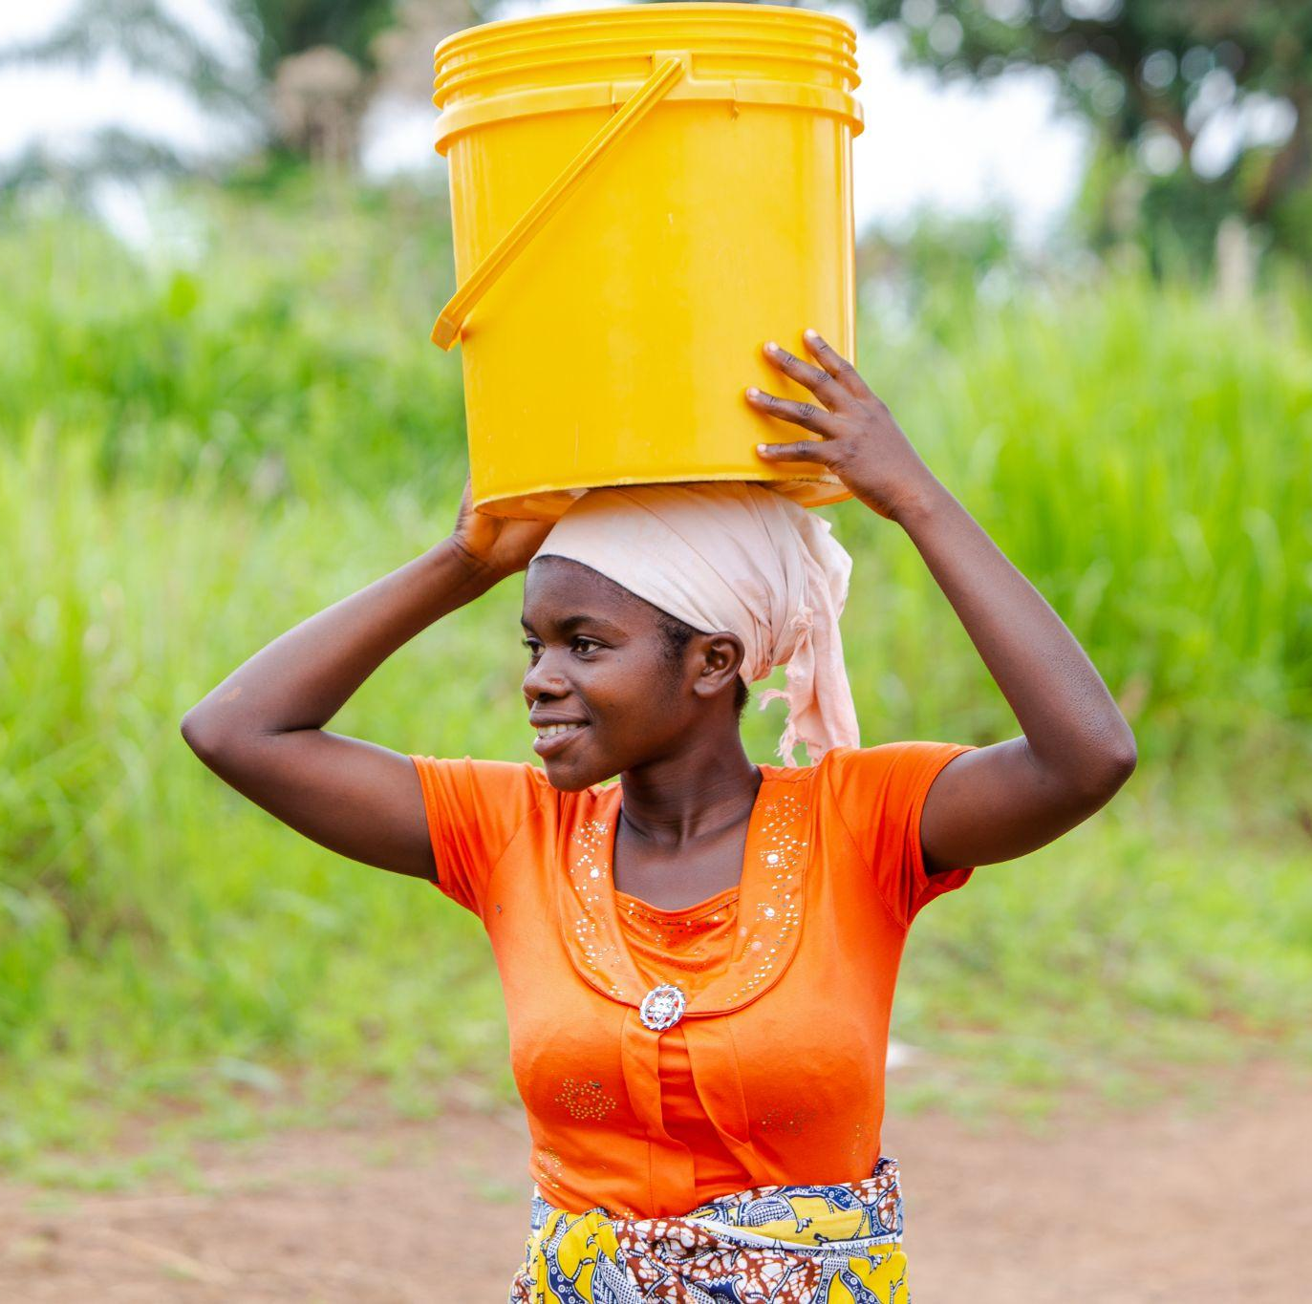
Cecile
Mother of a 1 year old, Cecile and her husband are farmers growing cassava, beans, maize and different types of vegetables
She says that the Church and Community Transformation approach opened their eyes and they could see the existing opportunities within and around them.
Notes:
Cecile Niyonsaba, 23 years old, is a farmer. She is married to Misigaro Emmanuel and they have a daughter of 1 year and 7 months, named Bernice. Cecile and her husband are both farmers. They grow cassava, beans, maize and different types of vegetables.
She joined the Gisagazuba community 3 years ago, after she got married. Her husband is from the area. They live 15 minutes walk from the Church. Both sing in the choir and are very active in different church activities.
“I love to sing, I sing alto. When I sing, my heart gets filled with love and joy. I love God and enjoy singing for God. I like this community, they are very welcoming, peaceful and have a good heart. I have made friends.”
Cecile testifies how she has seen the Church and Community transformation training at work. She says that the approach opened their eyes and they could see the existing opportunities within and around them.
“We understood the power of coming together as a Church and working together for our own development. A changed church changes the community for the better. As you could see, our congregation was able to build a health centre, a road and bring up water."
“I am happy to be part of this church as I come to know God and see his hand. I now have a Church family, we love and support one another. I played my part in the construction, even if I was not strong, I worked with others in digging the road and moving rocks, and we also contributed some money.”
“Before, we were living like any other poor community, working in our farms and selling our produce to access money. On Sunday, we would go to church and join different church activities. But now it is like an awakening. People are more engaged, we have been inspired to change and to change our community and we are now active. Apart from building the health centre, more people are working hard to change their situation. Some have started small businesses, I’ve also been selling vegetables and I hope that once I get enough capital, I’ll be able to start a small business at the market.”
“I hope that our family will have a better future. My husband and I are both farmers and we hope we will be able to start a small business and earn more money to help us improve our lives and build a house.”
When they told me that I had been selected to play Violette in this film, I was so happy and excited. I kept thinking about it so I would not forget my role and my lines. I was very happy when I was playing and when everything went alright. I will always remember this experience. I thank you for choosing to come to our place, thank you for choosing us. May God bless you.

Slide 13
Cecile
“We understood the power of coming together as a Church and working together for our own development. A changed church changes the community for the better. As you could see, our congregation was able to build a health centre, a road and bring up water."
Notes:
Cecile Niyonsaba, 23 years old, is a farmer. She is married to Misigaro Emmanuel and they have a daughter of 1 year and 7 months, named Bernice. Cecile and her husband are both farmers. They grow cassava, beans, maize and different types of vegetables.
She joined the Gisagazuba community 3 years ago, after she got married. Her husband is from the area. They live 15 minutes walk from the Church. Both sing in the choir and are very active in different church activities.
“I love to sing, I sing alto. When I sing, my heart gets filled with love and joy. I love God and enjoy singing for God. I like this community, they are very welcoming, peaceful and have a good heart. I have made friends.”
Cecile testifies how she has seen the Church and Community transformation training at work. She says that the approach opened their eyes and they could see the existing opportunities within and around them.
“We understood the power of coming together as a Church and working together for our own development. A changed church changes the community for the better. As you could see, our congregation was able to build a health centre, a road and bring up water."
“I am happy to be part of this church as I come to know God and see his hand. I now have a Church family, we love and support one another. I played my part in the construction, even if I was not strong, I worked with others in digging the road and moving rocks, and we also contributed some money.”
“Before, we were living like any other poor community, working in our farms and selling our produce to access money. On Sunday, we would go to church and join different church activities. But now it is like an awakening. People are more engaged, we have been inspired to change and to change our community and we are now active. Apart from building the health centre, more people are working hard to change their situation. Some have started small businesses, I’ve also been selling vegetables and I hope that once I get enough capital, I’ll be able to start a small business at the market.”
“I hope that our family will have a better future. My husband and I are both farmers and we hope we will be able to start a small business and earn more money to help us improve our lives and build a house.”
When they told me that I had been selected to play Violette in this film, I was so happy and excited. I kept thinking about it so I would not forget my role and my lines. I was very happy when I was playing and when everything went alright. I will always remember this experience. I thank you for choosing to come to our place, thank you for choosing us. May God bless you.

Slide 14
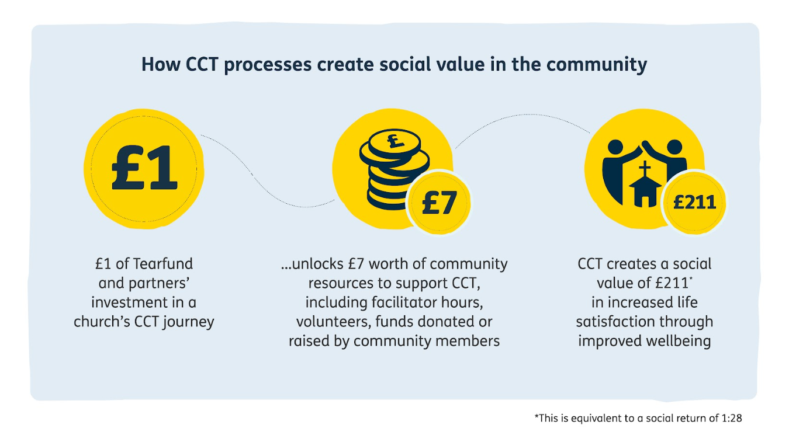
Church & Community Transformation

Slide 15
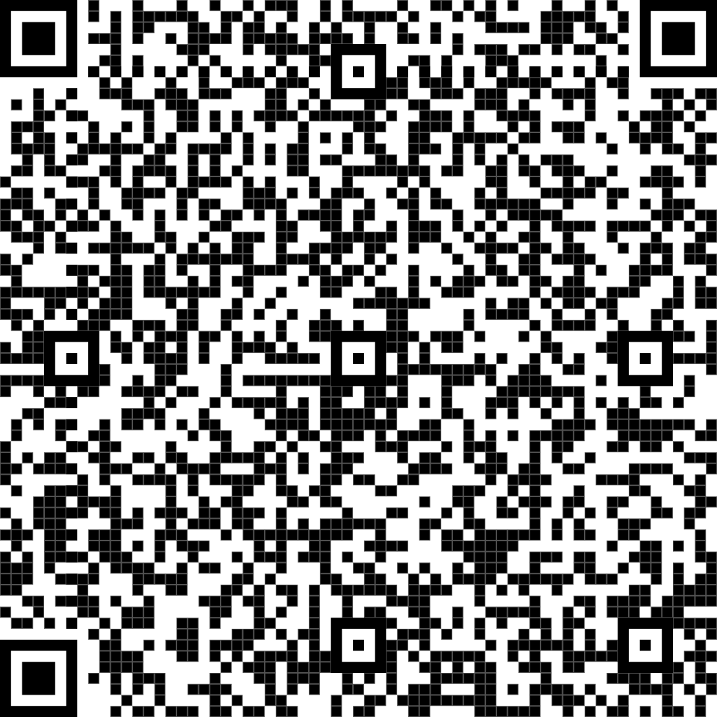
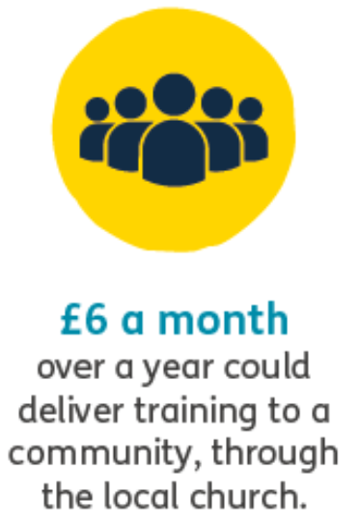
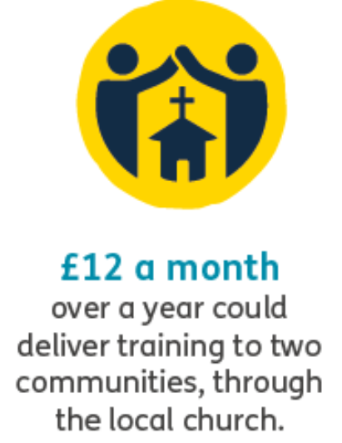
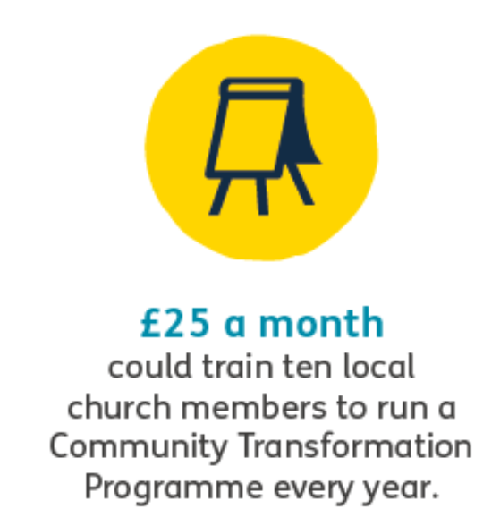
Your generosity can change lives today
Notes:
Cecile Niyonsaba, 23 years old, is a farmer. She is married to Misigaro Emmanuel and they have a daughter of 1 year and 7 months, named Bernice. Cecile and her husband are both farmers. They grow cassava, beans, maize and different types of vegetables.
She joined the Gisagazuba community 3 years ago, after she got married. Her husband is from the area. They live 15 minutes walk from the Church. Both sing in the choir and are very active in different church activities.
“I love to sing, I sing alto. When I sing, my heart gets filled with love and joy. I love God and enjoy singing for God. I like this community, they are very welcoming, peaceful and have a good heart. I have made friends.”
Cecile testifies how she has seen the Church and Community transformation training at work. She says that the approach opened their eyes and they could see the existing opportunities within and around them.
“We understood the power of coming together as a Church and working together for our own development. A changed church changes the community for the better. As you could see, our congregation was able to build a health centre, a road and bring up water."
“I am happy to be part of this church as I come to know God and see his hand. I now have a Church family, we love and support one another. I played my part in the construction, even if I was not strong, I worked with others in digging the road and moving rocks, and we also contributed some money.”
“Before, we were living like any other poor community, working in our farms and selling our produce to access money. On Sunday, we would go to church and join different church activities. But now it is like an awakening. People are more engaged, we have been inspired to change and to change our community and we are now active. Apart from building the health centre, more people are working hard to change their situation. Some have started small businesses, I’ve also been selling vegetables and I hope that once I get enough capital, I’ll be able to start a small business at the market.”
“I hope that our family will have a better future. My husband and I are both farmers and we hope we will be able to start a small business and earn more money to help us improve our lives and build a house.”
When they told me that I had been selected to play Violette in this film, I was so happy and excited. I kept thinking about it so I would not forget my role and my lines. I was very happy when I was playing and when everything went alright. I will always remember this experience. I thank you for choosing to come to our place, thank you for choosing us. May God bless you.

