Slide 1
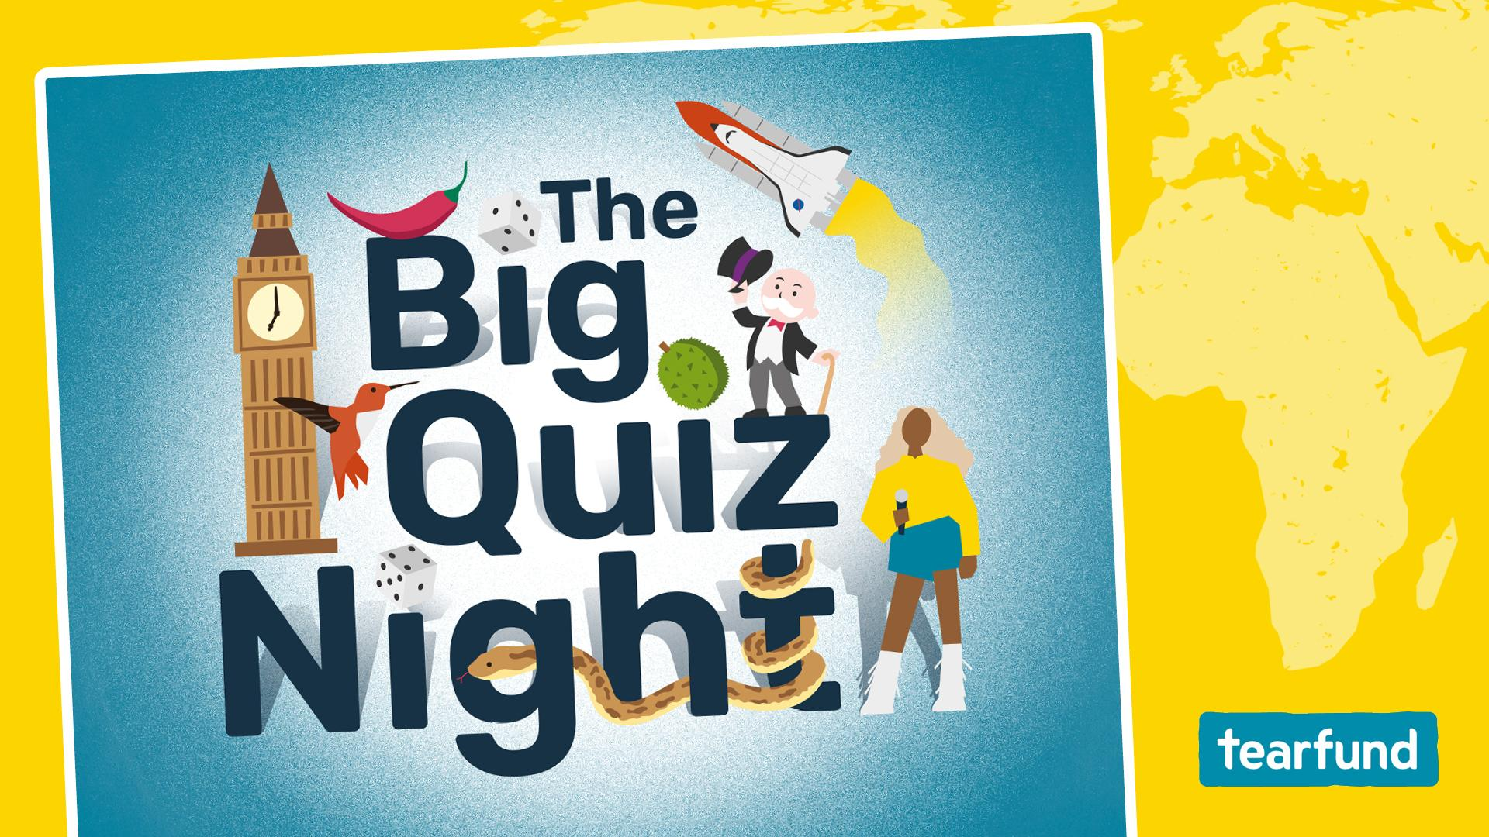

Slide 2
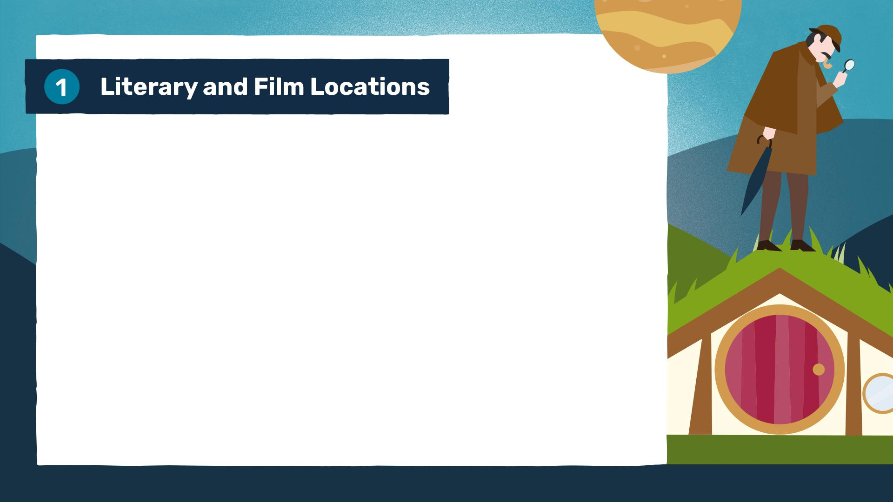
1. The 2019 Oscar-winning film Parasite is set in which East Asian capital city?
2. The film Zootropolis has a different name in the UK than the US, what is its American title?
3. The Jurassic Park film franchise is primarily set on the small fictional island, Isla Nublar, supposedly off the coast of which Central American country?
4. In which Pennsylvanian US city would you find the 'Rocky Steps', made famous by the film Rocky?

Slide 3
5. Which Greek island in the Aegean Sea served as the primary filming location for the 2008 musical film Mamma Mia!?
6. In The Lord of the Rings, what is the name of the pastoral, green ancestral home of the Hobbits?
7. In the Sherlock Holmes stories, at which famous central London address does the detective reside?
8. Which real-world desert stretching across North Africa was used to film the desert planet 'Tatooine' in the first Star Wars film?

Slide 4
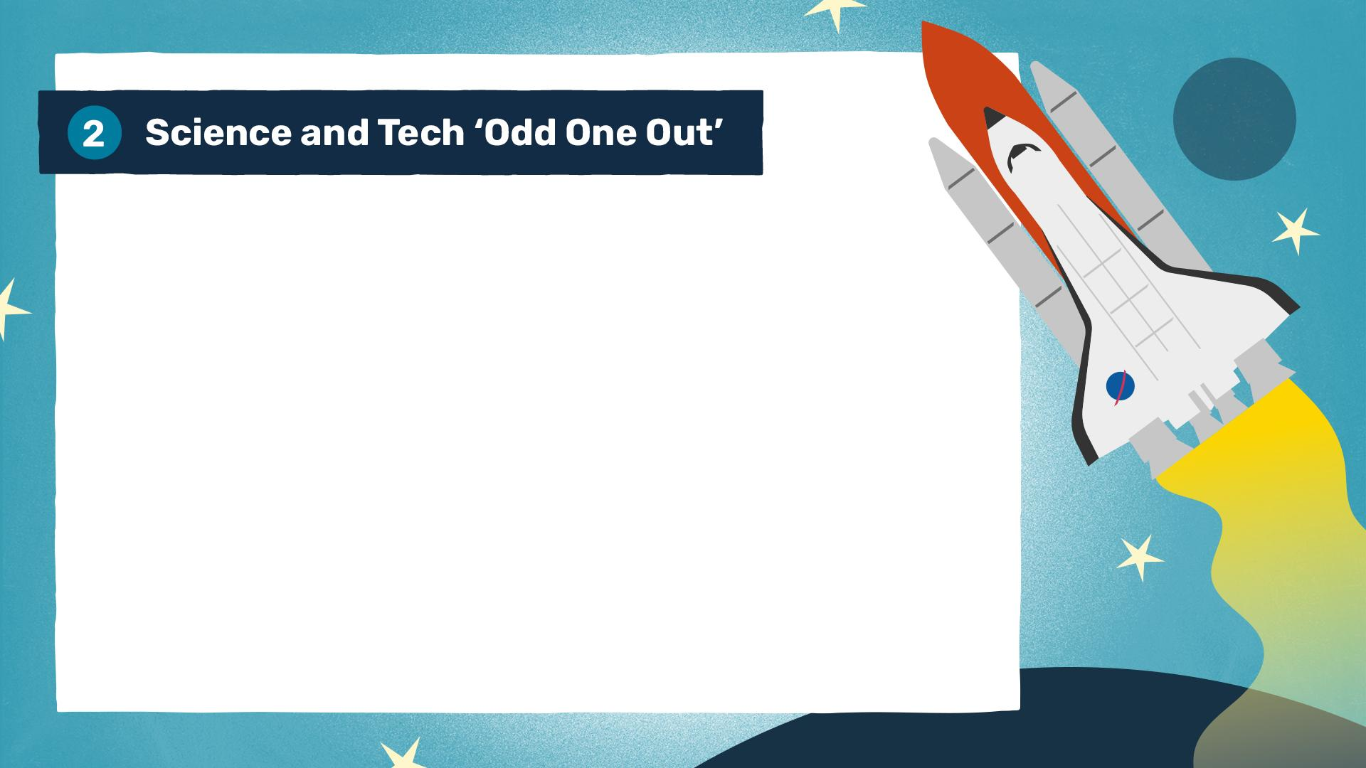
1. Which of these is not a noble gas?
A: Helium B: Neon C: Nitrogen D: Argon
2. Which of these social media platforms was
not founded in the 2000s?
A: Facebook B: Twitter C: Instagram D: TikTok
3. Which of these is not a bone found in the human ear?
A: Stirrup B: Anvil C: Hammer D: Tibia
4. Which of these was not a NASA space shuttle?
A: Discovery B: Apollo C: Challenger D: Endeavour

Slide 5
5. Which of these programming languages is not named after a
person or a gem?
A: Ruby B: Perl C: Python D: Pascal
6. Which of these is not a mammal?
A: Whale B: Platypus C: White Shark D: Bat
7. Which of these is not a web browser?
A: Chrome B: Firefox C: Linux D: Safari
8. Which of these is not a type of cloud?
A: Cirrus B: Cumulus C: Stratus D: Ignis

Slide 6
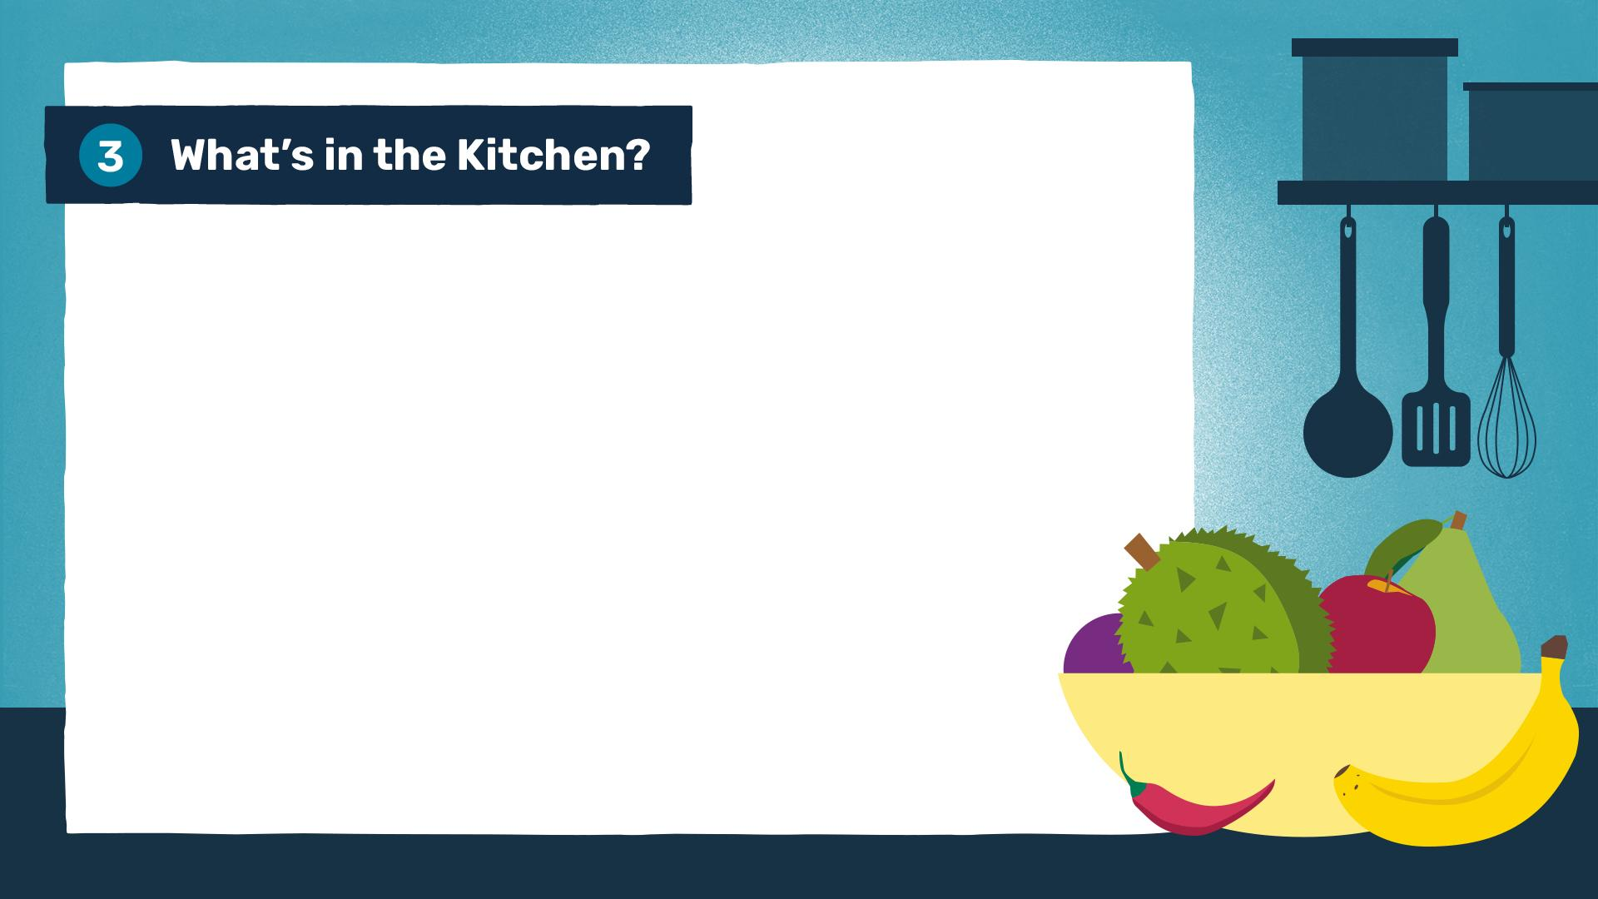
1. Other than eggs, what is the main, starchy ingredient in a traditional Spanish omelette?
2. Which drink is made from the leaves of the Camellia sinensis plant, often grown in Asia?
3. Which fruit, known as the King of Fruits in Southeast Asia,
is famous for its extremely strong smell?
4. What is the single-celled organism leavening agent used
to make bread rise?

Slide 7
5. Scoville units are used to measure the strength of which vegetable?
6. Which spice, often used in baking, comes from the dried inner bark of a tree?
7. If you are 'julienning' a vegetable, what shape are you cutting it into, named after a common small household object?
8. What is the world’s most expensive spice by weight?

Slide 8
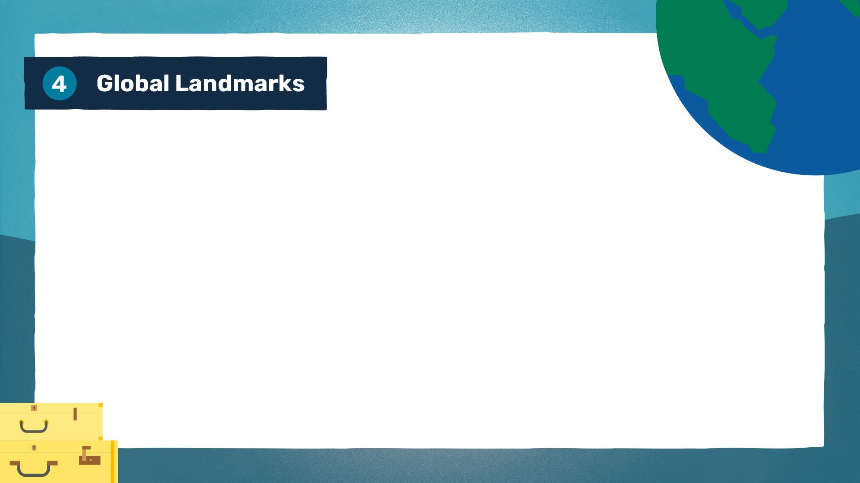
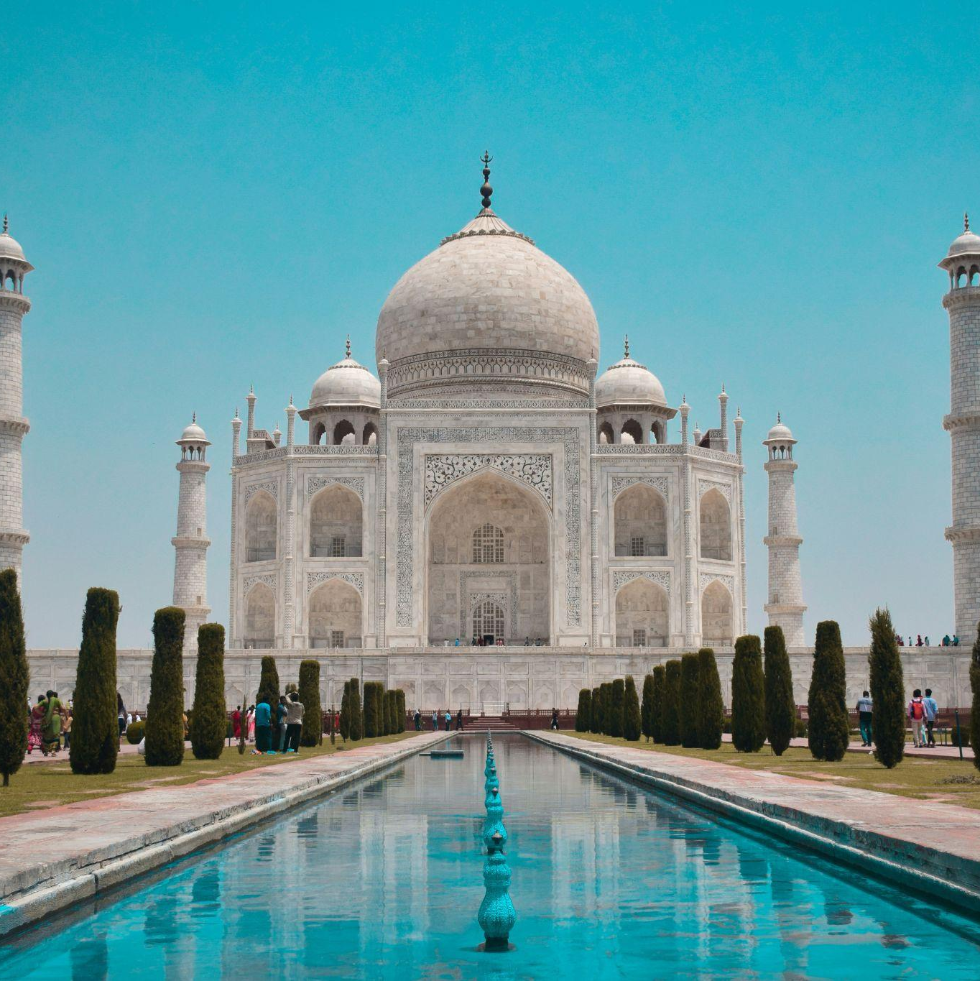
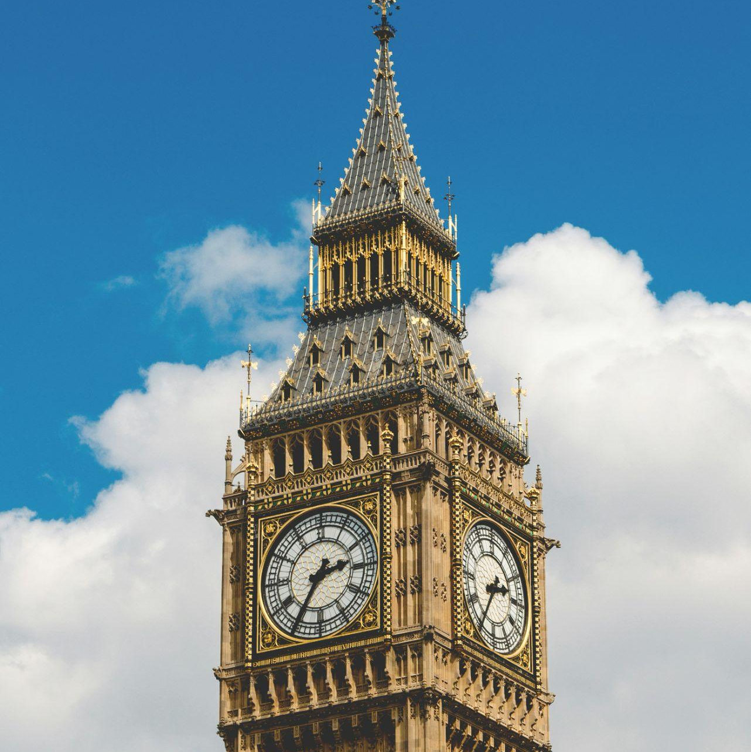
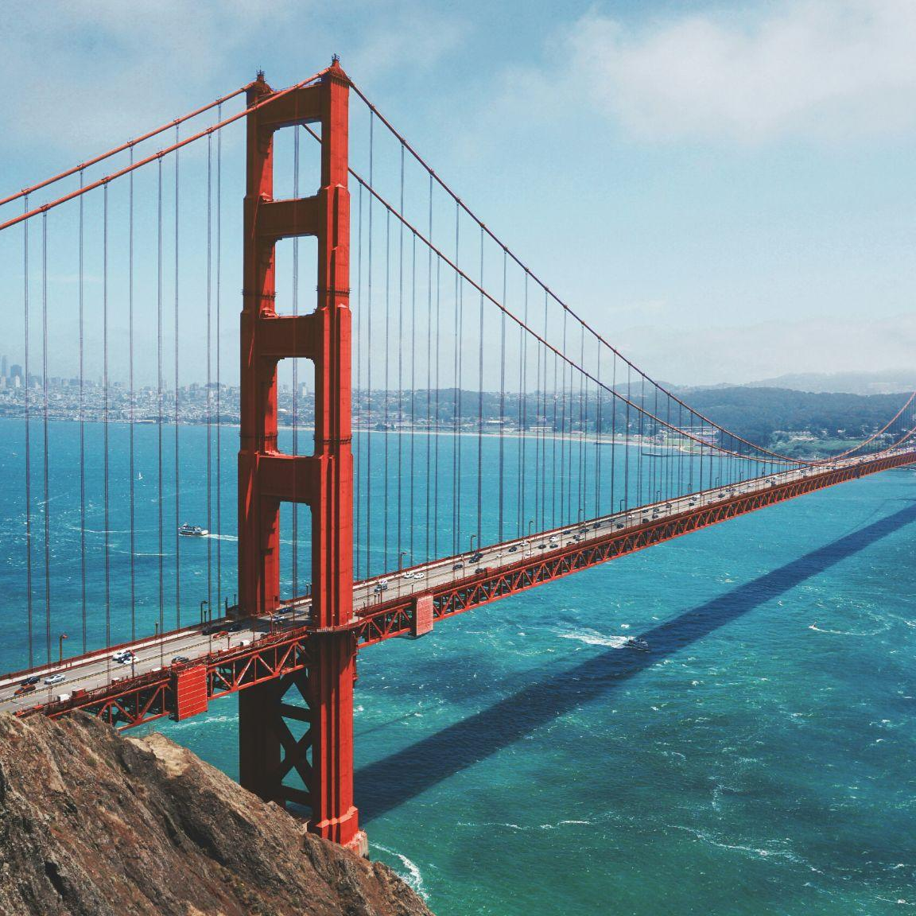
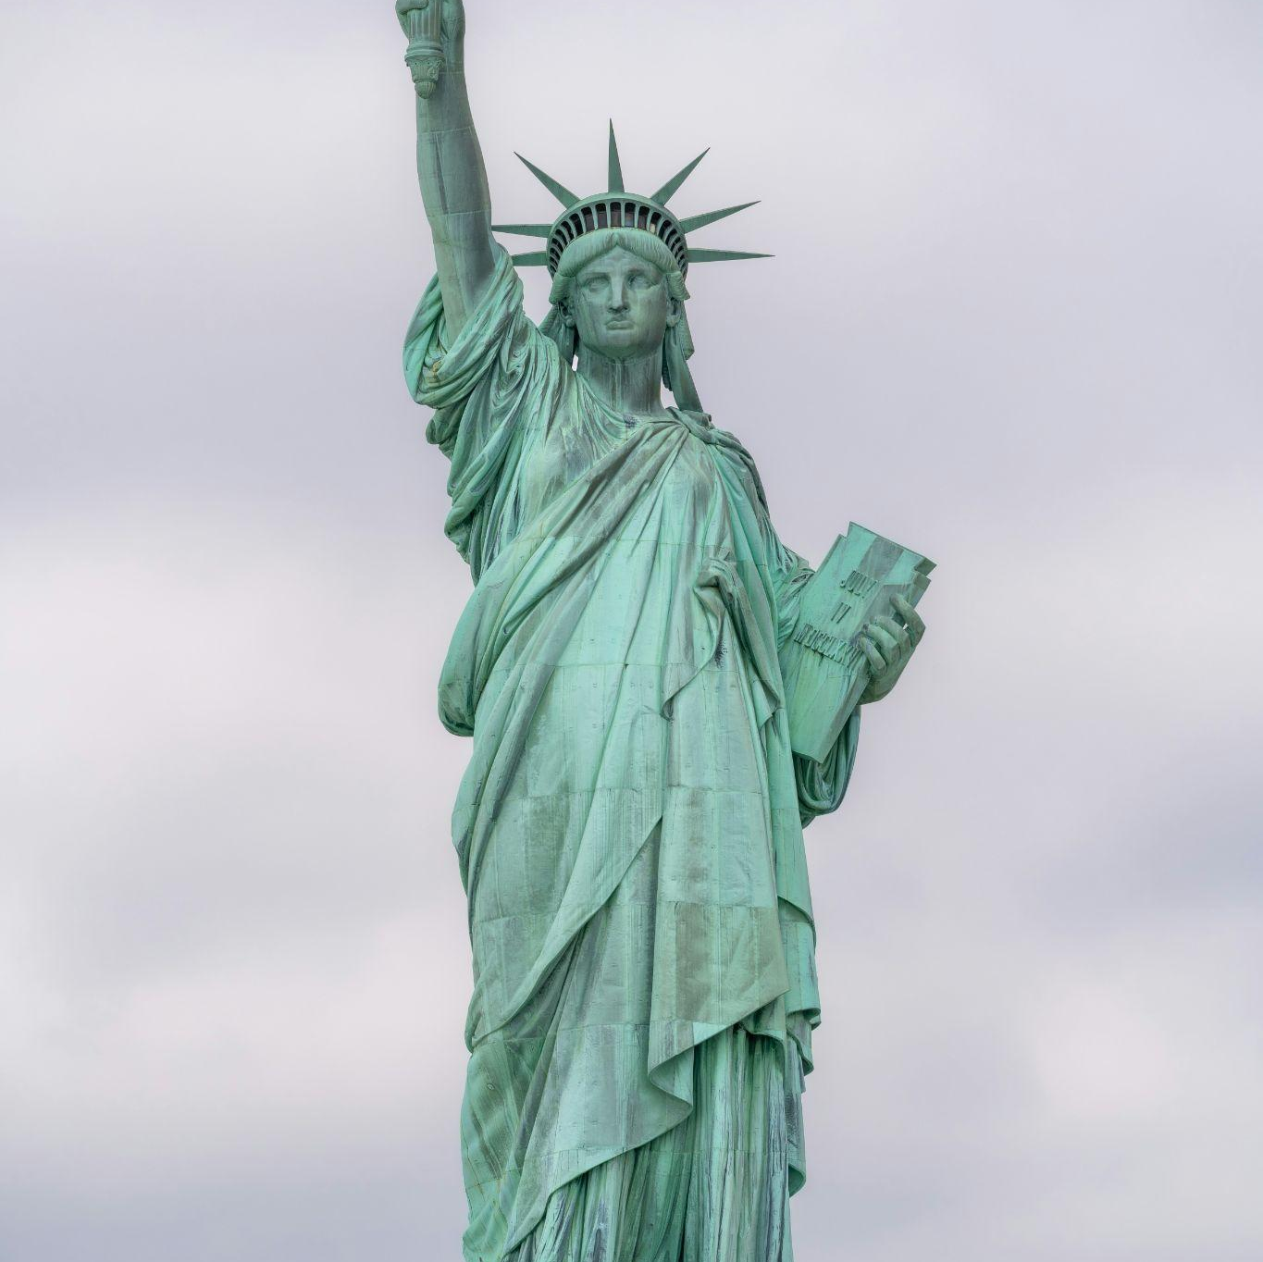
Can you name the famous landmarks pictured here?
1.
2.
3.
4.
Photos: Jovyn Chamb, Enrico Bet, Maarten van den Heuvel, Tomasz Zielonka/Unsplash

Slide 9
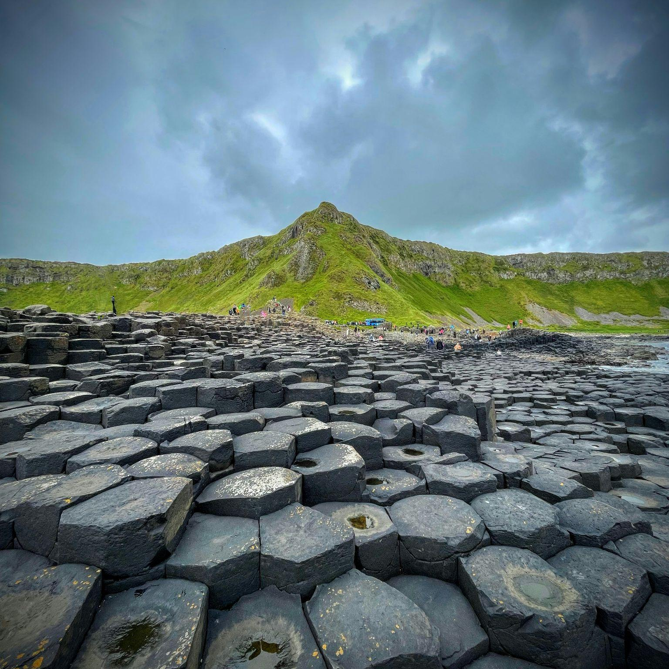
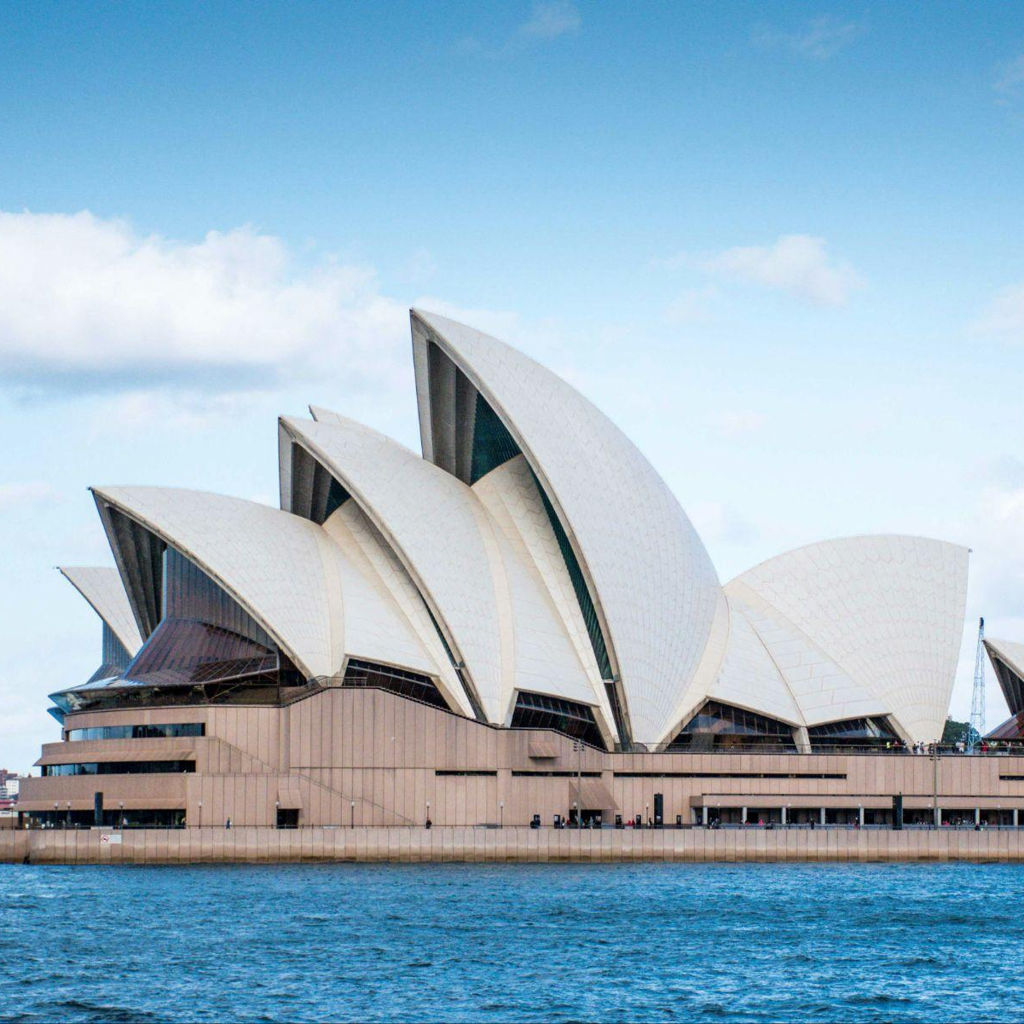
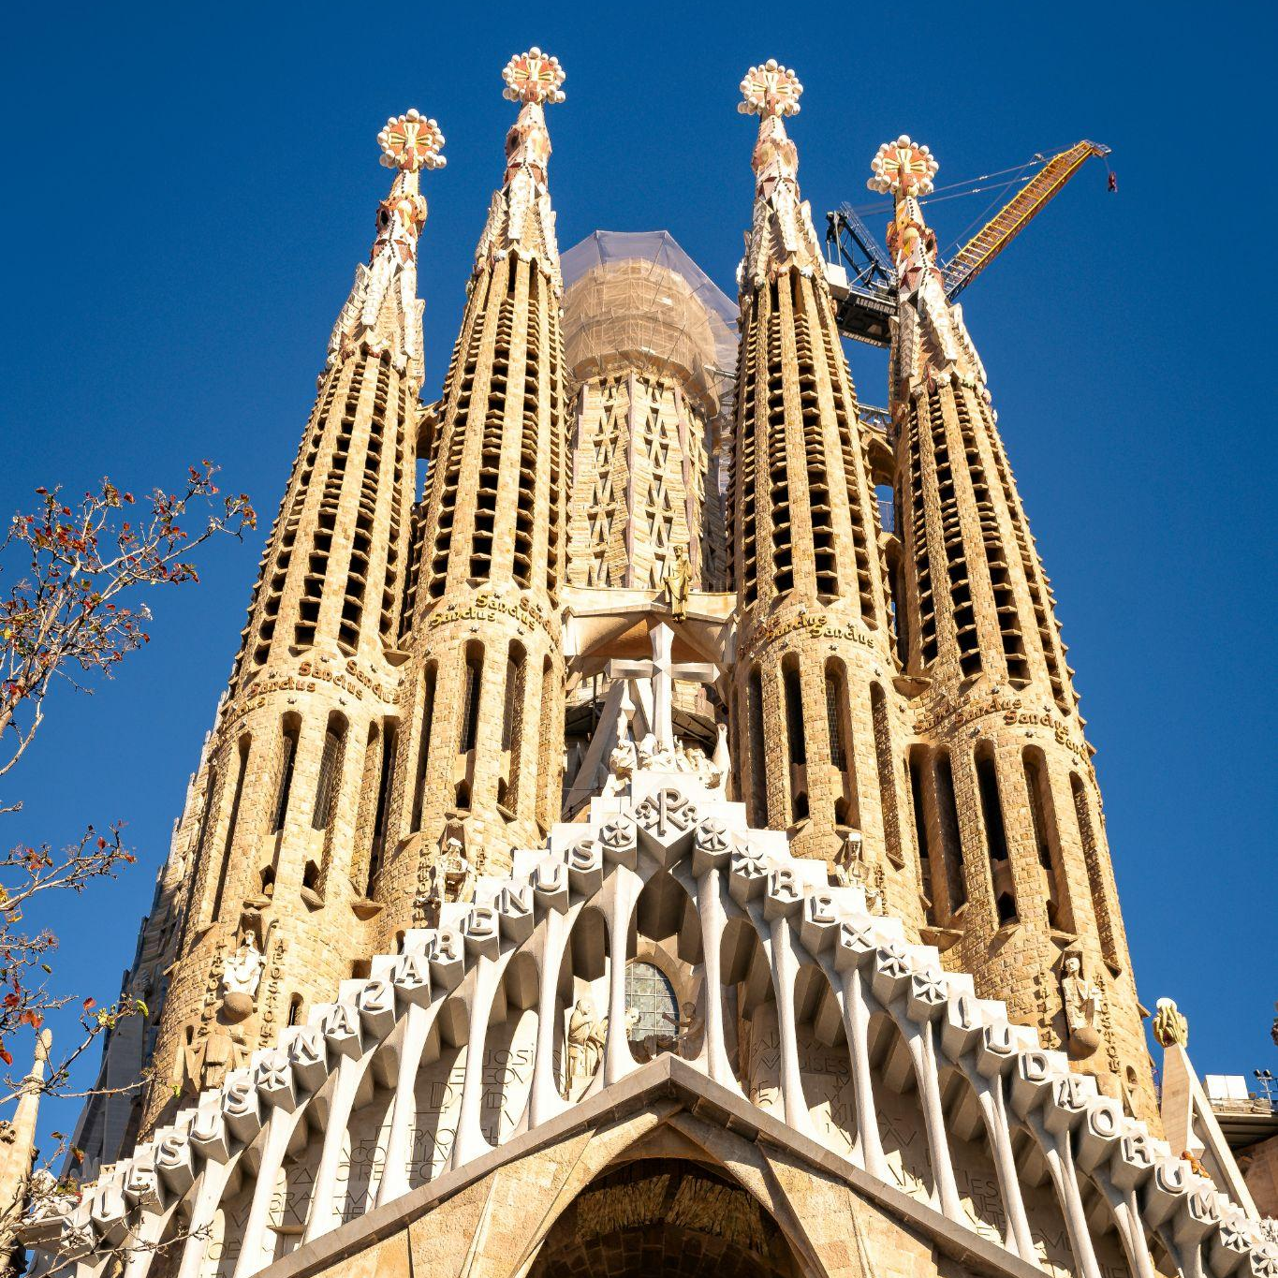
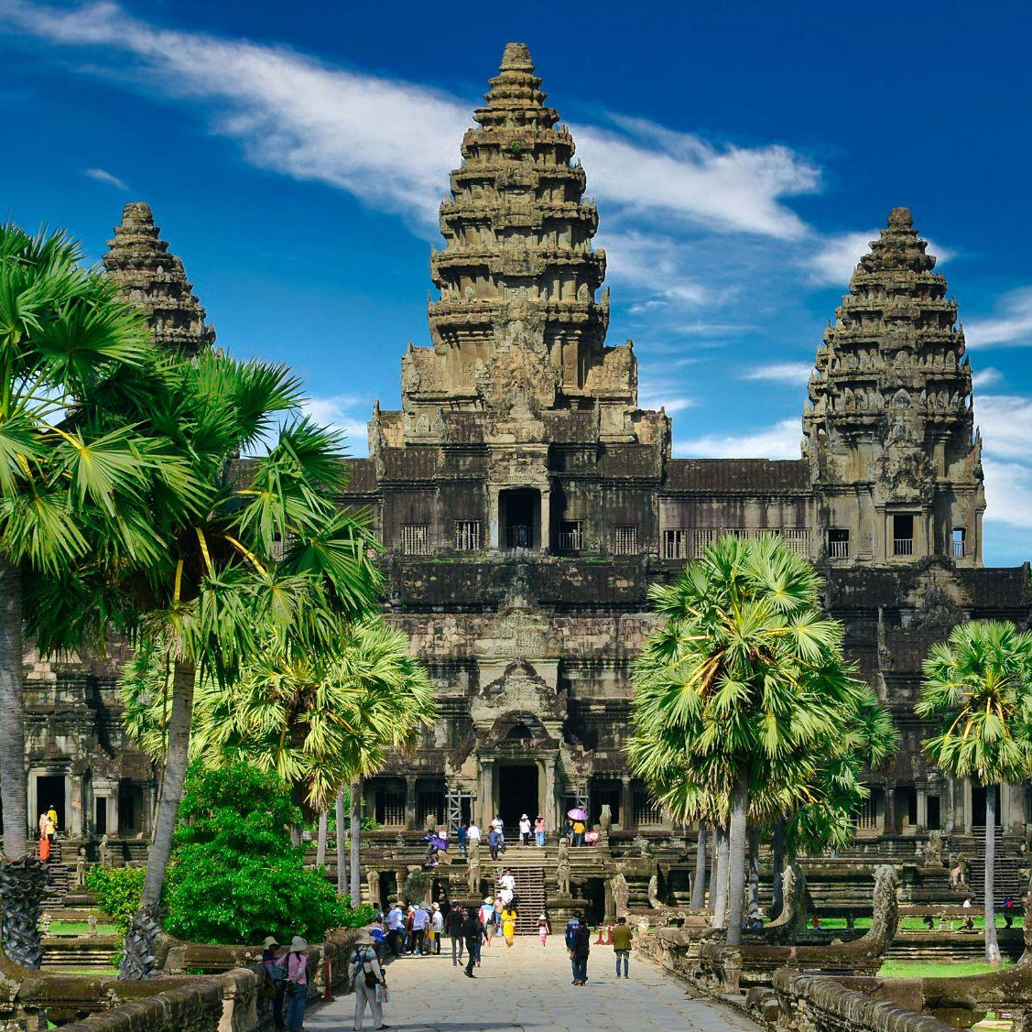
5.
6.
7.
8.
Photos: Cam Stockdale, Susan Kuriakose, Sofiia Vytrishko, allPhoto Bangkok/Unsplash

Slide 10





In this visual challenge, how many company names do you recognise from their partial black & white logos?
1.
2.
3.
4.

Slide 11




5.
6.
7.
8.

Slide 12

Fill in the blanks of these common phrases.
1. ‘A far…’
2. ‘To pull out all the…’
3. ‘To wait for the dust to…’
4. ‘To keep something at…’

Slide 13
5. ‘The exception that proves the...’
6. ‘To throw down the…’
7. ‘To take the wind out of someone’s...’
8. ‘To buy a pig in a...’

Slide 14
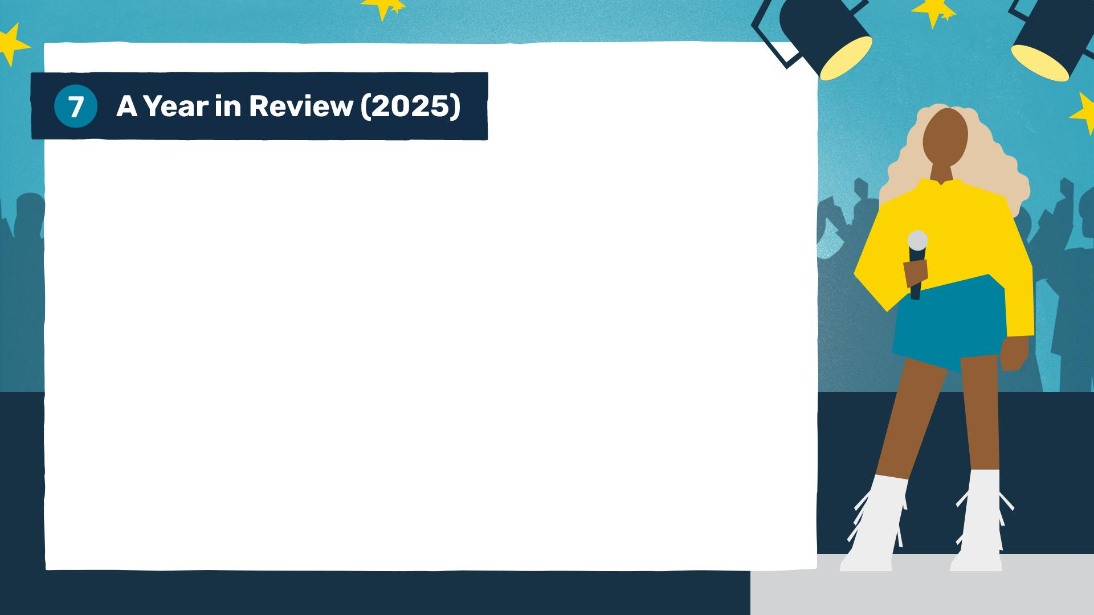
1. Which Swiss city hosted the 2025 Eurovision Song Contest?
2. Which South Asian country officially overtook Japan to become the world's third-largest economy?
3. Which European world leader celebrated their 77th birthday in 2025?
4. Which team won Super Bowl LIX in February 2025, the Philadelphia…?

Slide 15
5. In 2025, the Royal Mint released a special coin themed around which famous board game?
6. Which tech company launched their first 'fully autonomous' consumer car last year?
7. Which Scandinavian country became the first in the world to officially have more electric vehicles on the road than petrol cars in 2025?
8. Which female singer finally won her first-ever Album of the Year award at the 2025 Grammys for Cowboy Carter?

Slide 16
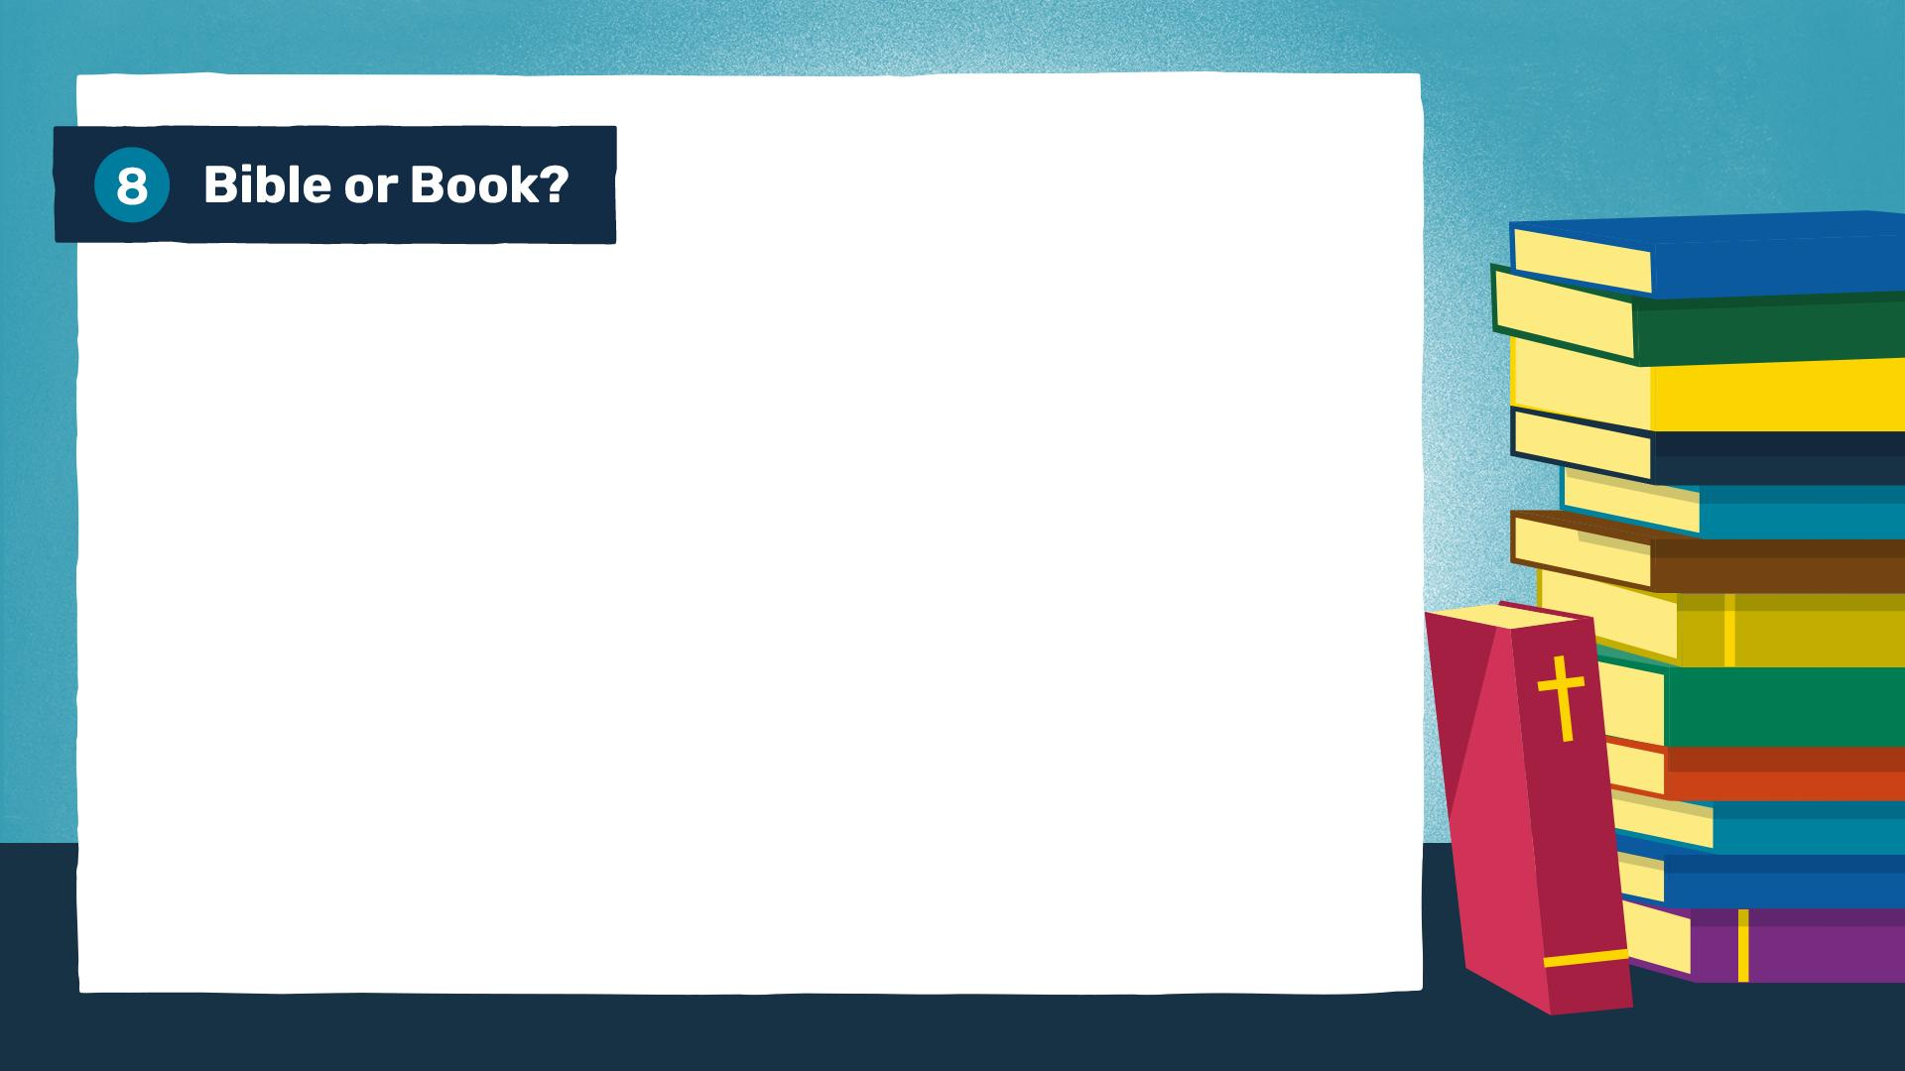
This round tests your knowledge of well known phrases.
Can you identify whether they are from the Bible or another book – and which one?
1. ‘God helps those who help themselves.’
2. ‘There is nothing new under the sun.’
3. ‘The greatest of these is love.’
4. ‘All we have to decide is what to do with the time that is given us.’

Slide 17
5. ‘Cleanliness is next to godliness.’
6. ‘Can a leopard change his spots?’
7. ‘To thine own self be true.’
8. ‘Pride goes before destruction.’

Slide 18
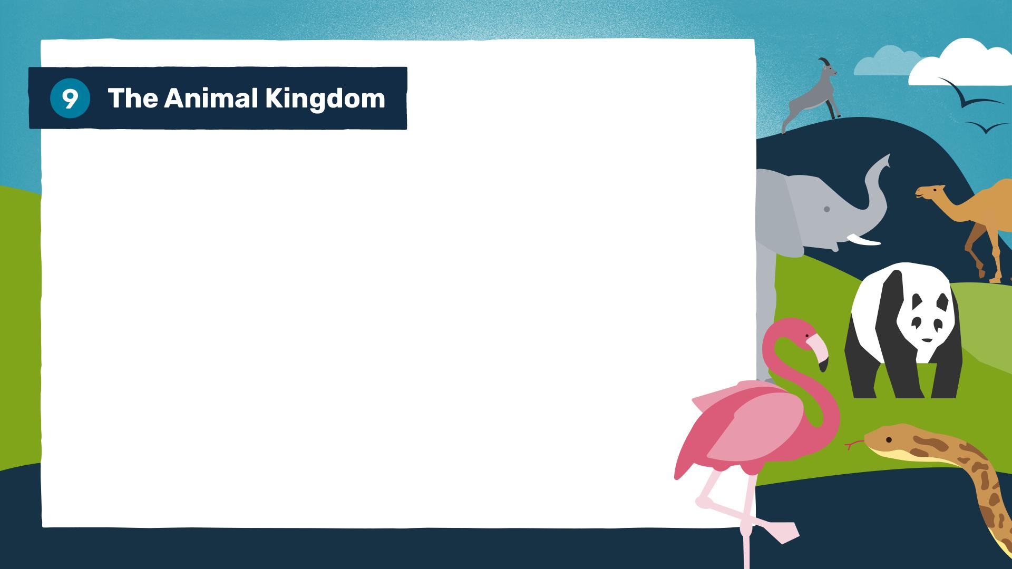
1. What is the only mammal capable of sustained true flight?
2. How many separate hearts does an octopus have?
3. Which tiny bird is the only one that can fly backwards?
4. What is the largest species of shark currently living in our oceans?

Slide 19
5. What is the species of fish, named after a land mammal, where the male, rather than the female, carries the eggs and gives birth to the young?
6. What name is given to a group of owls?
7. Which land animal has the longest pregnancy, lasting about 22 months?
8. Which flightless African bird has eyes that are larger than its brain?

Slide 20
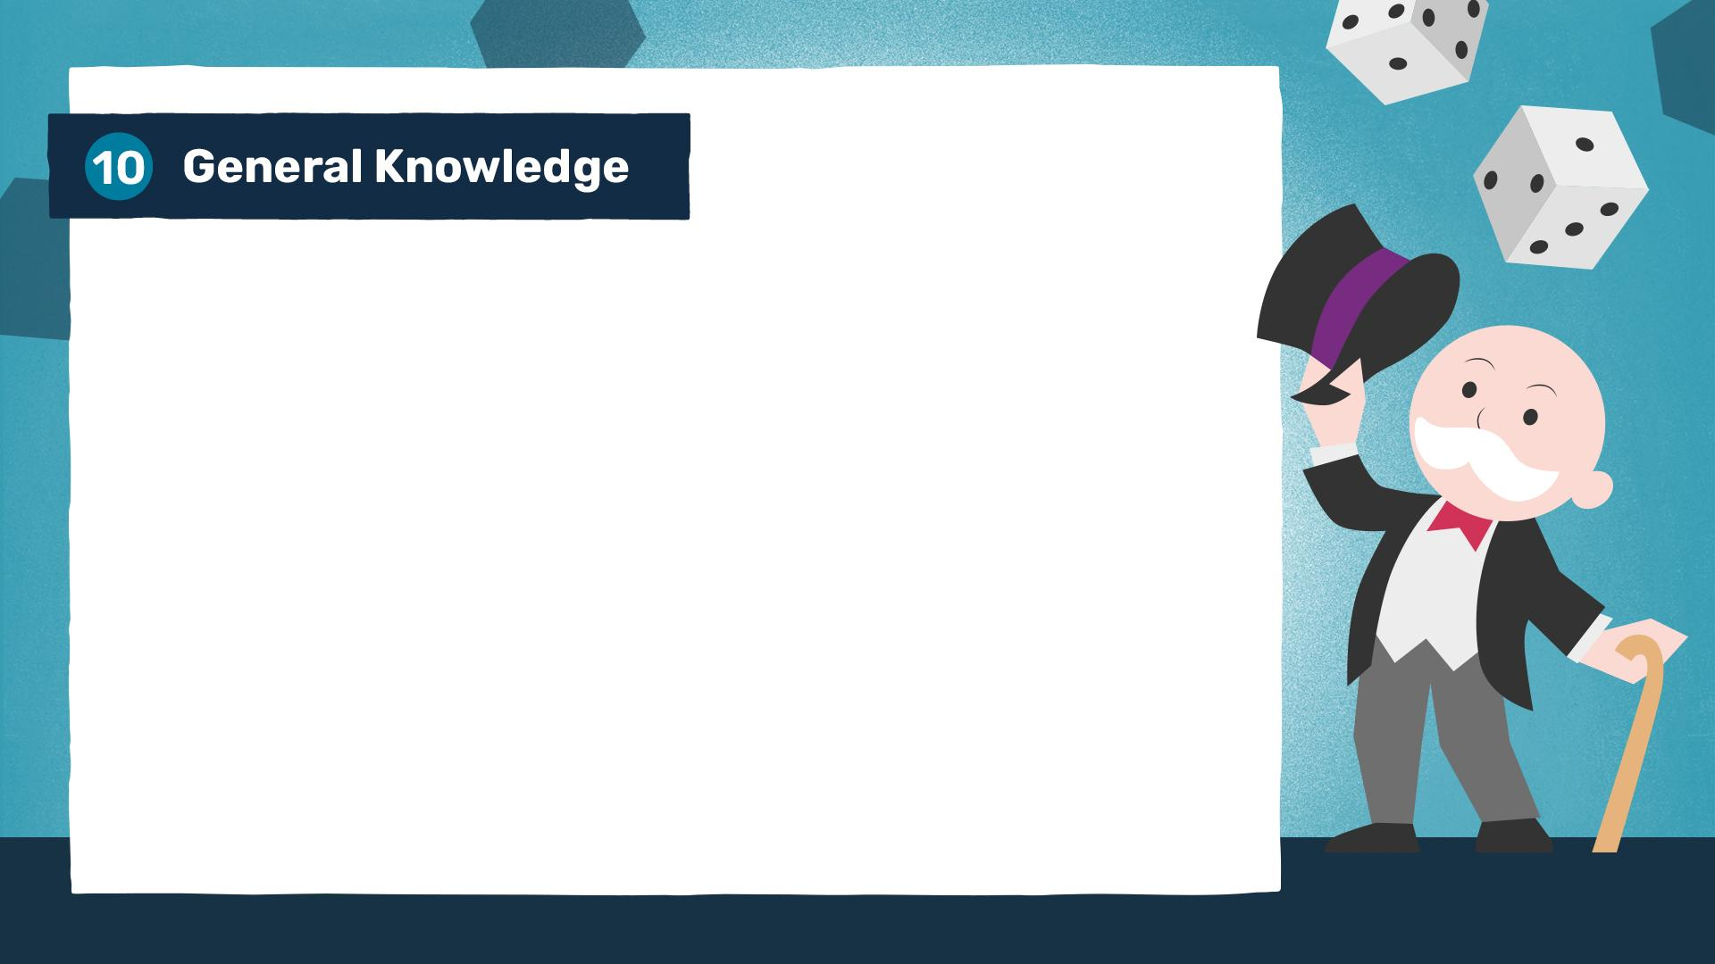
1. How many colours are in a standard rainbow, devised by Isaac Newton?
2. In which year did the Berlin Wall fall, marking a pivotal moment in the end of the Cold War?
3. Which major greenhouse gas do plants absorb from the atmosphere for photosynthesis?
4. What is the smallest country in the world by land area?

Slide 21
5. Which metal is the only one that is liquid at room temperature?
6. What is the only state in the USA that consists entirely of islands?
7. In the classic board game Monopoly, what is the only property on the board where a player can land on but cannot actually stay?
8. Which is the only organ in the human body that can naturally regenerate itself, even if up to 75 per cent of it is removed?

Slide 22
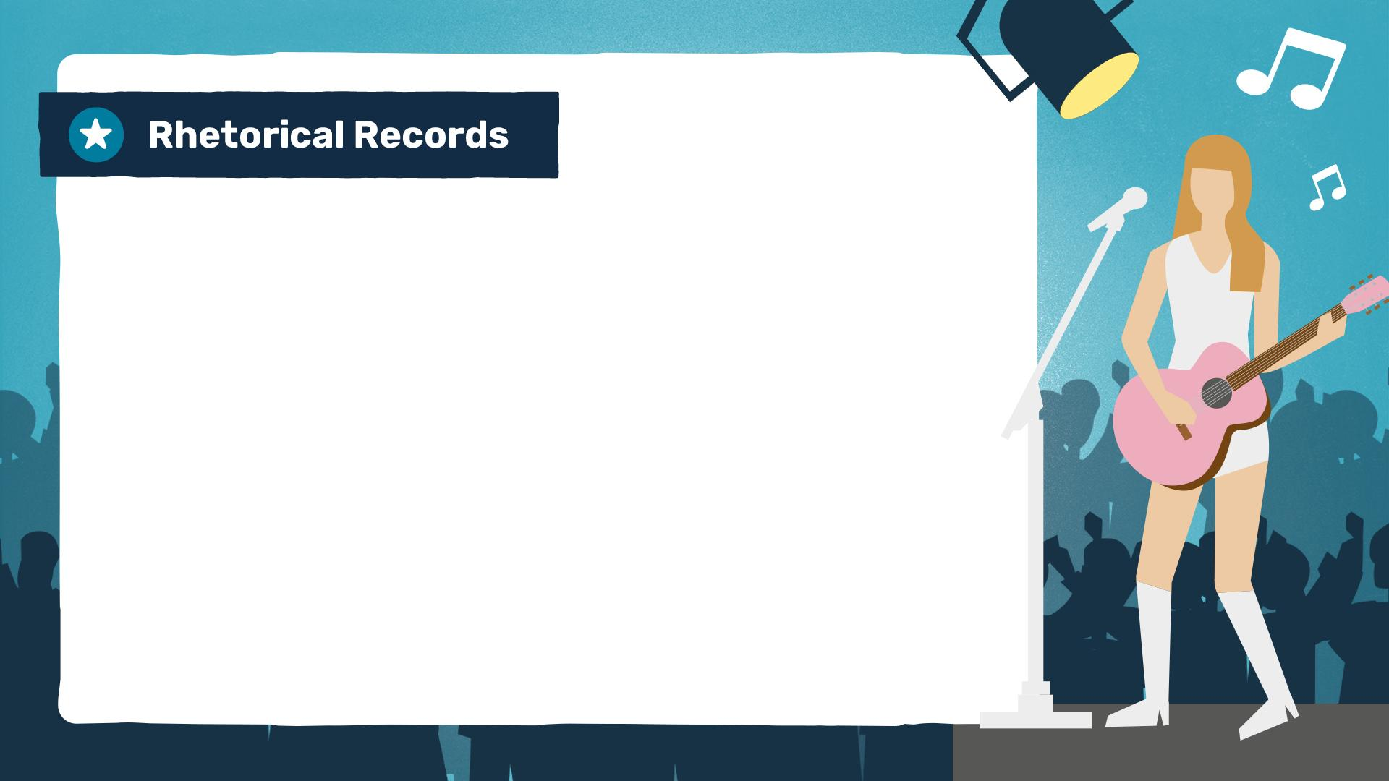
Extra round (optional)
Can you name the artist based on these lyrical questions.
1. ‘What is love? (Oh, baby, don't hurt me)’
2. ‘Are friends electric?’
3. ‘How soon is now?’
4. ‘Did you write the book of love, and do you have faith in God above?’

Slide 23
5. ‘Do you ever feel like a plastic bag, drifting through the wind, wanting to start again?’
6. ‘Isn't it ironic... Don't you think?’
7. ‘Who’s afraid of little old me?’
8. ‘Does it ever drive you crazy just how fast the night changes?’

Slide 24

These slides are for your own bonus round. There are some fun ideas in your Quizmaster Pack to get you started. (Delete this note before using this slide.)
1. Add question here…
2. Add question here…
3. Add question here…

Slide 25
4. Add question here…
5. Add question here…
6. Add question here…

Slide 26
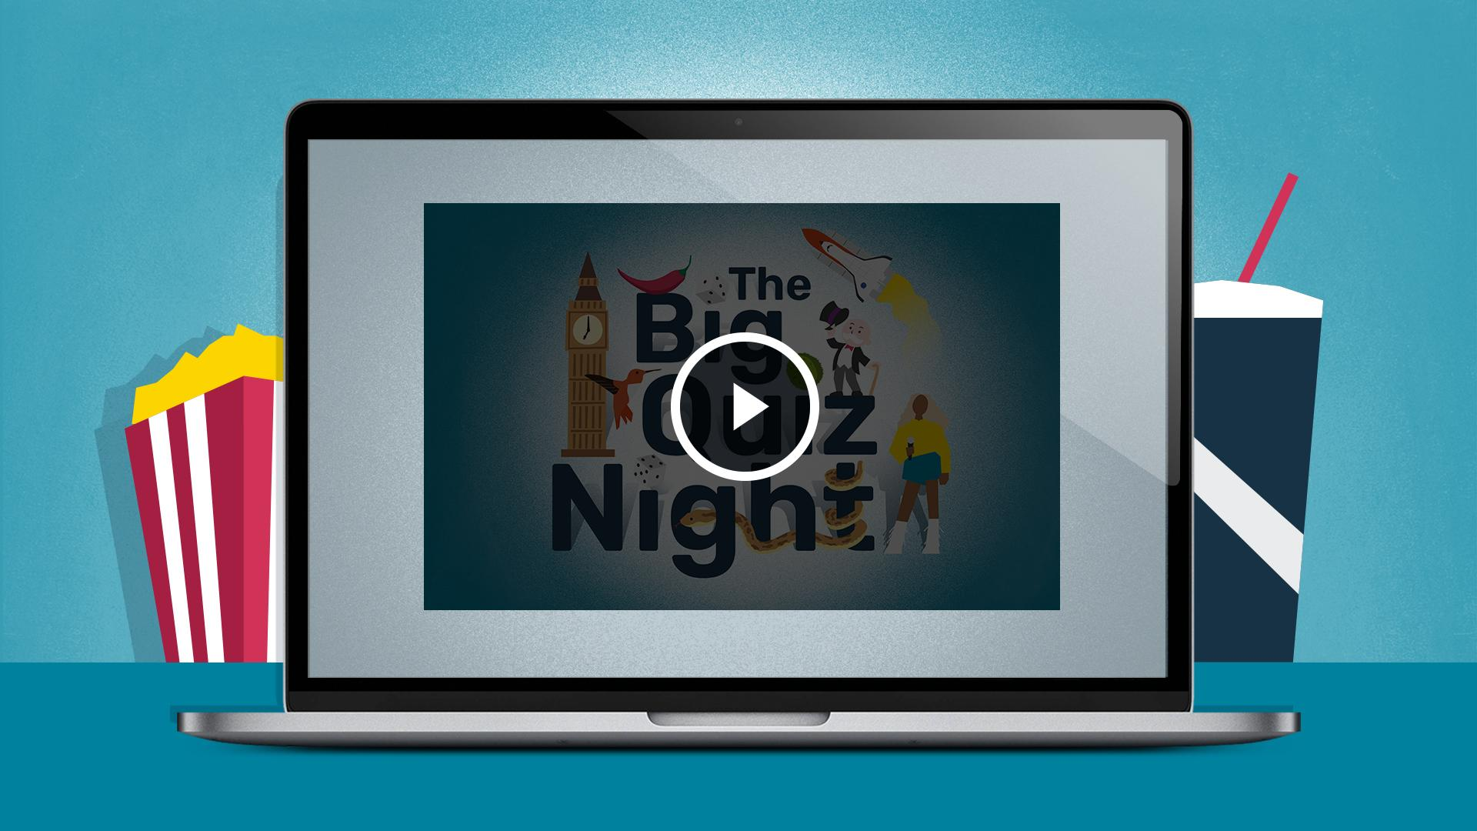

Slide 27
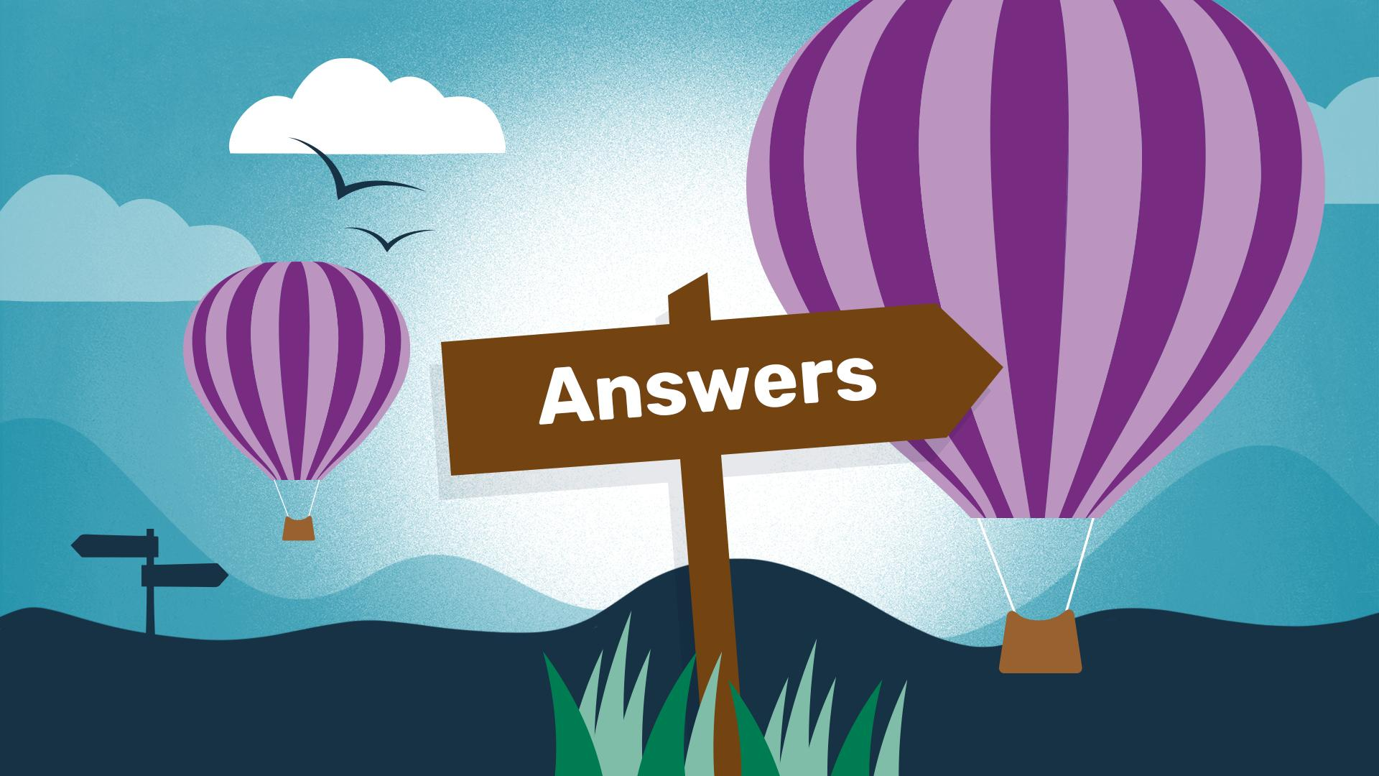

Slide 28
IMPORTANT NOTE: Please do not delete anything from these answer slides. Questions and answers both appear on the slide, but when viewed as a slideshow they are animated to appear with each click. (Delete this note before using this slide.)
1. The 2019 Oscar-winning film Parasite is set in which East Asian capital city?
Seoul
2. The film Zootropolis has a different name in the UK than the US, what is its American title?
Zootopia
3. The Jurassic Park film franchise is primarily set on the small fictional island, Isla Nublar, supposedly off the coast of which Central American country?
Costa Rica

Slide 29
4. In which Pennsylvanian US city would you find the 'Rocky Steps,' made famous by the film Rocky?
Philadelphia
5. Which Greek island in the Aegean Sea served as the primary filming location for the 2008 musical film Mamma Mia!?
Skopelos
6. In The Lord of the Rings, what is the name of the pastoral, green ancestral home of the Hobbits?
The Shire

Slide 30
7. In the Sherlock Holmes stories, at which famous central London address does the detective reside?
221B Baker Street
Sahara
8. Which real-world desert stretching across North Africa was used to film the desert planet 'Tatooine' in the first Star Wars film?

Slide 31
1. Which of these is not a noble gas?
A: Helium B: Neon C: Nitrogen D: Argon
C: Nitrogen
2. Which of these social media platforms
was not founded in the 2000s?
A: Facebook B: Twitter
C: Instagram D: TikTok
D: TikTok
3. Which of these is not a bone found in
the human ear?
A: Stirrup B: Anvil C: Hammer D: Tibia
D: Tibia

Slide 32
4. Which of these was not a NASA
space shuttle?
A: Discovery B: Apollo
C: Challenger D: Endeavour
B: Apollo
5. Which of these programming languages
is not named after a person or a gem?
A: Ruby B: Perl C: Python D: Pascal
C: Python
6. Which of these is not a mammal?
A: Whale B: Platypus
C: White Shark D: Bat
C: Great White Shark

Slide 33
7. Which of these is not a web browser?
A: Chrome B: Firefox C: Linux D: Safari
C: Linux
8. Which of these is not a type of cloud?
A: Cirrus B: Cumulus C: Stratus D: Ignis
D: Ignis

Slide 34
1. Other than eggs, what is the main, starchy ingredient in a traditional Spanish omelette?
Potatoes
2. Which drink is made from the leaves of the Camellia sinensis plant, often grown in Asia?
Tea
3. Which fruit, known as the King of Fruits in Southeast Asia, is famous for its extremely strong smell?
Durian
4. What is the single-celled organism leavening agent used to make bread rise?
Yeast

Slide 35
5. Scoville units are used to measure the strength of which vegetable?
Chilli peppers
6. Which spice, often used in baking, comes from the dried inner bark of a tree?
Cinnamon
7. If you are 'julienning' a vegetable, what shape are you cutting it into, named after a common small household object?
Matchsticks
8. What is the world’s most expensive spice by weight?
Saffron

Slide 36
1.
2.
3.
4.
Taj Mahal
Big Ben
Golden Gate Bridge
Statue of Liberty
Photos: Jovyn Chamb, Enrico Bet, Maarten van den Heuvel, Tomasz Zielonka/Unsplash

Slide 37
5.
6.
7.
8.
The Giant’s Causeway
Sydney Opera House
Sagrada Família
Angkor Wat
Photos: Cam Stockdale, Susan Kuriakose, Sofiia Vytrishko, allPhoto Bangkok/Unsplash

Slide 38
1.
2.
3.
4.
McDonald’s
Ferrari
Apple
Pan Am

Slide 39
5.
6.
7.
8.
Starbucks
HSBC
Blockbuster Video
Chanel

Slide 40
1. ‘A far…’
Cry
2. ‘To pull out all the…’
Stops
3. ‘To wait for the dust to…’
Settle
4. ‘To keep something at…’
Bay

Slide 41
5. ‘The exception that proves the...’
Rule
6. ‘To throw down the…’
Gauntlet
7. ‘To take the wind out of someone’s...’
Sails
8. ‘To buy a pig in a...’
Poke

Slide 42
1. Which Swiss city hosted the 2025 Eurovision Song Contest?
Basel
2. Which South Asian country officially overtook Japan to become the world's third-largest economy?
India
3. Which European world leader celebrated their 77th birthday in 2025?
King Charles III

Slide 43
4. Which team won Super Bowl LIX in February 2025, the Philadelphia…?
Eagles
5. In 2025, the Royal Mint released a special coin themed around which famous board game?
Monopoly
6. Which tech company launched their first 'fully autonomous' consumer car last year?
Tesla/Waymo

Slide 44
7. Which Scandinavian country became the first in the world to officially have more electric vehicles on the road than petrol cars in 2025?
Norway
8. Which female singer finally won her first-ever Album of the Year award at the 2025 Grammys for Cowboy Carter?
Beyoncé

Slide 45
Book – Attributed to Benjamin Franklin
1. ‘God helps those who help themselves.’
Bible – Ecclesiastes 1:9
2. ‘There is nothing new under the sun.’
3. ‘The greatest of these is love.’
Bible – 1 Corinthians 13:13
4. ‘All we have to decide is what to do with the time that is given us.’
Book – J.R.R. Tolkien's
The Fellowship of the Ring

Slide 46
Book – Coined by Christian theologian John Wesley
5. ‘Cleanliness is next to godliness.’
Bible – Jeremiah 13:23
6. ‘Can a leopard change his spots?’
Book – From Shakespeare's play Hamlet
7. ‘To thine own self be true.’
8. ‘Pride goes before destruction.’
Bible – Proverbs 16:18

Slide 47
1. What is the only mammal capable of sustained true flight?
The bat
2. How many separate hearts does an octopus have?
Three
3. Which tiny bird is the only one that can fly backwards?
Hummingbird
4. What is the largest species of shark currently living in our oceans?
Whale Shark

Slide 48
5. What is the species of fish, named after a land mammal, where the male, rather than the female, carries the eggs and gives birth to the young?
The seahorse
A parliament
6. What name is given to a group of owls?
7. Which land animal has the longest pregnancy, lasting about 22 months?
Elephant
8. Which flightless African bird has eyes that are larger than its brain?
The ostrich

Slide 49
1. How many colours are in a standard rainbow, devised by Isaac Newton?
Seven
2. In which year did the Berlin Wall fall, marking a pivotal moment in the end of the Cold War?
1989
3. Which major greenhouse gas do plants absorb from the atmosphere for photosynthesis?
Carbon dioxide
Vatican City
4. What is the smallest country in the world by land area?

Slide 50
5. Which metal is the only one that is liquid at room temperature?
Mercury
6. What is the only state in the USA that consists entirely of islands?
Hawaii
7. In the classic board game Monopoly, what is the only property on the board where a player can land on but cannot actually stay?
Go To Jail
8. Which is the only organ in the human body that can naturally regenerate itself, even if up to 75 per cent of it is removed?
The liver

Slide 51
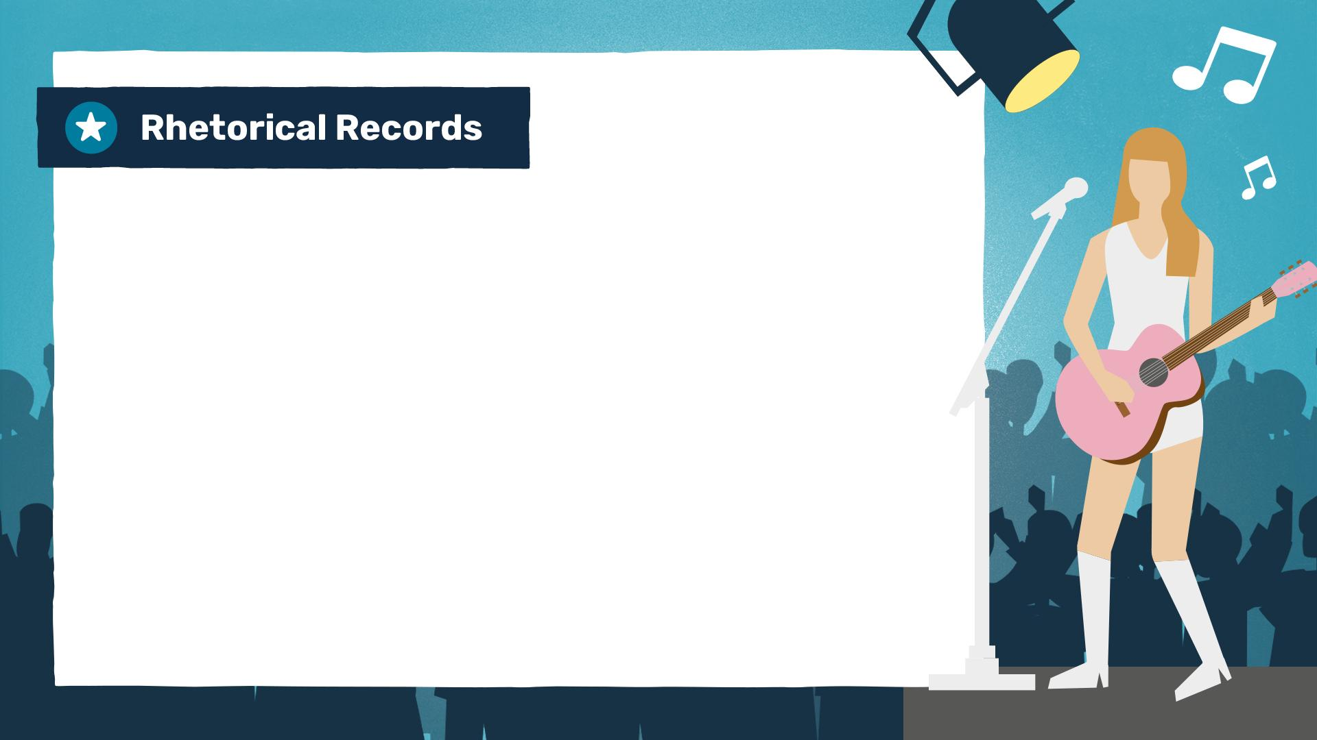
Haddaway
1. ‘What is love? (Oh, baby, don't hurt me)’
Tubeway Army/
Gary Numan
2. ‘Are friends electric?’
3. ‘How soon is now?’
The Smiths
4. ‘Did you write the book of love, and do you have faith in God above?’
Don McLean – American Pie

Slide 52
Katy Perry – Firework
5. ‘Do you ever feel like a plastic bag, drifting through the wind, wanting to start again?’
Alanis Morissette – Ironic
6. ‘Isn't it ironic... Don't you think?’
Taylor Swift
7. ‘Who’s afraid of little old me?’
One Direction – Night Changes
8. ‘Does it ever drive you crazy just how fast the night changes?’

Slide 53
1. Add question here…
Answer
2. Add question here…
Answer
Answer
3. Add question here…

Slide 54
4. Add question here…
Answer
5. Add question here…
Answer
Answer
6. Add question here…

