Slide 1

Notes:
This Christmas, we have the opportunity to support Tearfund’s Christmas Appeal. Through literacy and training programmes, women in the Central African Republic and around the world are learning skills they need to change their lives and the lives of their children.
Our support could help more women gain an education so that they can earn an income, send their children to school, and lift their families out of extreme poverty.

Slide 2

Notes:
£52 could enable a woman to attend a literacy centre, where she can learn to read and write.
£86 could help a mother like Julia learn sewing skills, so she can earn an income and send her children to school.
£140 could train a church member to start a women’s association in their community, so mothers can gain an education.

Slide 3

Notes:
This Christmas, our donations will be DOUBLED by SPAR, EUROSPAR, ViVO and ViVOXTRA until 31 January 2026, and could help even more families across the world gain the skills they need to lift themselves out of extreme poverty.
If you would like more information, please scan the QR code on the screen to be directed to the Tearfund Christmas Appeal webpage.

Slide 4
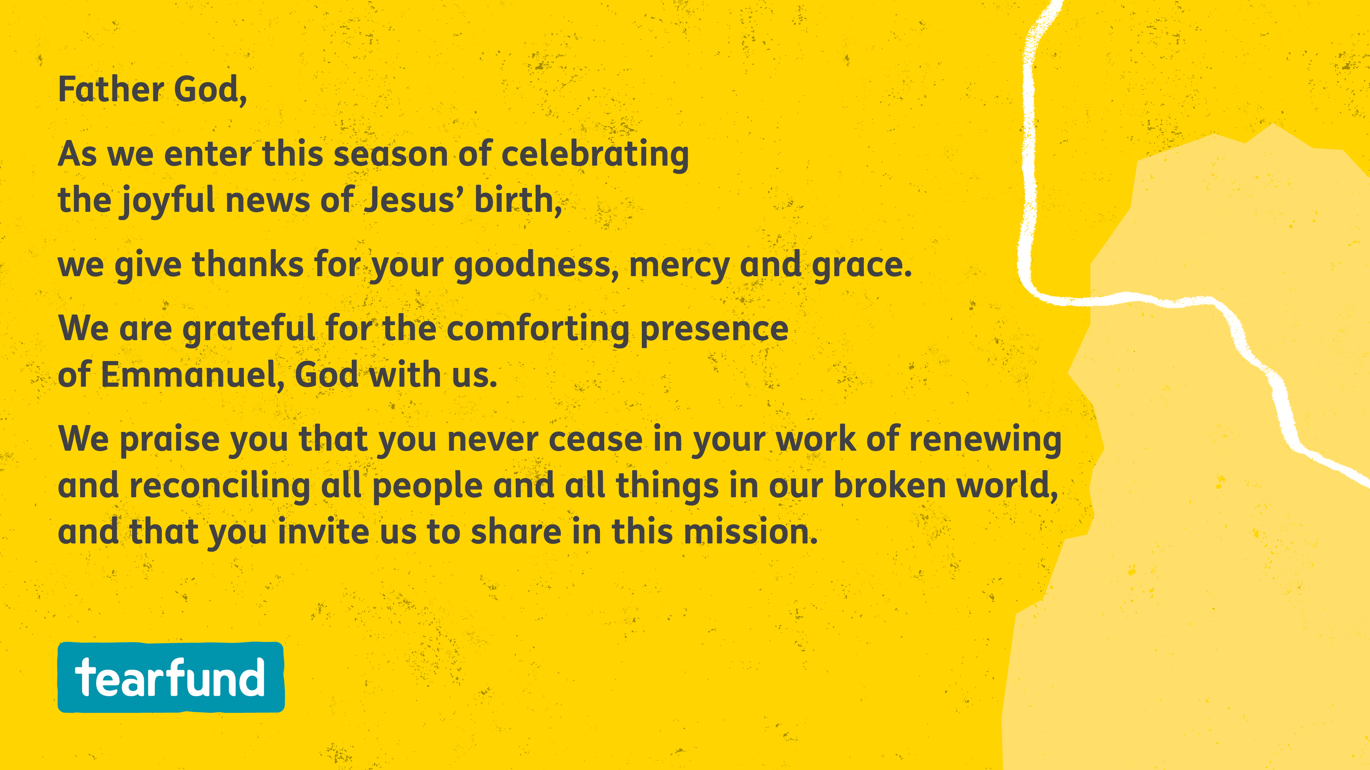
Notes:
Now, let us pray.
Father God,
As we enter this season of celebrating the joyful news of Jesus’ birth,
we give thanks for your goodness, mercy, and grace.
We are grateful for the comforting presence of Emmanuel, God with us.
We praise you that you never cease in your work of renewing and reconciling all people and all things in our broken world,
and that you invite us to share in this mission.

Slide 5
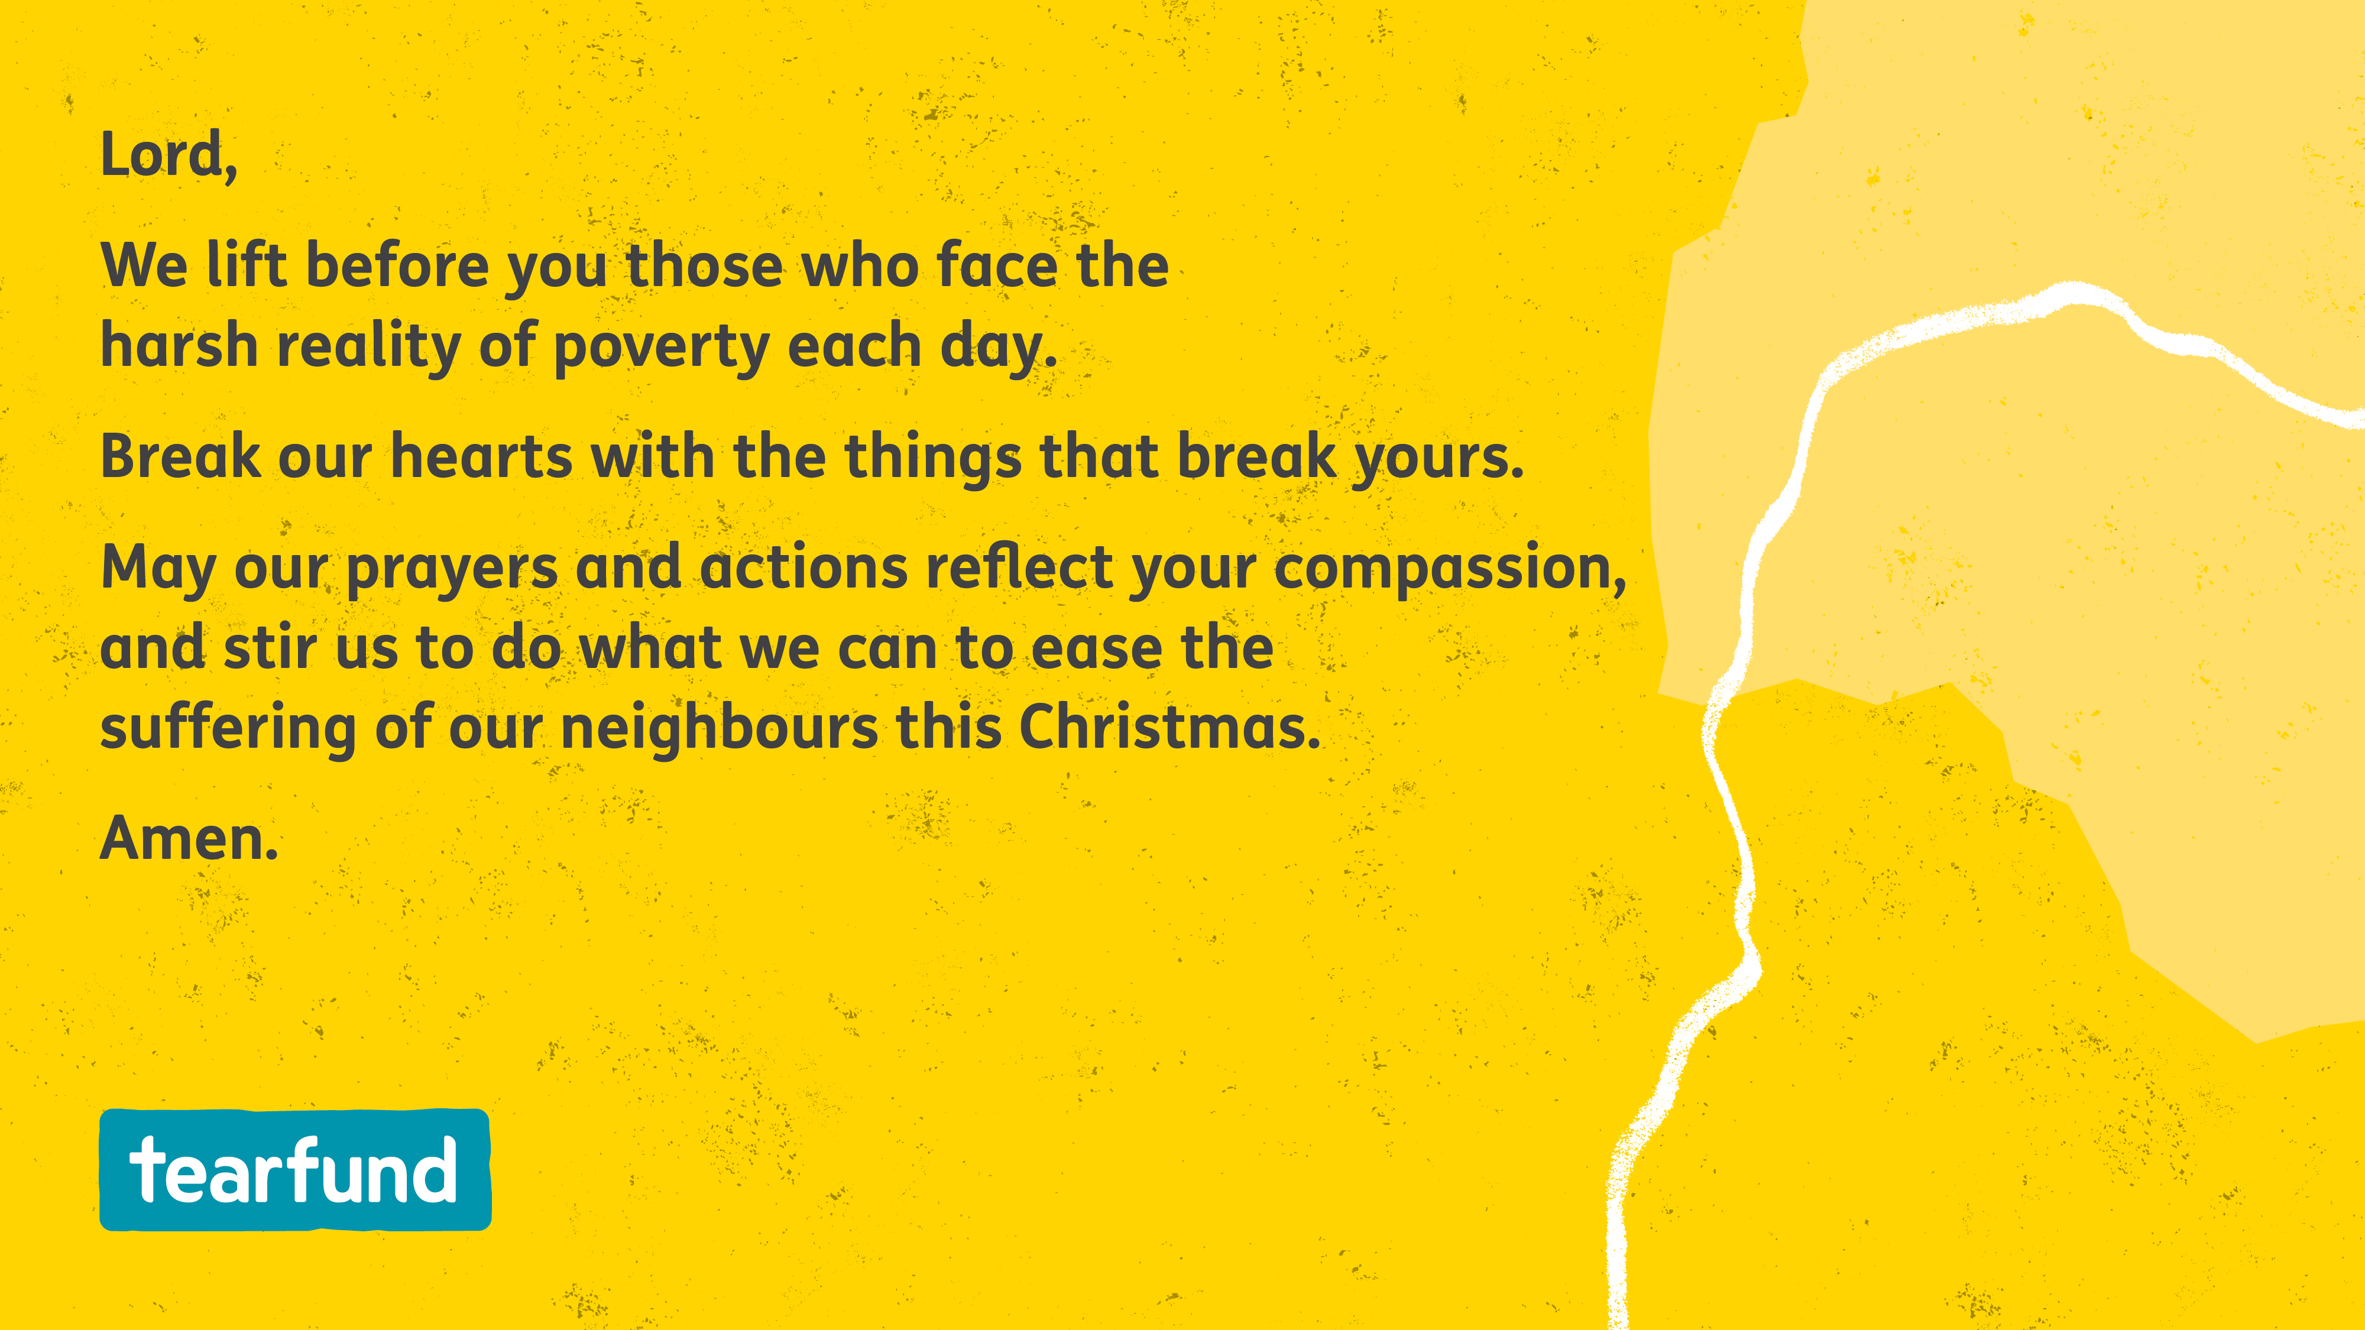
Notes:
Lord,
We lift before you those who face the harsh reality of poverty each day.
Break our hearts with the things that break yours.
May our prayers and actions reflect your compassion,
and stir us to do what we can to ease the suffering
of our neighbours this Christmas.
Amen.

