Slide 1
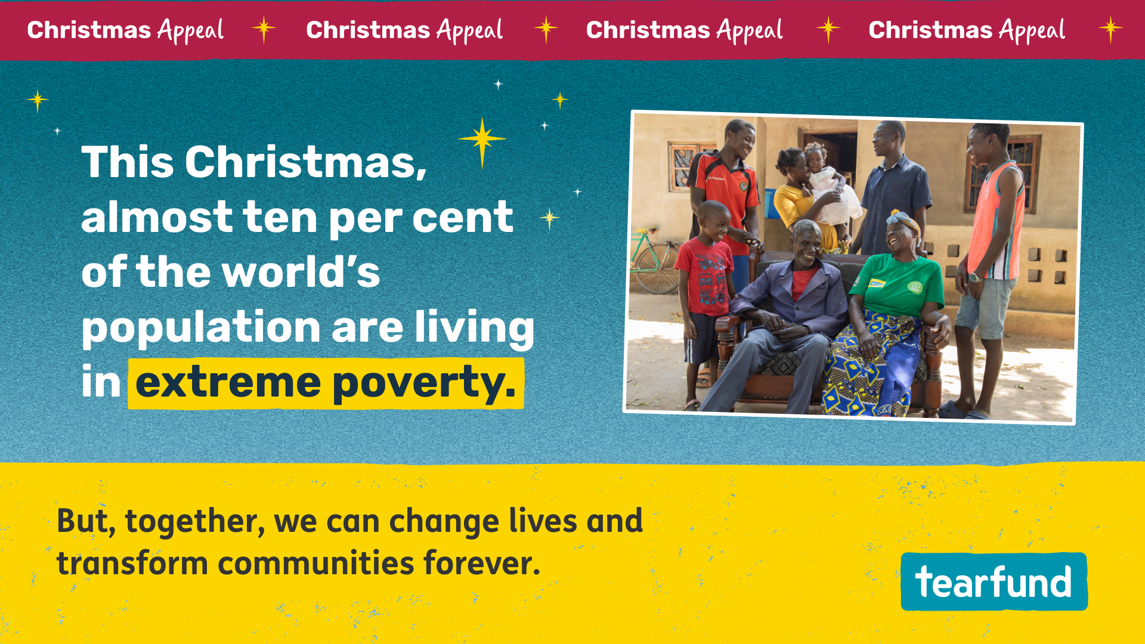
Notes:
Extreme poverty is preventing people from writing their own story. Around the world, more than 700 million people live in extreme poverty. That’s almost ten per cent of the global population.
At Tearfund, we believe the local church has a key role to play in helping people work their way out of poverty.

Slide 2
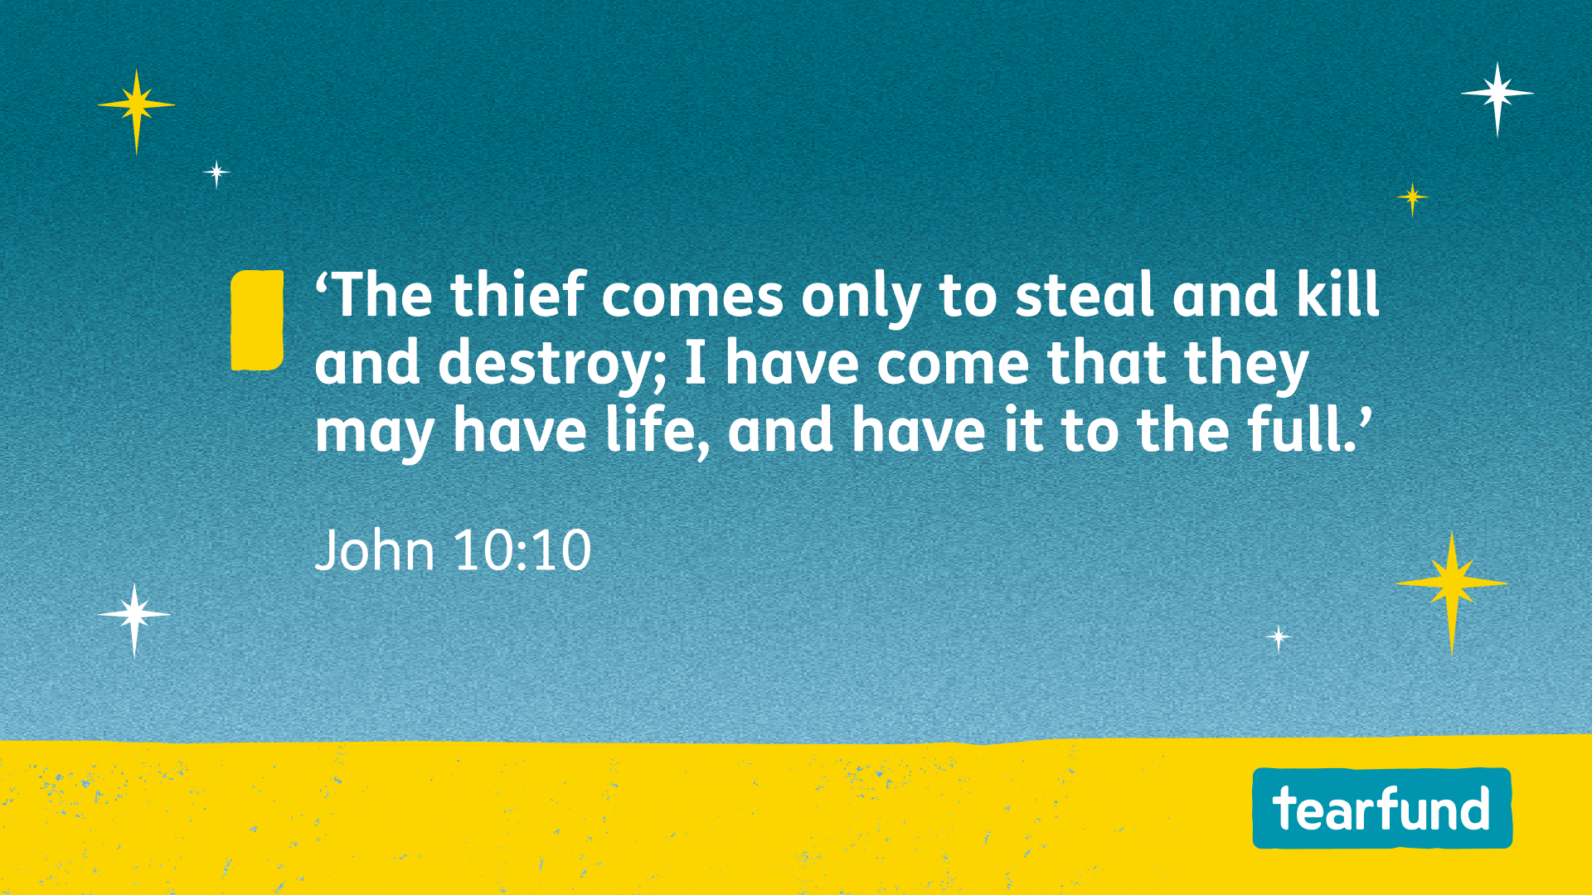
Notes:
Tearfund’s Transforming Communities programme helps churches around the world lead their local communities out of extreme poverty and into a sustainable future. Working with churches and local organisations in more than 40 countries, Tearfund offers communities Bible-based training that helps them identify the God-given resources in and around them.
Transforming Communities is helping people and communities take control of their lives and write their own future. As we faithfully follow Jesus where the need is greatest, we see communities and relationships transformed, and lives lived to the full. This is made possible thanks to the support of churches like yours.

Slide 3
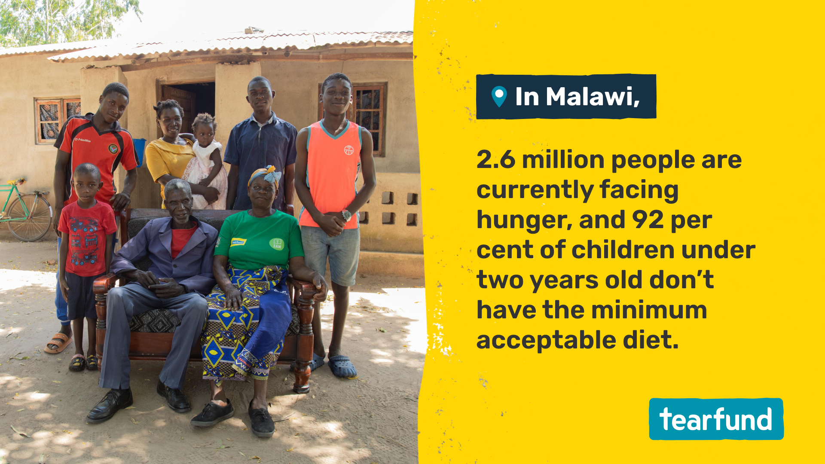
Notes:
Tearfund works in over 1,500 communities in Malawi, delivering Transforming Communities training to teach people efficient and sustainable farming methods so they can harvest enough food for their families. The training introduces people to self-help groups where they can study the Bible, learn financial literacy skills, access business loans and build strong, supportive friendships.

Slide 4
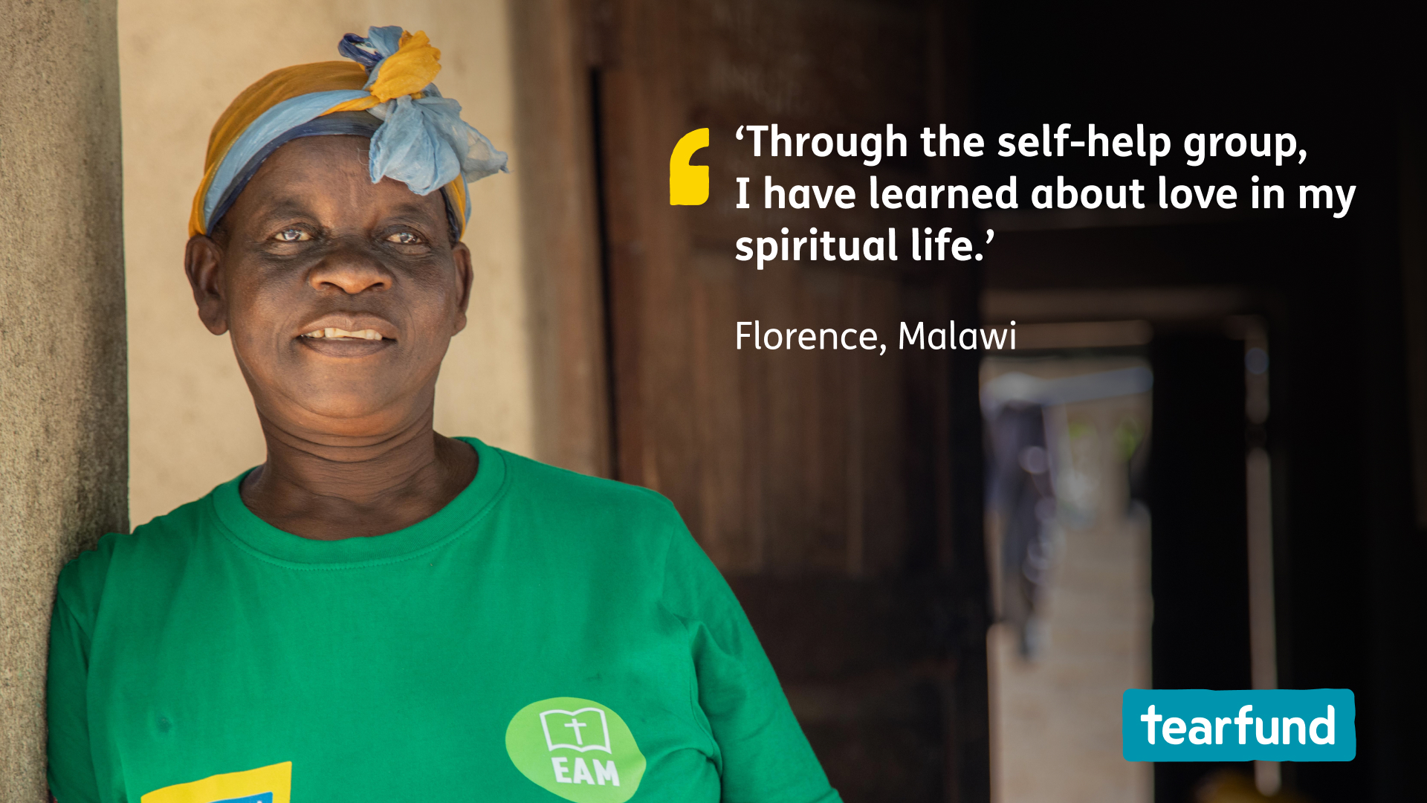
Notes:
In Malawi, Florence joined a Tearfund self-help group through Transforming Communities. She met like-minded people and made new friends who regularly come together to worship and read the Bible.
Thanks to her self-help group, Florence has been saving and taking out small loans to improve her home and invest in her business. Now, she uses conservation farming techniques and has learned how to raise cows and chickens. Florence now has a better income from selling the milk from the cows, and the animal droppings provide fertiliser for her crops.
As well as giving her the support she needed to take control of her own life, the self-help group taught her life skills to help her live independently and reach her God-given potential.

Slide 5
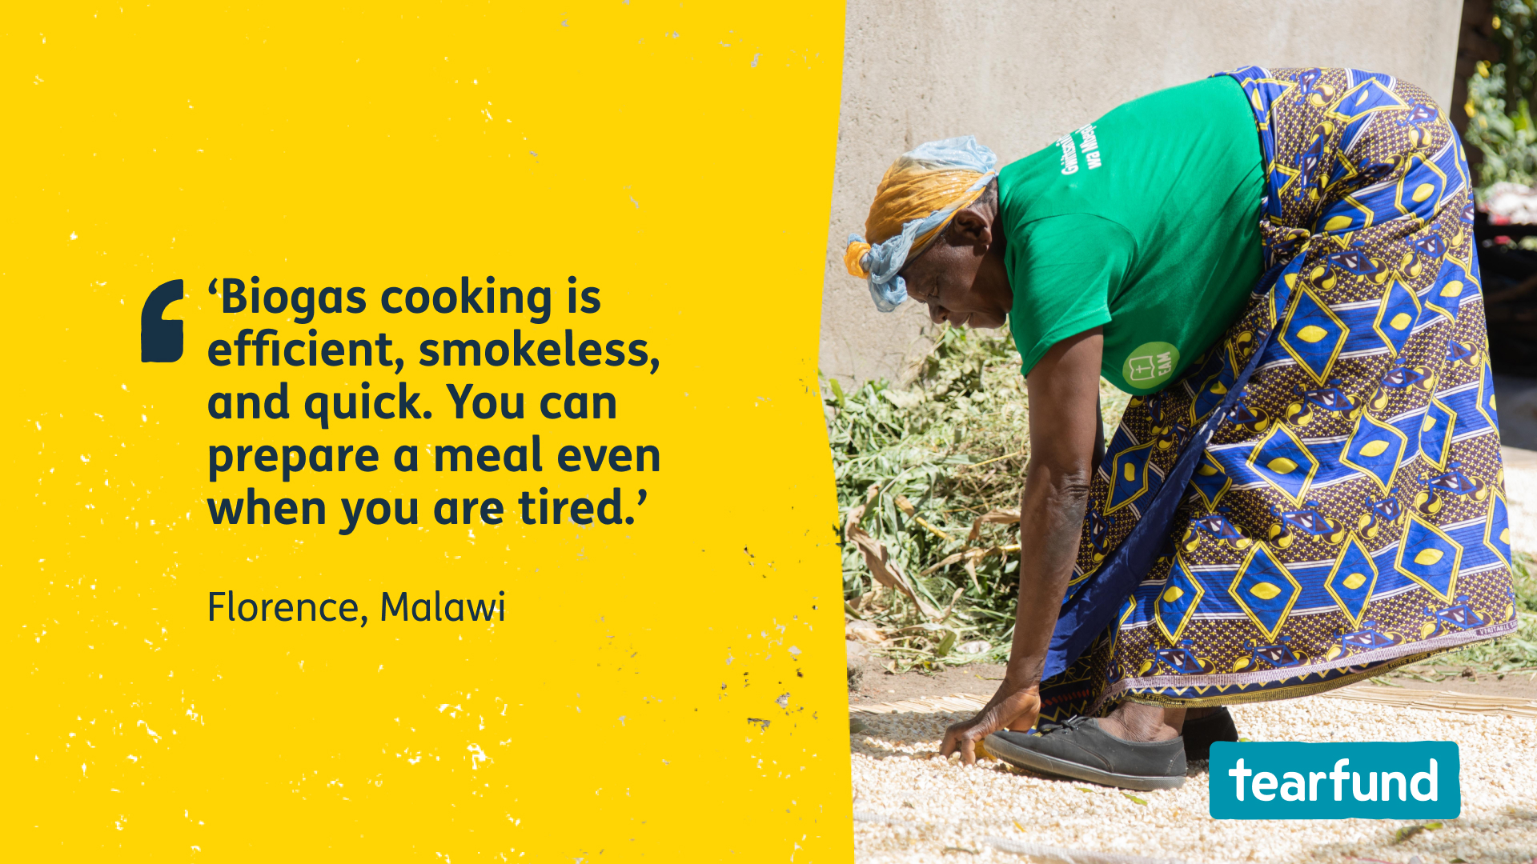
Notes:
And it doesn't stop there – in her newly renovated home, she’s replaced wood burning with renewable biogas (fuelled by the waste from her animals and crops) for cooking. This is healthier and more efficient for her, and a more sustainable fuel for the environment.

Slide 6
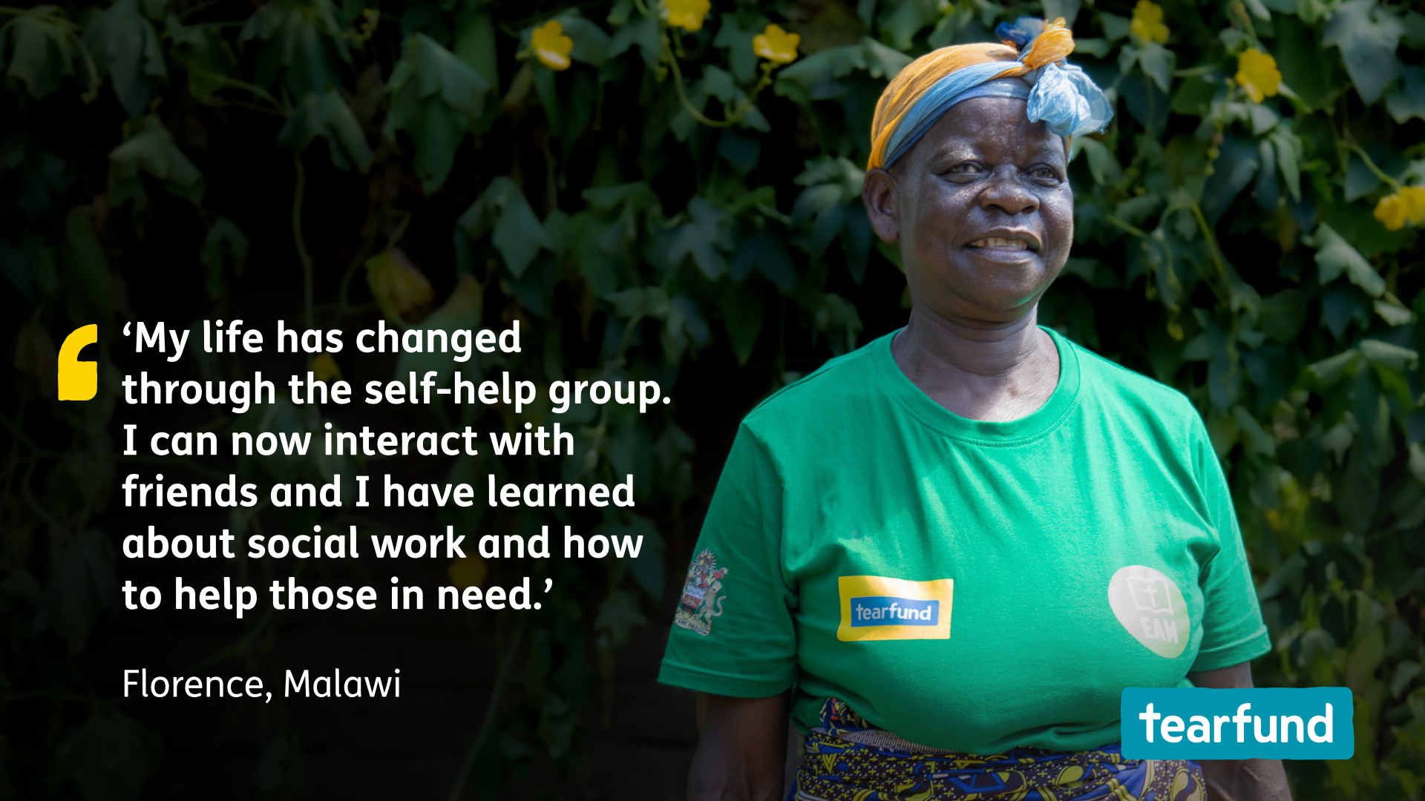
Notes:
Today, Florence is more financially independent and in a better position to serve her family and community.
Florence’s transformation is spreading to those around her as she turns hope into action. She’s living out her faith, serving the vulnerable elderly and others who need support in her community.
Florence has discovered faith, friendship and a way forward out of extreme poverty. Florence is now writing her own future. All of this was made possible because she joined a Tearfund self-help group through the Transforming Communities programme.

Slide 7
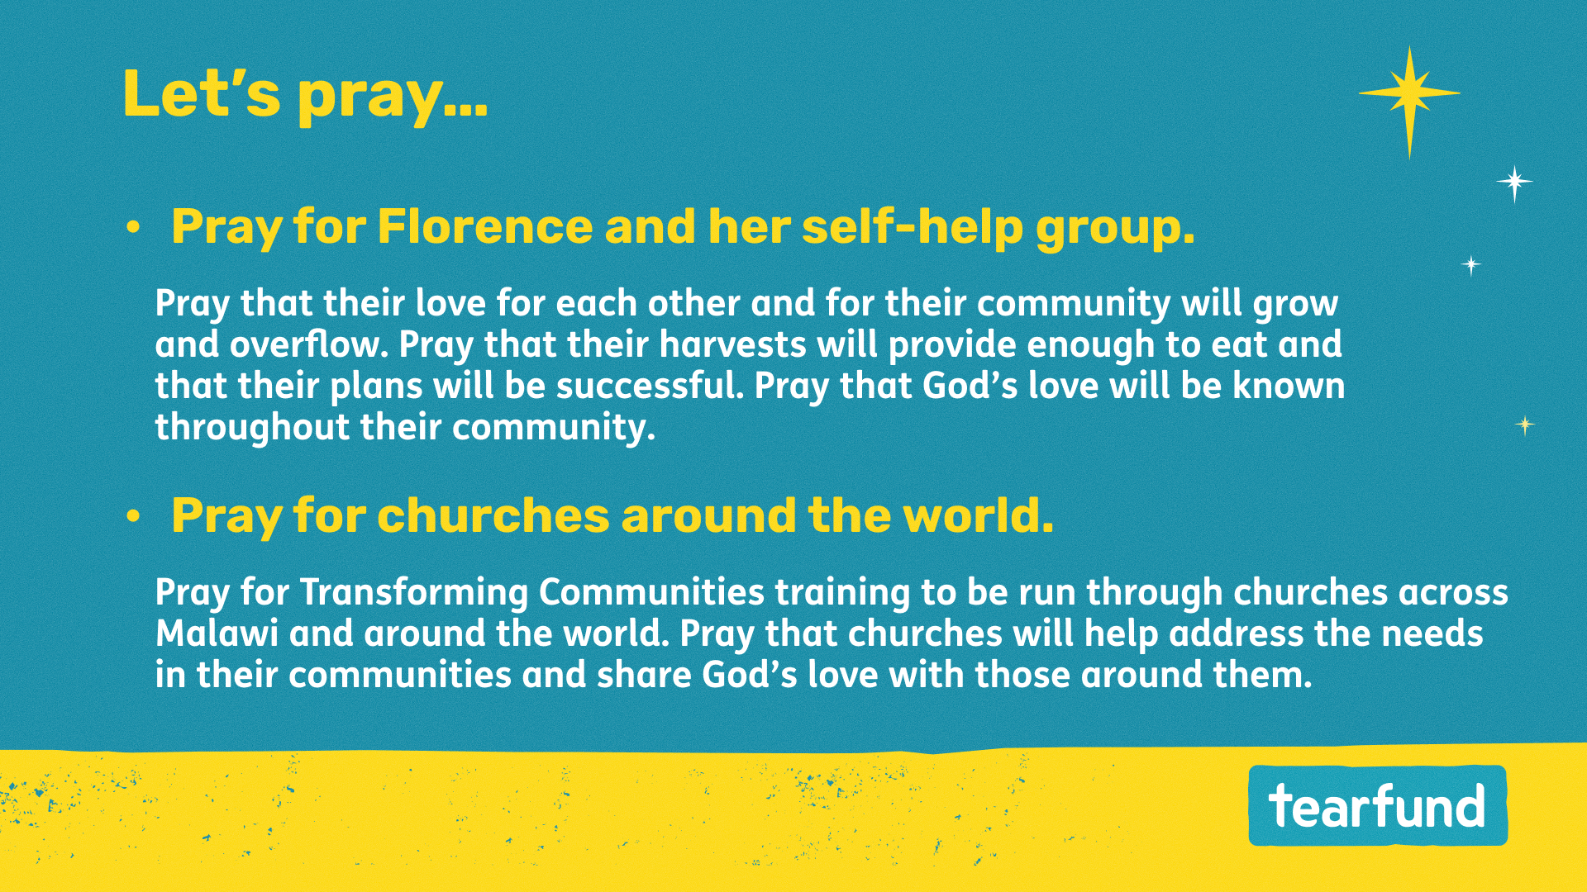
Notes:
For more stories and ideas to inspire your prayers, visit tearfund.org/stories

Slide 8
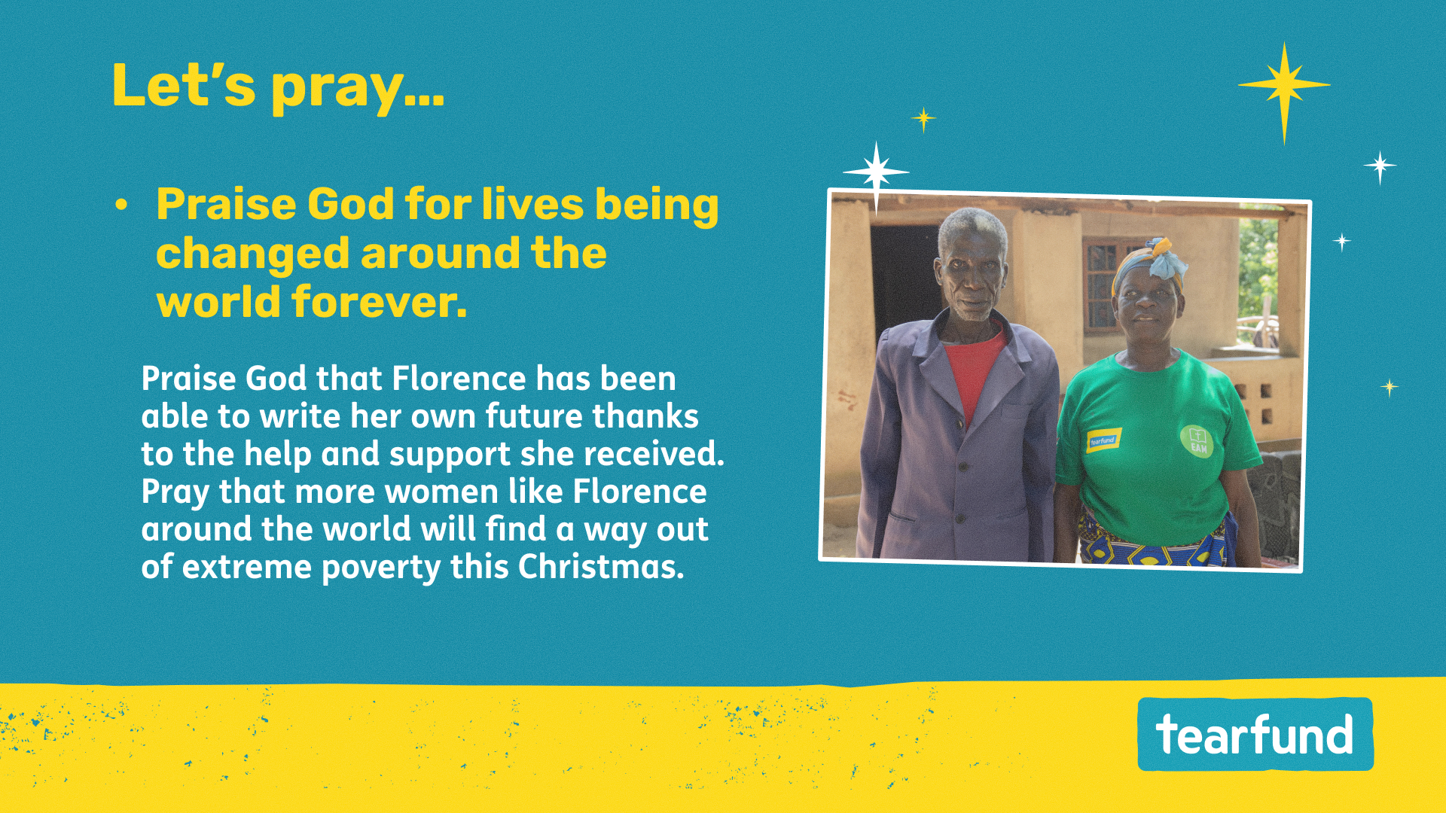
Notes:
For more stories and ideas to inspire your prayers, visit tearfund.org/stories

Slide 9
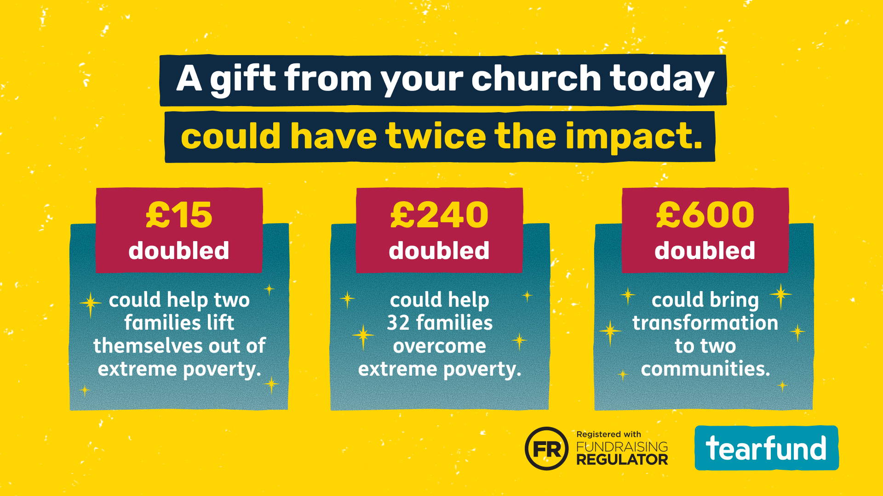

Slide 10
