Slide 2
Notes:
Speaker notes
The power of the church
Around the world, conflict is rife, climate change is forcing millions from their homes, and one in ten people are still living in extreme poverty. This is not God’s plan.
But there is an answer.
Together, we can release the power of the local church.

Slide 3
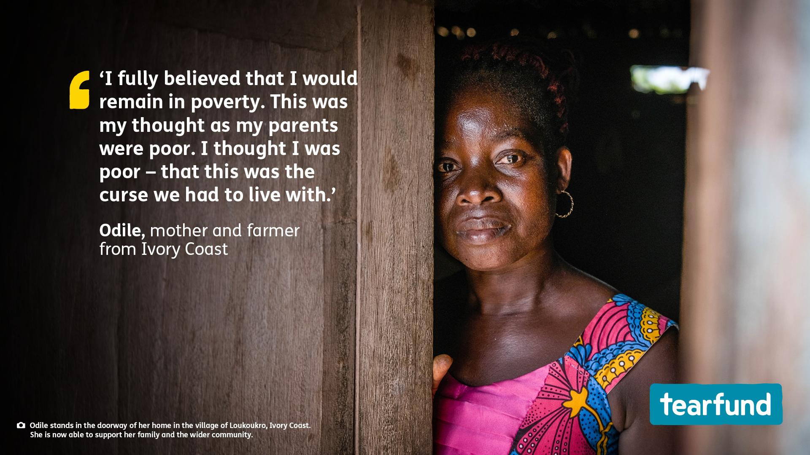

Slide 4
Notes:
Speaker notes
This Christmas, we’re going to be meeting a family from Ivory Coast. But before we start, let’s find out how much you know about Christmas traditions in this West African nation.

Slide 5
Notes:
Speaker notes
Extra detail for question 1: On the Sunday before Christmas the children and young people manage the church service. They will organise a choir, plan sketches, put on a ballet performance, share announcements and appoint someone to preach the gospel.
Extra detail for question 2: During the Christmas season, Jingle Bells is played everywhere in Ivory Coast. You’ll hear the tune playing in shops, in homes and while people are wrapping gifts for their children.
Extra detail for question 3: Pistachio Soup is rarely eaten during the year, but at Christmas it is traditionally prepared and eaten with pounded banana or yam.

Slide 6
Notes:
Speaker notes
A recent independent study into the impact of Tearfund’s training through local churches found that people living in communities that have been through Tearfund's Church and Community Transformation training are:
113% more likely to work on shared projects
51% more likely to have maintained or increased their income in the last year
35% more likely to be hopeful about the future

Slide 7
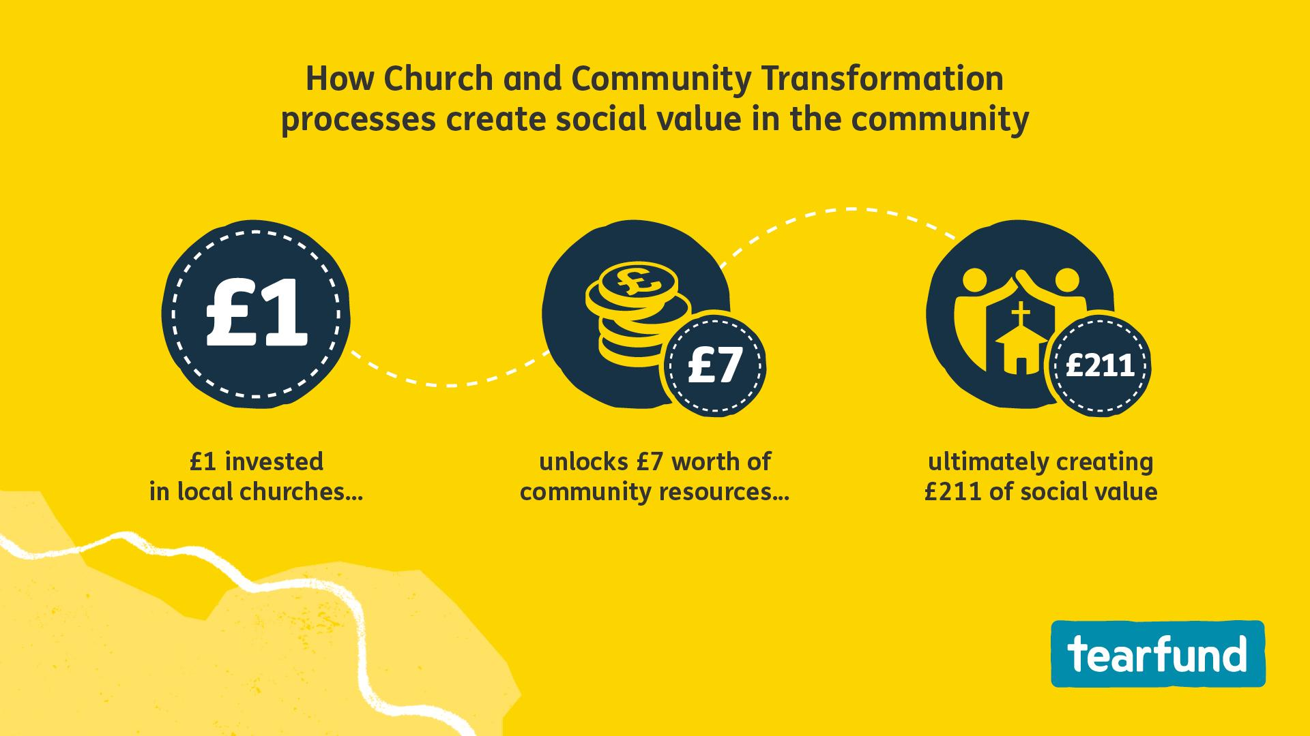
Notes:
Speaker notes
Tearfund’s Church and Community Transformation training, delivered through the local church, helps communities recognise the skills and resources God has given them to overcome poverty from within and build greater resilience – with immediate effect.
A recent independent study into the impact of Tearfund's training through local churches found that every £1 invested by Tearfund in local churches helps the community to unlock a further £7 in time and resources for shared projects, which ultimately creates £211 of social value through improved wellbeing.
(Social value measurement aims to put a monetary value to costs and benefits that do not have a market price. These include improved quality of life, increased trust in neighbours, or an improved natural environment.)

Slide 8
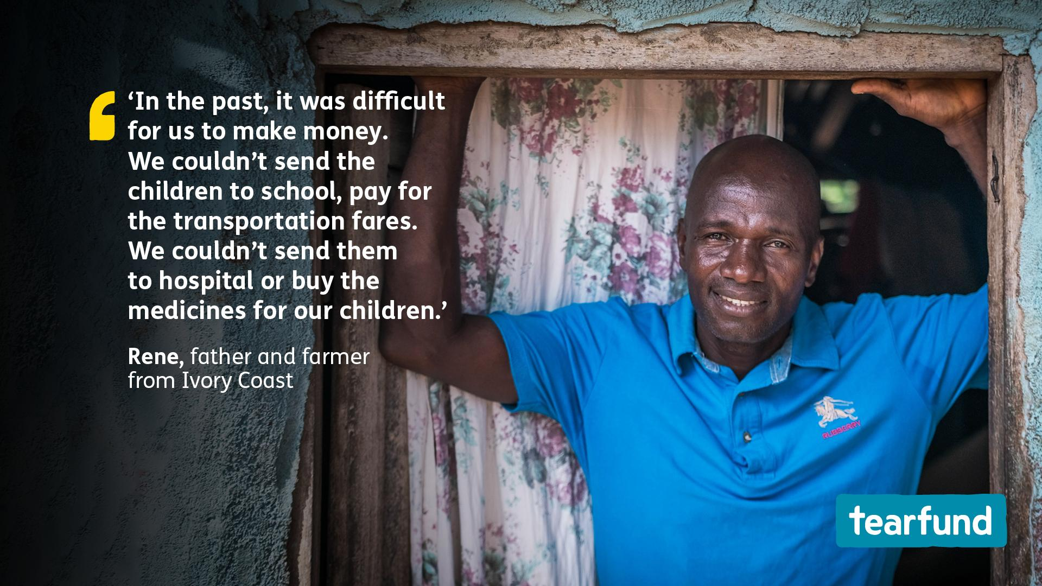
Notes:
Speaker notes
Rene and Odile from Ivory Coast lived in fear and worry. The couple could barely afford to put food on the table – let alone pay for school fees, or for medicine when their children got sick.
But all this changed when Tearfund’s Bible-based training – delivered through the local church – equipped them to realise and unlock their God-given potential.
Today, Rene and Odile have a thriving pineapple business.
When communities are empowered to fulfil their God-given potential, everything changes.

Slide 10
Notes:
Speaker notes
Let us pray that Tearfund’s partners will be able to reach many more communities with Tearfund’s Bible-based training so that they can be equipped to realise and unlock their God-given potential.

Slide 11
Notes:
Speaker notes
Let us pray that Tearfund’s partners will be able to reach many more communities with Tearfund’s Bible-based training so that they can be equipped to realise and unlock their God-given potential.

